Slide 1

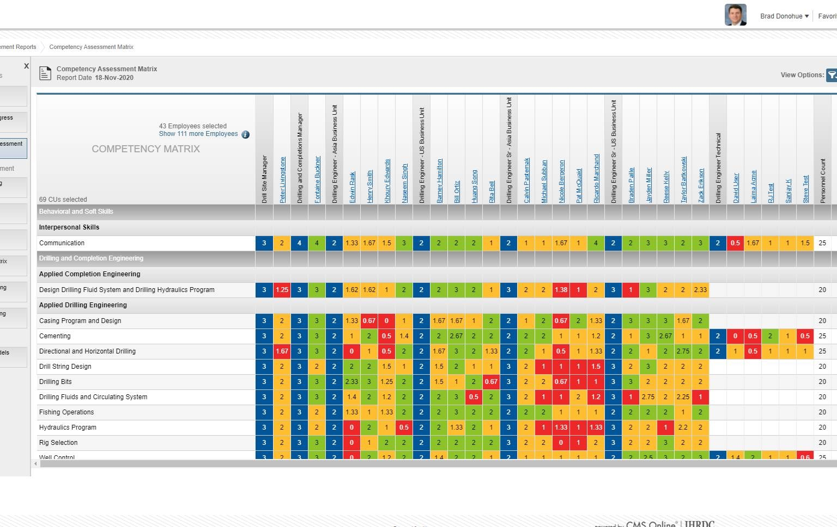

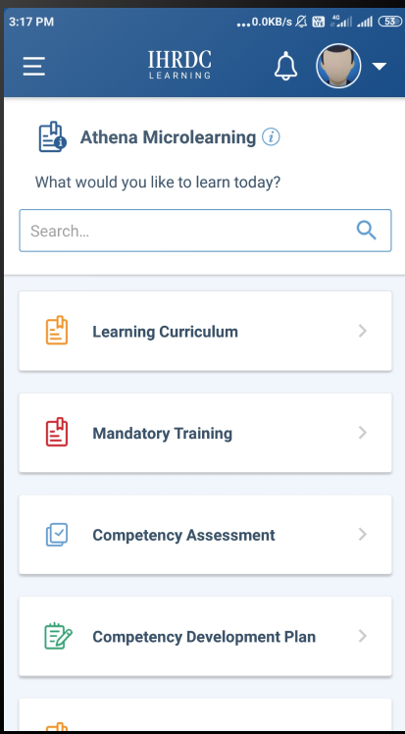


Feature:04 (animated)
CMS Online Overview
Version 4.40
March 2026
iOS
Android

Slide 2








CMS Online Product Features
Responsive Design
Cloud-based
User-friendly
interface
CMS Online 4x is backed by IHRDC’s 55+ years of industry experience and comprehensive competency content!
Multi-Language
Interface
Reporting
Tools
Dual Language
Skill Definitions
Powerful
Assessment
Tools

Slide 3
CMS Online Enables Learning and Assessment Process
Assess
Plan
Develop
Provides a comprehensive assessment process including self-assessment, supervisor and qualified assessor assessments
Generates reports that provide an overview of the workforce’s strengths and areas of vulnerability
Once competency development plans are approved, employees can start the learning process
When ready, employees can initiate the reassessment process to close skill gaps
Determines competency skill gaps for each employee through assessment process
Allows employees to review their competency profile and build competency development plans
Supervisors can then approve or reject the plans and provide feedback and comments
Supervisors can keep track of the employee learning progress throughout
Mentors may support the process by building plans on employees’ behalf

Slide 4
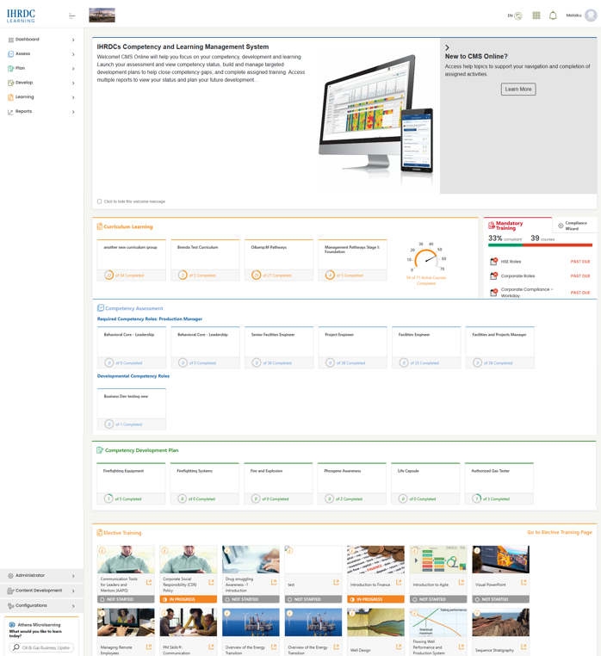

Dashboard
The single launch point for CMS Online!
  Competency Assessment & Gap Analysis
  Training Resources & Development
  Curriculum Training Pathways
  Management and Individual Reports
  Competency Content of 4,000+ Topics
Notes:
The Dashboard is designed for the global system configuration of Competency Management (Self-Assign and Standard Assessment) and Learning Curriculum.

Slide 5
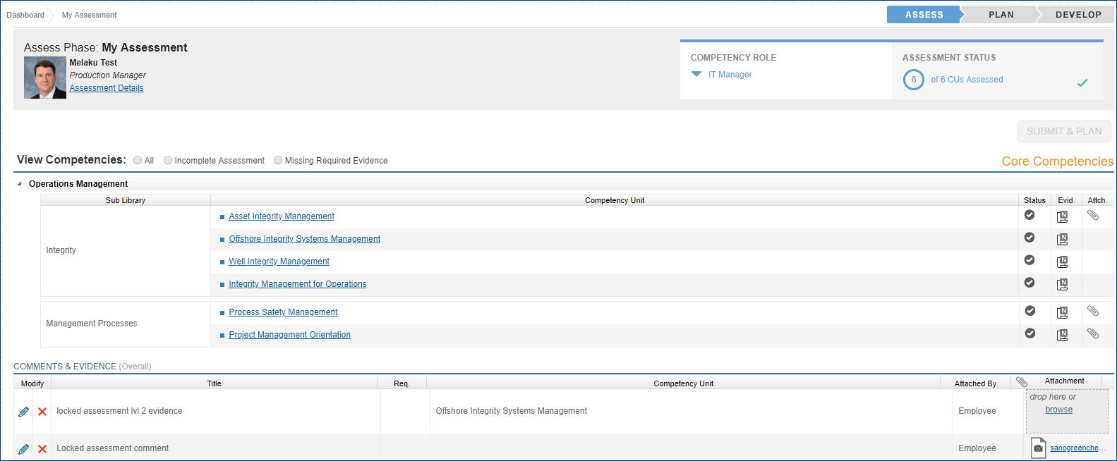
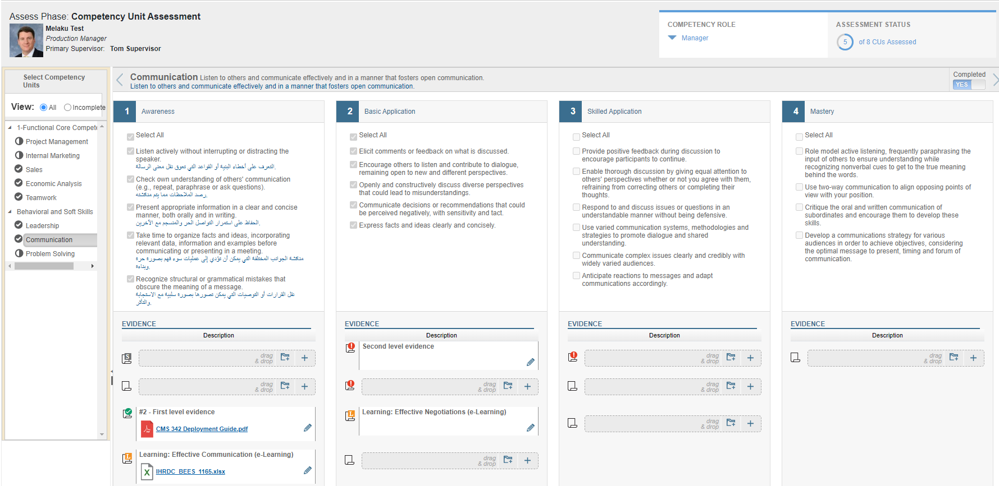
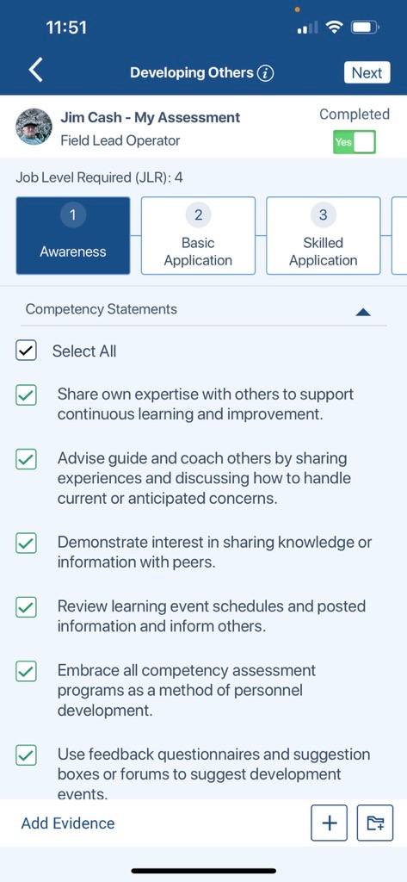
Assess - My Assessment
Employee performs a self-assessment against each competency unit within each competency role assigned to their job title. They indicate their level of proficiency and can upload work products as evidence to help support their current level
Key Functions:
Assessment details
Toggle between competency roles
Assess one competency unit at a time
Multi-level skill statements
View all matched learning resources
Comments & evidence
Optimized for tablet and smartphone
Provide assessment process feedback

Slide 6
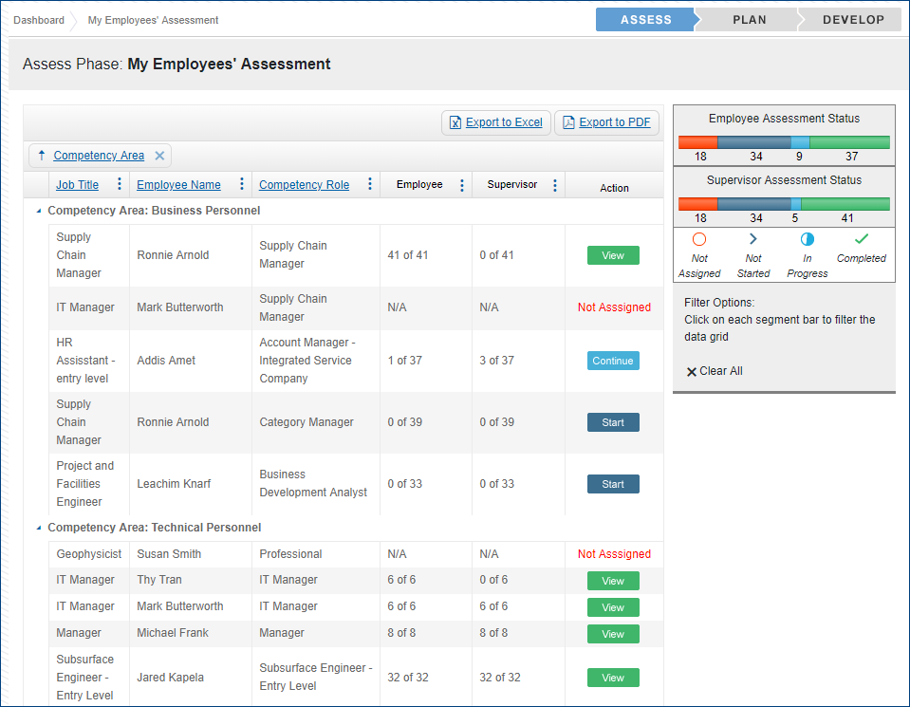
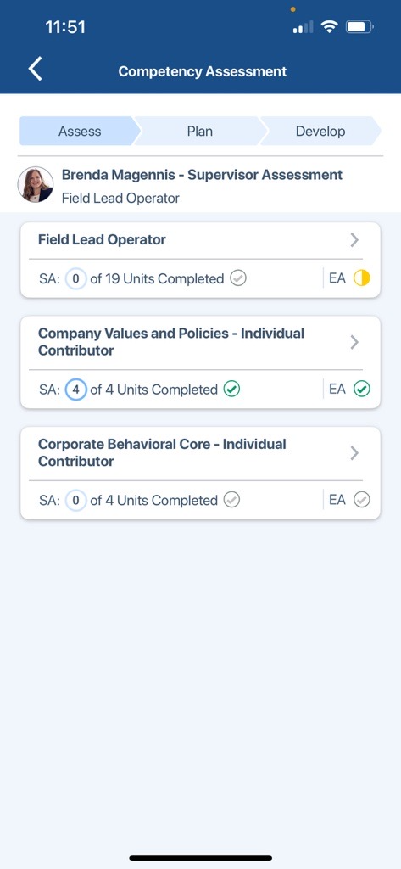
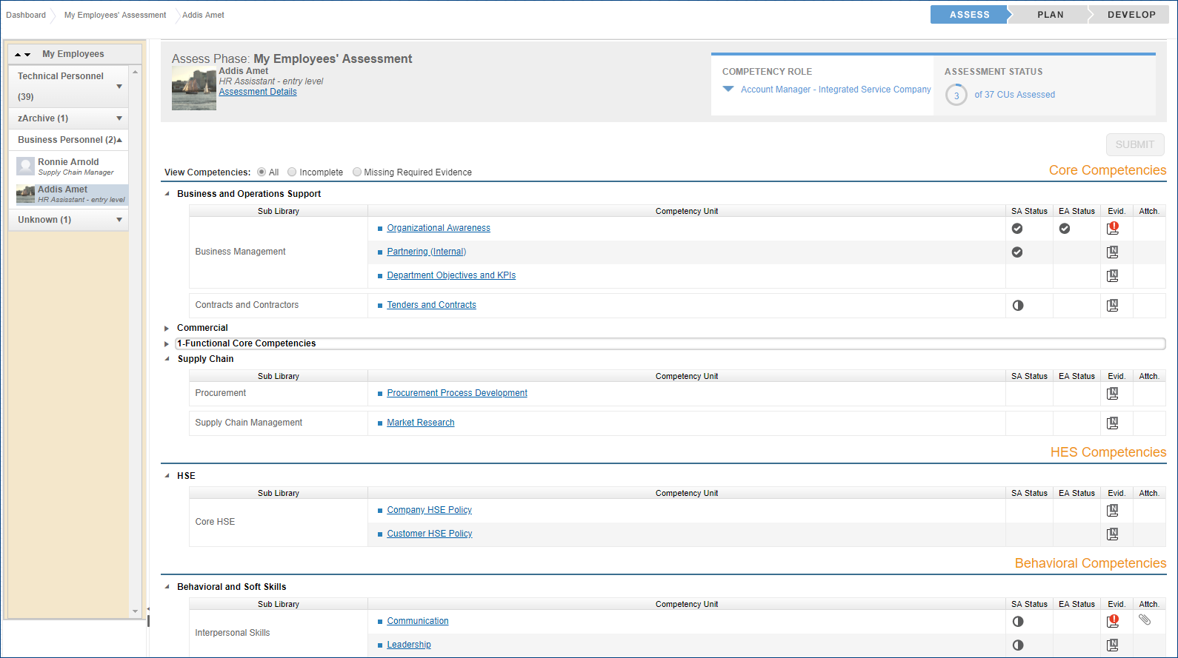
Assess - My Employees’ Assessment
Key Functions:
Employee and Supervisor Assessment Status
Launch Employee Assessment from Supervisor landing page
Toggle between Competency Roles assigned to employee job title
View any comments and evidence submitted by the employee
Option to perform a blind employee assessment
Option to assign assessment to be completed by a Secondary Supervisor
Key Functions:
Employee and Supervisor Assessment Status
Launch Employee Assessment from Supervisor landing page
Toggle between Competency Roles assigned to employee job title
View any comments and evidence submitted by the employee
Option to perform a blind employee assessment
Option to assign assessment to be completed by a Secondary Supervisor
Supervisors can assess their employees against assigned job competency roles. CMS Online provides an intuitive set of screens to launch the assessments and complete the process
Key Functions:
Employee and Supervisor Assessment status displays
Launch assessment from Supervisor landing page
Toggle between Competency Roles assigned to employee
View any comments and evidence submitted by the employee
Option to perform a blind employee assessment
Option to assign assessment to be completed by a Secondary Supervisor

Slide 7
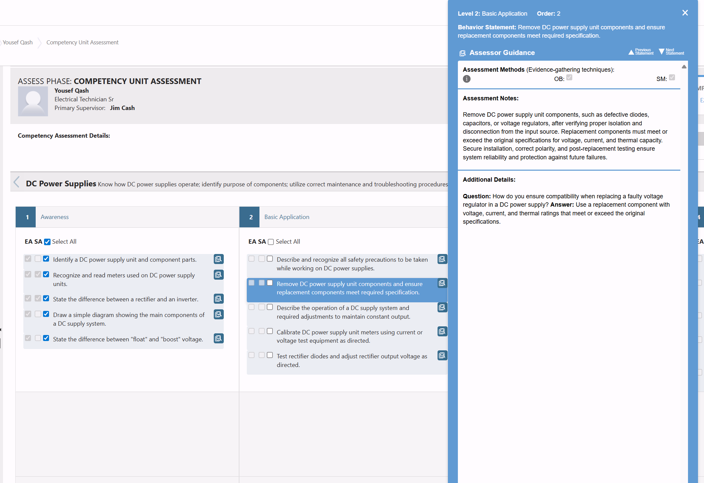
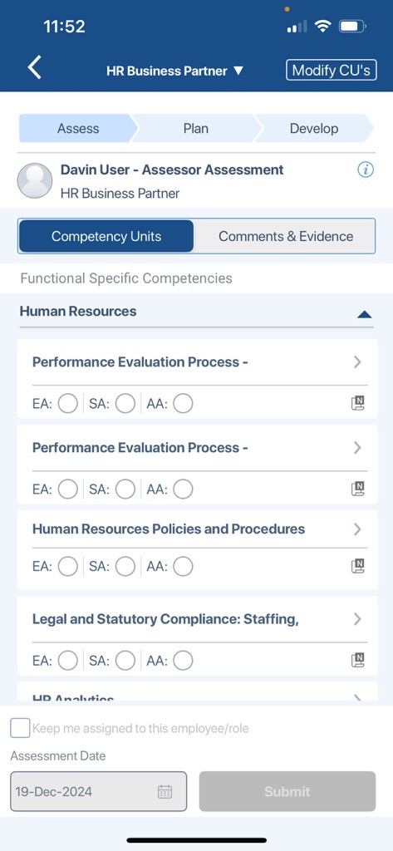
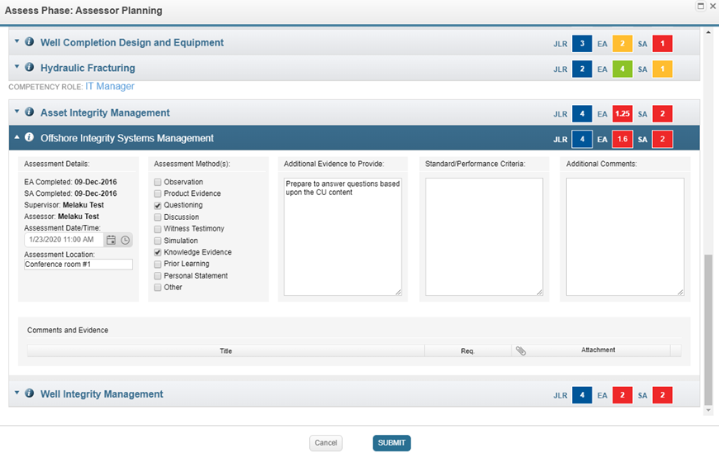
Assess - Assessor Assessment
A Qualified Assessor can complete an assessment after the supervisor and employee assessments have been completed. They can select specific competencies to assess after reviewing the supervisor and employee assessment results and conduct further assessment where large variances exist
Key Functions:
Assessor selects Competency Units (CUs) to assess
CU assessment requirement priority
Assessment scores and gap
Assessor plans and communicates time, location, assessment method and other details of the assessment
Assessor Guides available to support consistent, thorough assessments

Slide 8
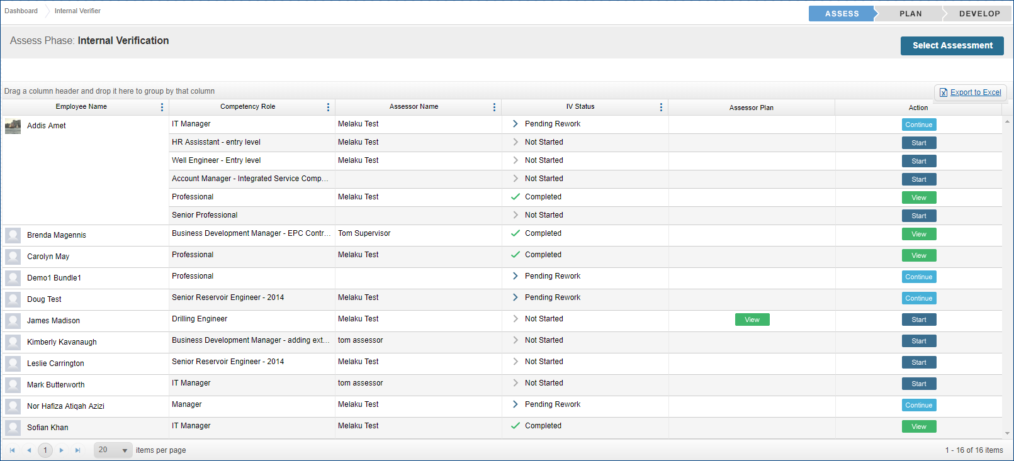
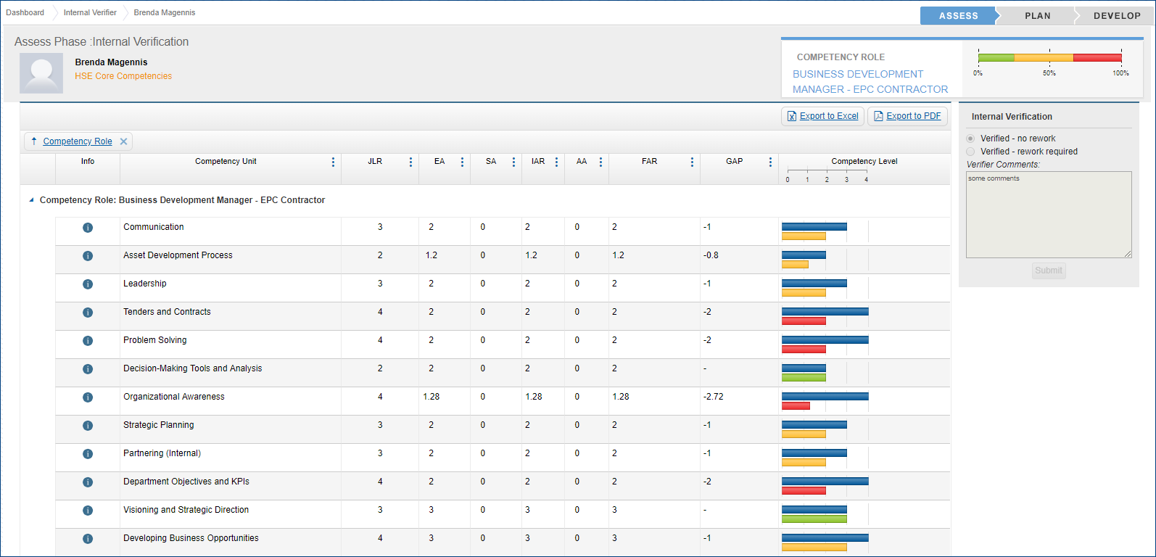
Assess – Internal Verifier
Where an organization uses an internal verifier (IV) to oversee the assessment process, CMS Online provides the ability for the IV to monitor and verify completed assessments, evidence and comments
Key Functions
Select any completed assessment to review
View assessment results, comments & evidence, and assessment plan where applicable
After verification is complete, IV indicates whether additional work is required by Assessor
Assessment selected by IV and their progress display in Assessment Progress report

Slide 9
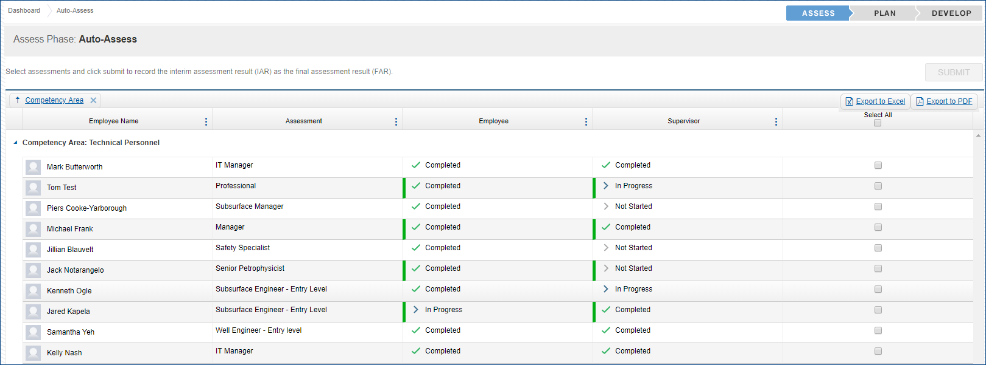
Assess – Auto-Assess
In cases where an assessor assessment is not required, an Administrator or certain types of Assessors can select assessments to batch auto-assess. The auto-assess is completed in place of an Assessor Assessment
Key Functions
Ability to choose one or all competency roles (assessments) provides flexibility
Submitting will record the lower of the Employee and Supervisor assessment scores for each competency unit as the final assessment result (FAR)

Slide 10
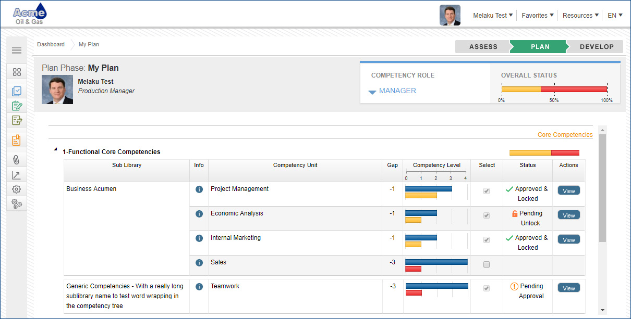
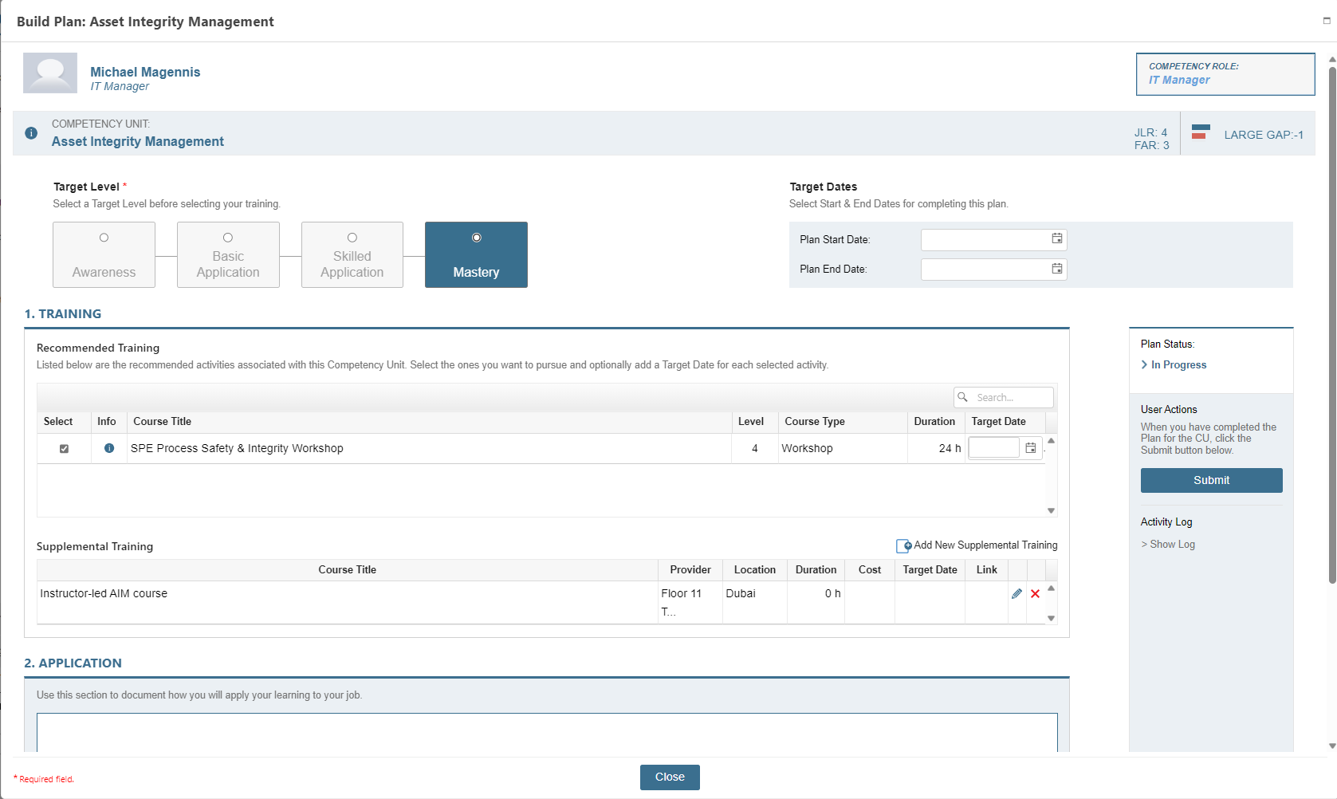
Plan - My Plan
Once the assessment is complete an employee can build their Competency Development Plan based on skill gaps using pre-matched learning events to help close gaps. The employee can then submit the plan and request approval from their supervisor.
Key Functions:
Employee selects which CUs to add to Competency Development plan
For each CU, the employee selects pre-matched training resources to close the gap and states how they will apply the learning back on the job
Progress status for the selected CU
  Not Started
  In Progress
  Request Approval
  Approve
  Reject
  Locked

Slide 11
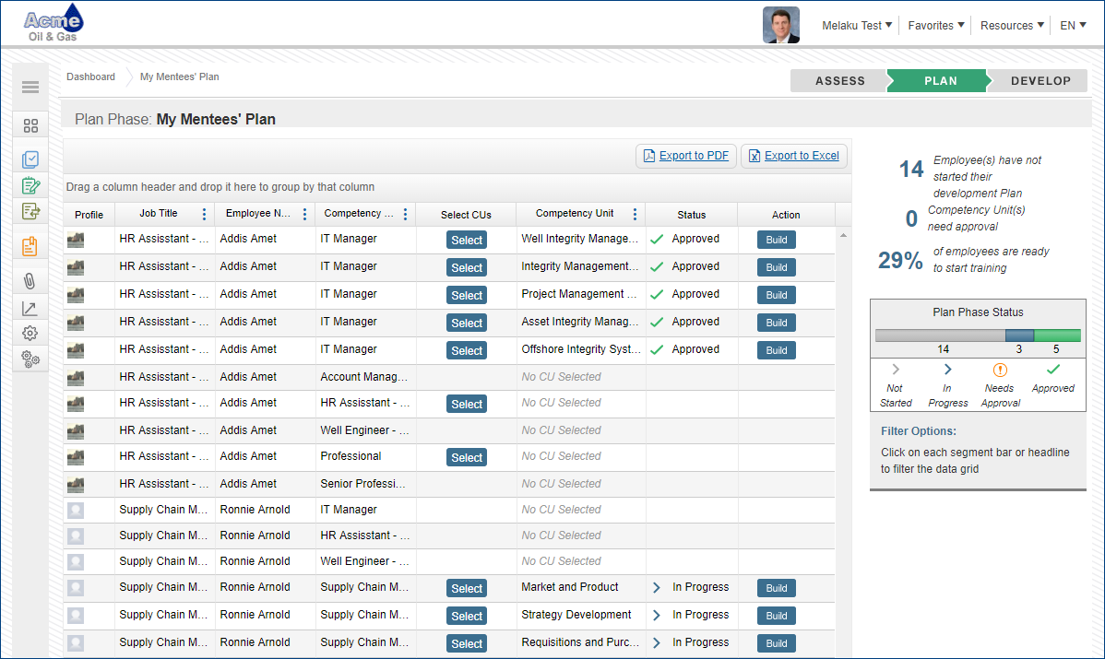
Plan – My Mentees’ Plan
plan
Mentors are assigned and can build Competency Development plans on behalf of employees
Key Functions:
Mentor selects which CUs to add to Competency Development plan
Mentor builds the plan and either:
  Submits on employee’s behalf
  Notifies employee to review and submit
Supervisor approves, modifies or rejects

Slide 12
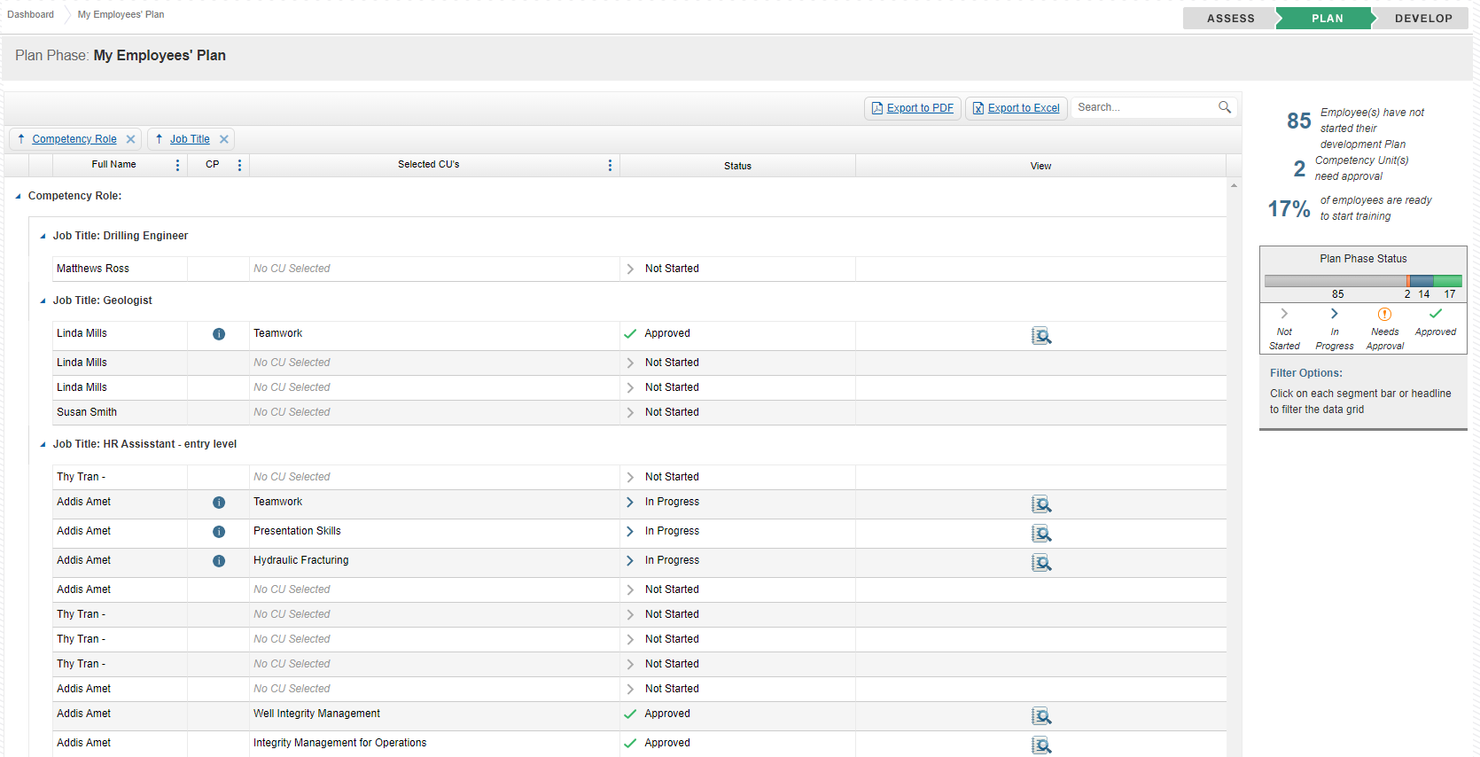
Plan – My Employees’ Plan
Key Functions:
Employee Competency Development progress status
Modify the plan as needed
Approve or Reject Competency Development plan with comments
Once the draft plan has been submitted by the employee or mentor, the supervisor can modify, approve or reject Competency Development Plans for each competency unit and provide feedback and recommendations about the plan
Key Functions:
Employee Competency Development progress status
Modify the plan as needed
Approve or Reject Competency Development plan with comments

Slide 13
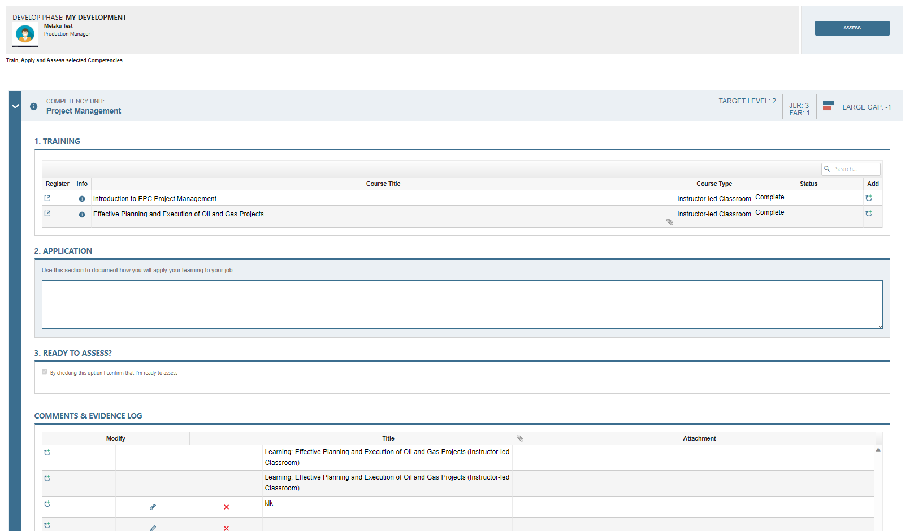
Develop – My Development
Key Functions:
Executes learning based on plan
Indicates completion date
Comments & Evidence as proof of competency
Initiates reassessment process when ready
Once the supervisor approves, the employee can start working on the Competency Development Plan. As he progresses by completing the selected training and applying the learning to the job, he can log comments and evidence to help demonstrate development. Finally, the employee can indicate when he is ready to reassess
Key Functions:
Executes learning based on plan
Indicates completion date
Comments & Evidence as proof of competency
Initiates reassessment process when ready

Slide 14
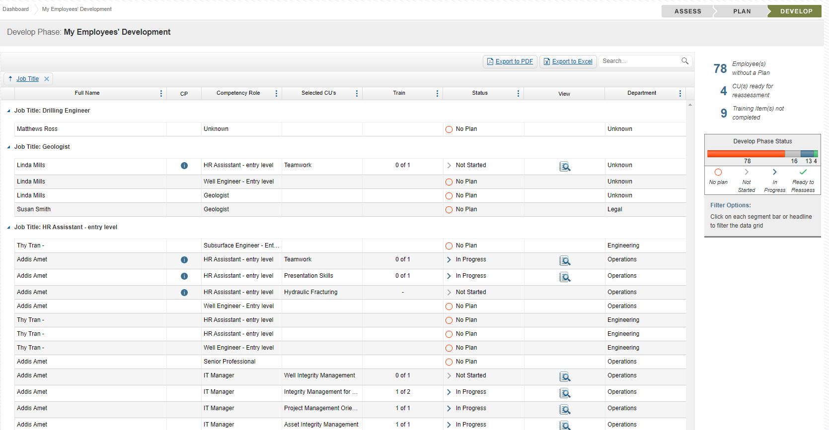
Develop – My Employees’ Development
Key Functions:
Status for each employee’s learning progress
Competency profile for each employee
View employee Competency Development plans
All through the learning process, supervisors can monitor each employee’s learning progress to help keep their employees on track
Key Functions:
Status for each employee’s learning progress
Competency profile for each employee
View employee Competency Development plans

Slide 15
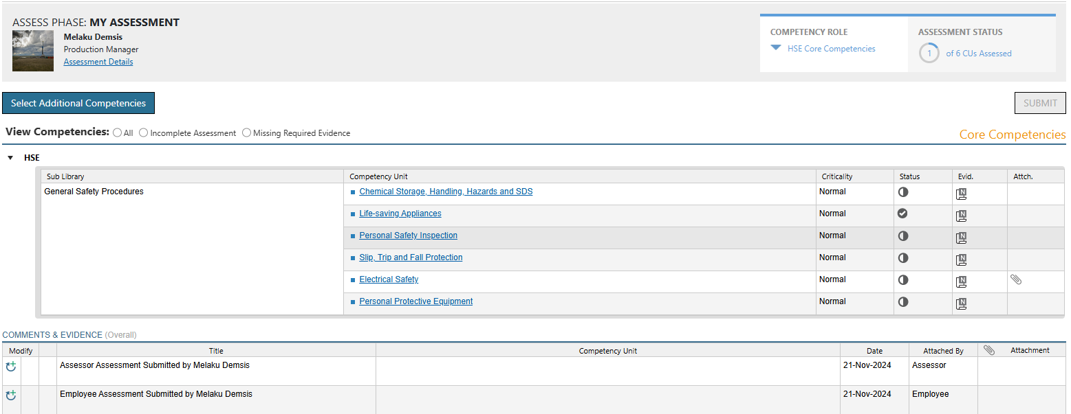
Assess – Employee Reassessment
Key Functions:
Employee initiates assessment for specific CU(s)
Employee has option to select additional CUs to include in assessment
Supervisor performs assessment on CUs employee selected
Assessor performs assessment – with the option to select additional CUs
Once the employee is ready, he initiates an assessment from the Learning cycle and a full assessment for that competency unit is completed to update the competency profile. During the assessment he can also select additional competencies to assess
Key Functions:
Employee initiates assessment for specific CU(s)
Employee has option to select additional CUs to include in assessment
Supervisor performs assessment on CUs employee selected
Assessor performs assessment – with the option to select additional CUs

Slide 16
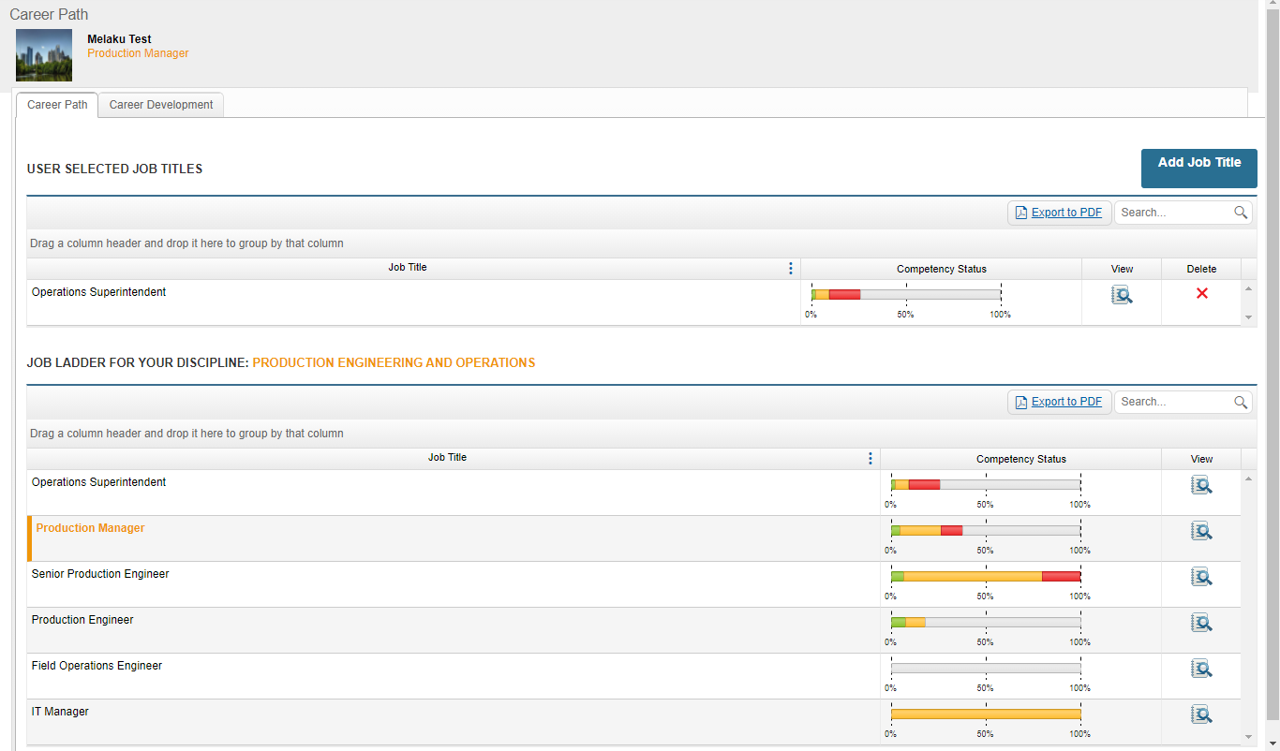
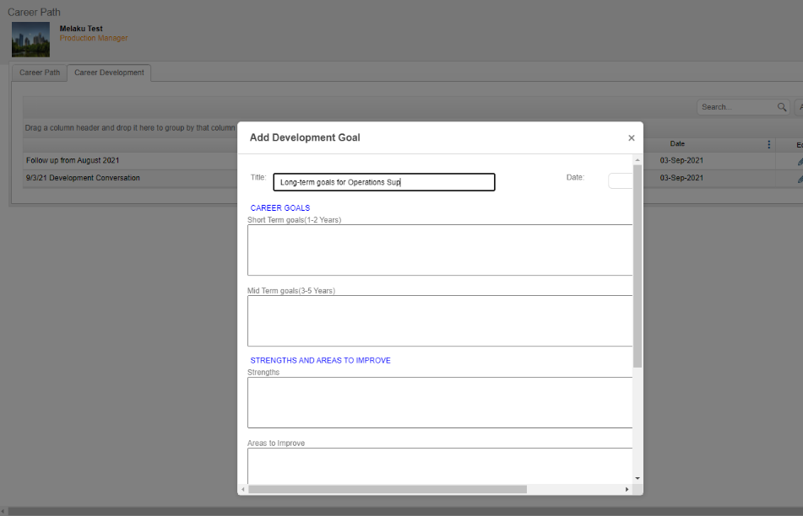
Career Path and Career Development
The Career Path provides employee users with a comparison view of their assessment results against requirements for all other job titles within their discipline or from selected job titles outside their discipline. Career Development then enables employees to document career goals
Key Functions:
Employee can view results of current assessments and how they compare to the requirements for other jobs
Employee can upload related attachment
Administrator sets a hierarchy of all job titles in a job area to establish the job ladder for a discipline
Employee can compare current results to the requirements for any other job title in the organization

Slide 17
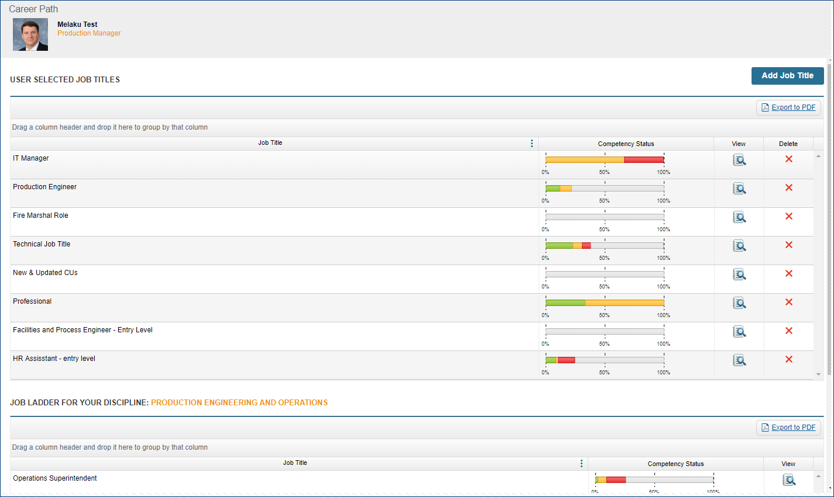
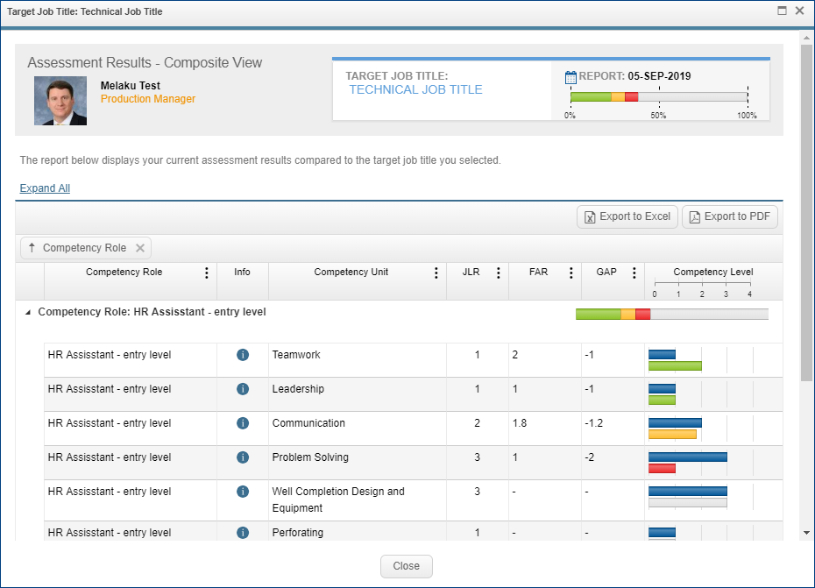
Career Path
Key Functions:
Employee can select any job title to view a detailed comparison of current assessment results vs. requirements for the selected job
Click to see all statements, with current tick marks, in a competency unit

Slide 18
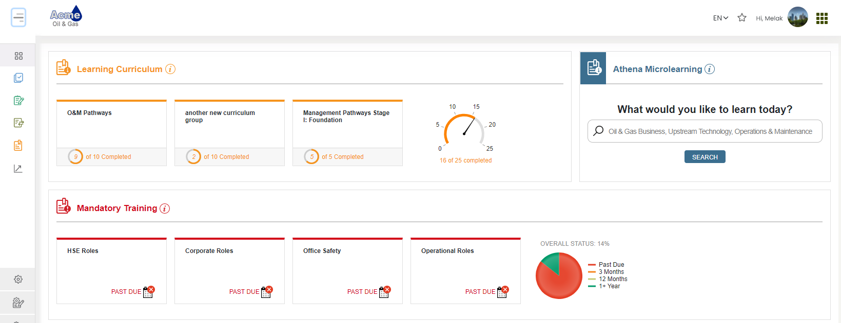
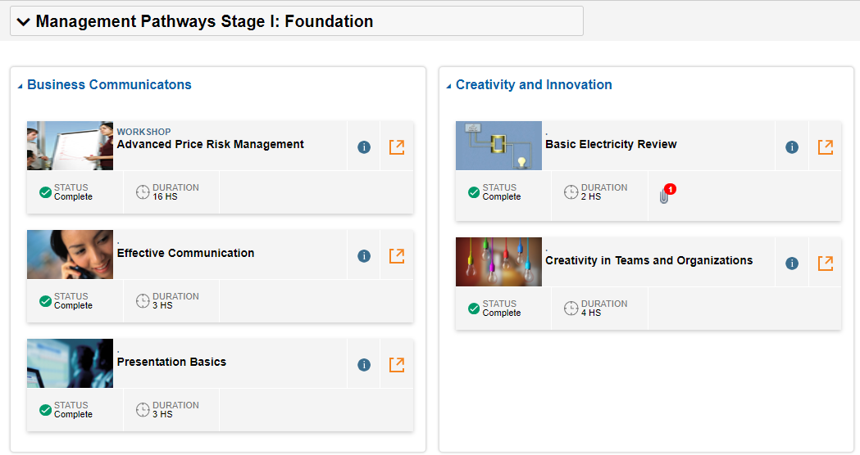
Learning Curriculum
Provides the ability to create customized curricula in CMS Online. Bundles of learning events are created and assigned to jobs or individuals and can include all types of learning: e-Learning, webinars, workshops, mentoring and on-job assignments
Key Functions:
Delivers a pre-defined learning curriculum to the end user
Displays the curriculum in sequential learning blocks
Allows the end user to open each block independently to see the list of courses / activities
Provides a link to the learning resource for each course

Slide 19
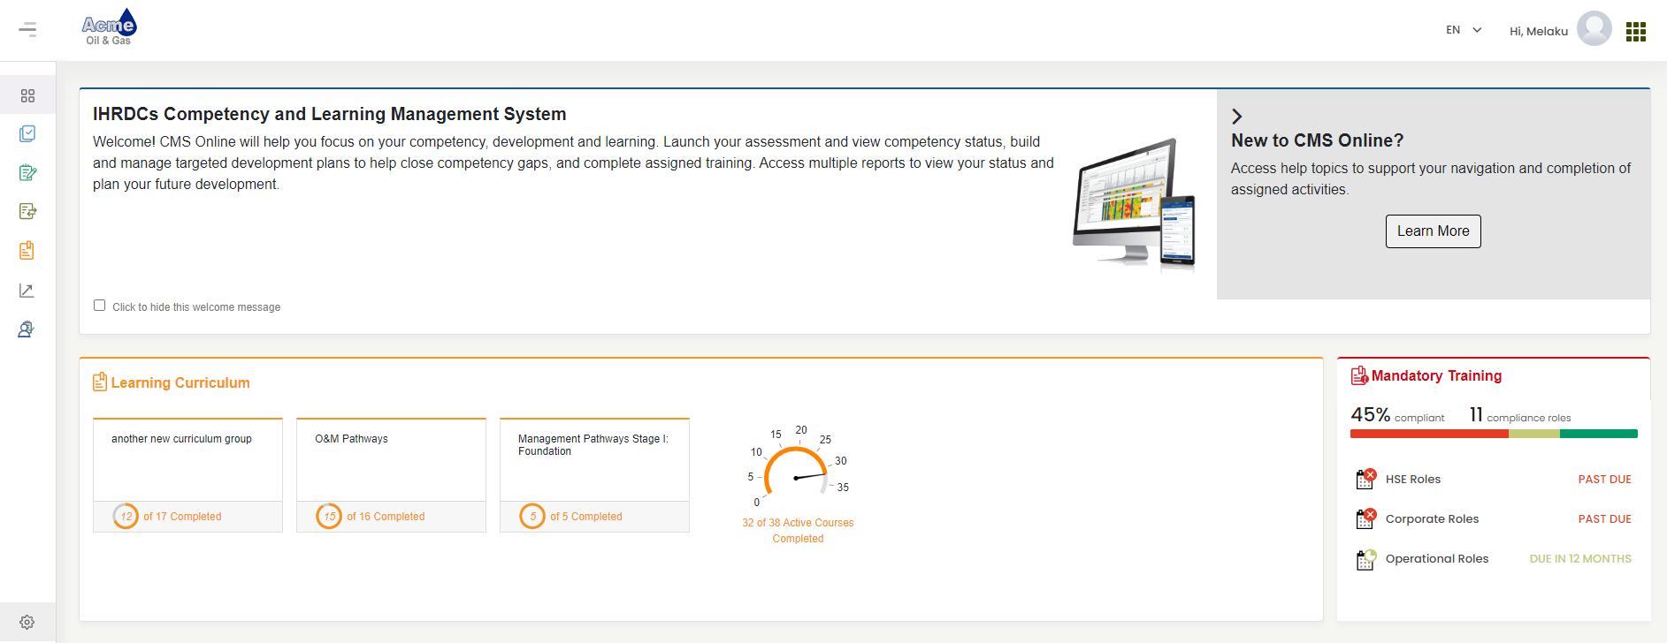
Employee Mandatory Training – Dashboard
Key Functions
Displays Mandatory Training overall status
Displays Mandatory Training category status
User can click to view and launch mandatory training assignments
The Dashboard provides the overall mandatory training status by mandatory training category. The employee can click into any role for more details
Key Functions
Displays Mandatory Training overall status
Displays Mandatory Training category status
User can click to view and launch mandatory training assignments

Slide 20
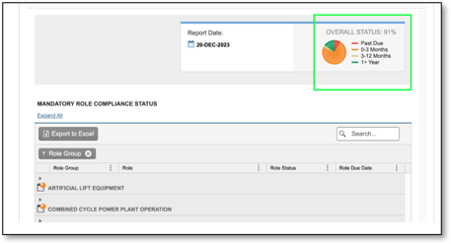
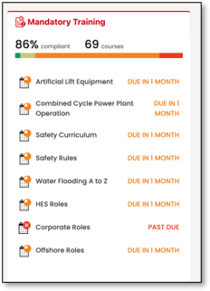

Employee Mandatory Training
Provides individual mandatory training status by role and the ability to track, launch, and view status of mandatory training and compliance learning assigned to the user. Additional information includes due date, date completed, duration and type of learning
Key Functions
Track mandatory training role status
Display individual training event progress and status
Launch mandatory training assignments
Upload course completion evidence

Slide 21
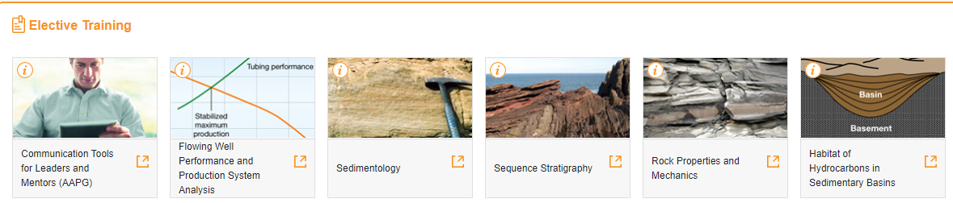
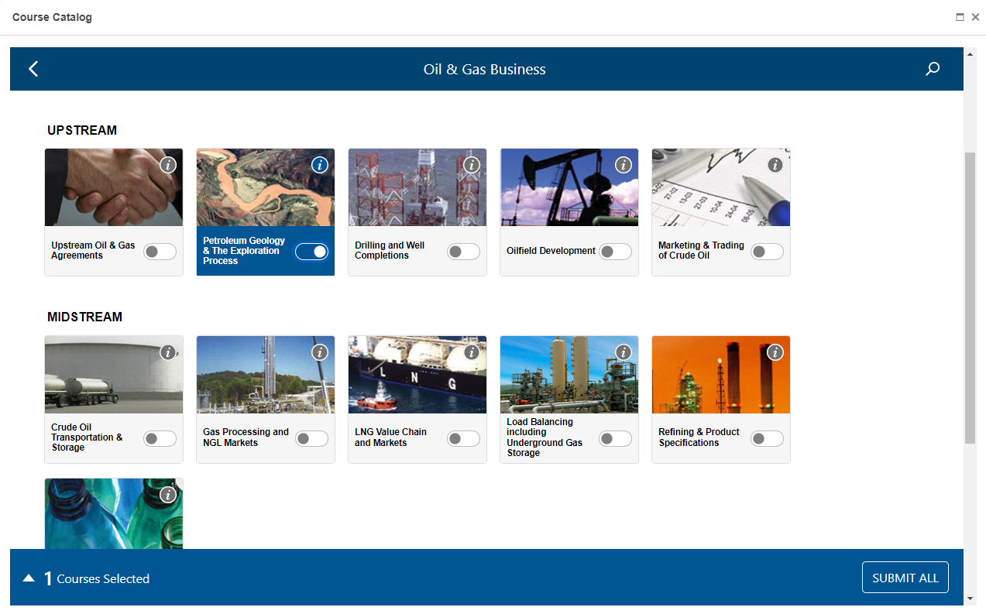
Elective Training
Users can view and launch all approved elective training and access the Dynamic Course Catalog to browse and search e-Learning
Key Functions
Browse and search the dynamic course catalog
Depending upon client configuration, launch or request approval for a course
View and launch approved elective training

Slide 22
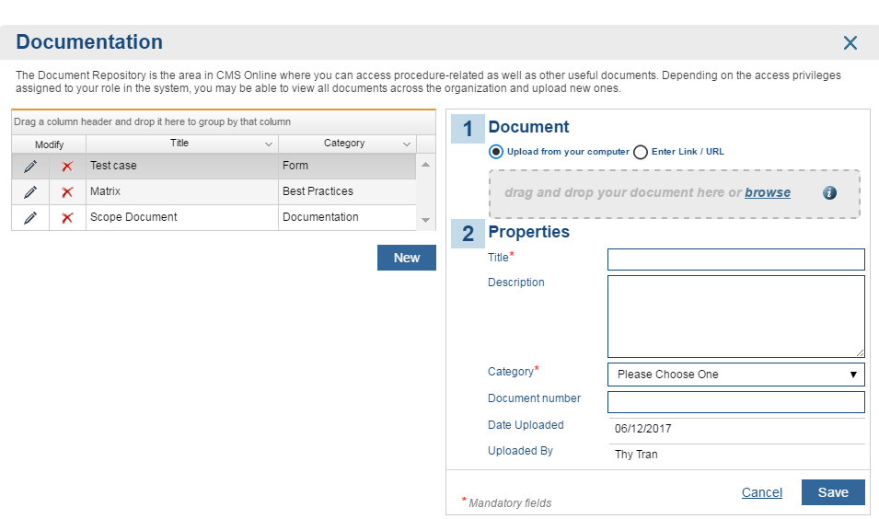
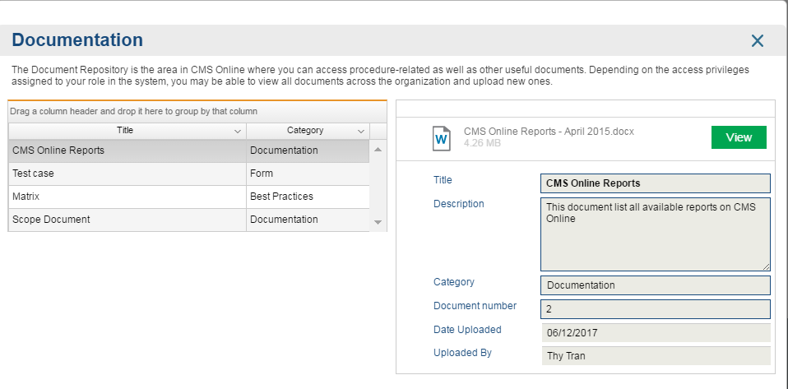
Document Repository
Clients can upload documents, such as policies and procedures governing the competency process, or employee communications. These documents are available for all users to download
Write Access - Advanced Users
Read Access - All Other Users

Slide 23
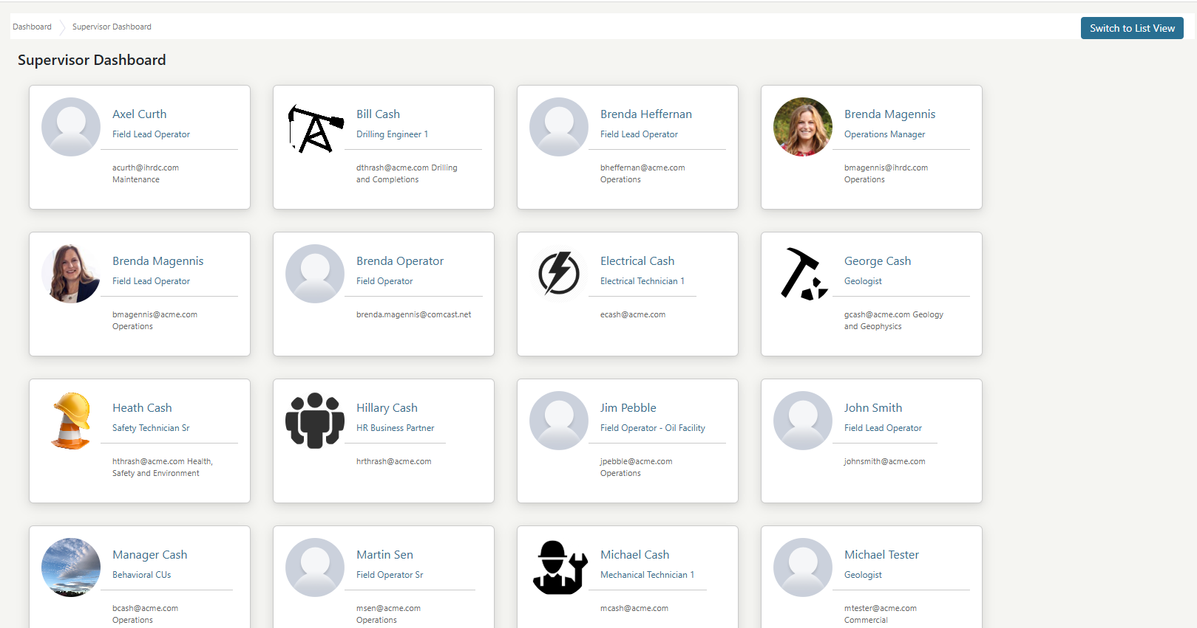
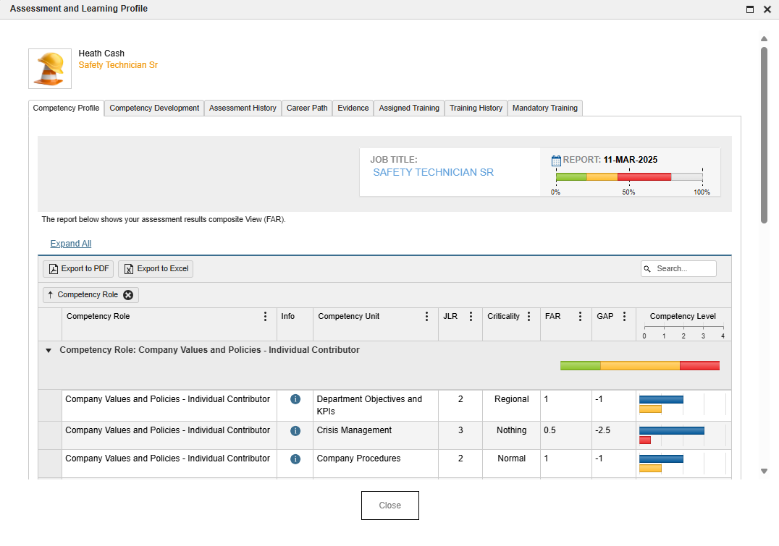
Supervisor Dashboard
Supervisors can view all direct reports and access their Employee Snapshot reports

Slide 24
Reporting

Slide 25
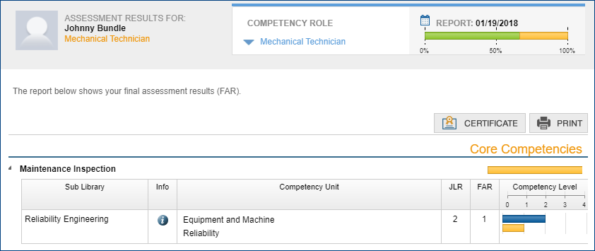
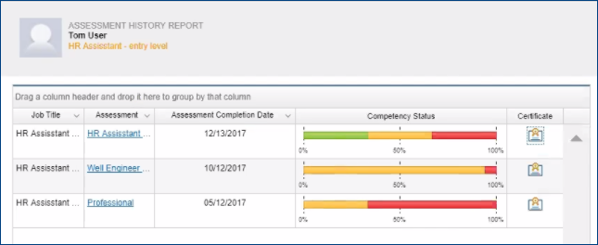
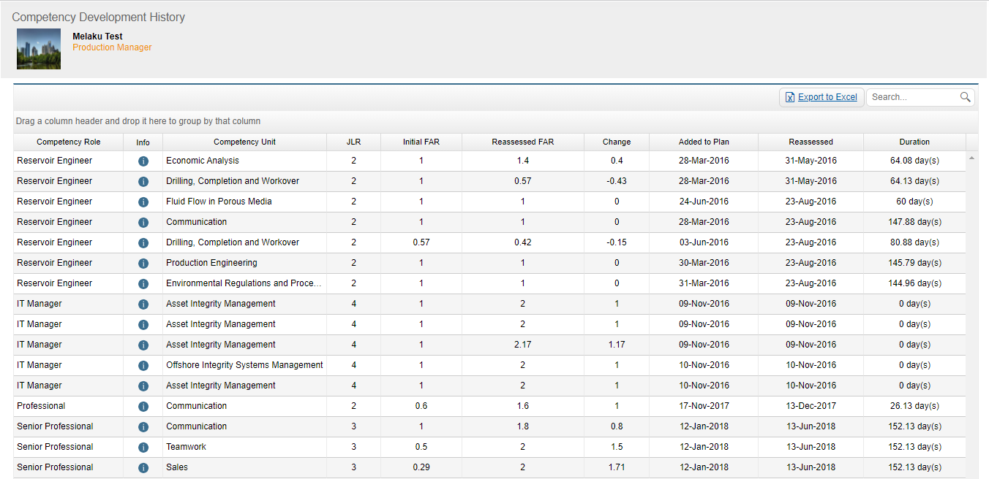
Employee Reports
Assessment Results – The results of an employee assessment after each stage of the process. It consists of Employee, Supervisor, and Assessor scores in comparison to the JLR and GAP
Assessment History – A history of all employee assessments along with completion dates and competency status
Competency Development History –
A history of the initial FAR and the changes after training and reassessment
Notes:
JLR = Job Level Required

Slide 26
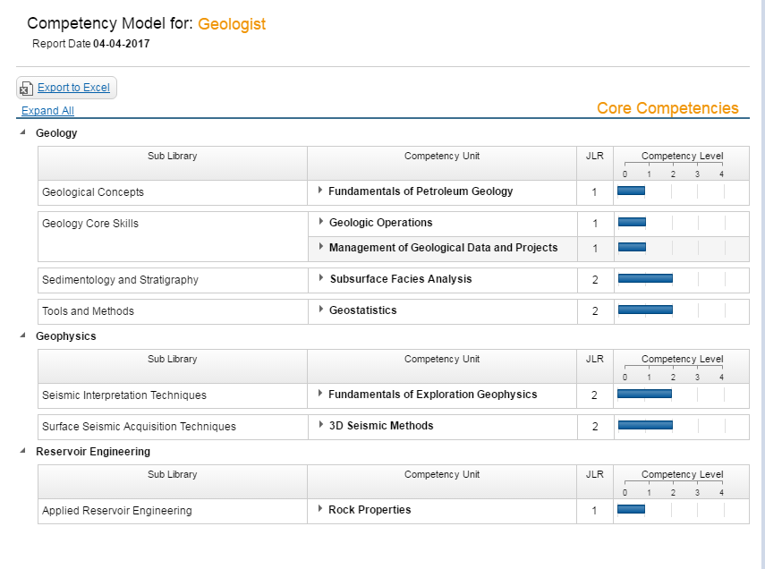
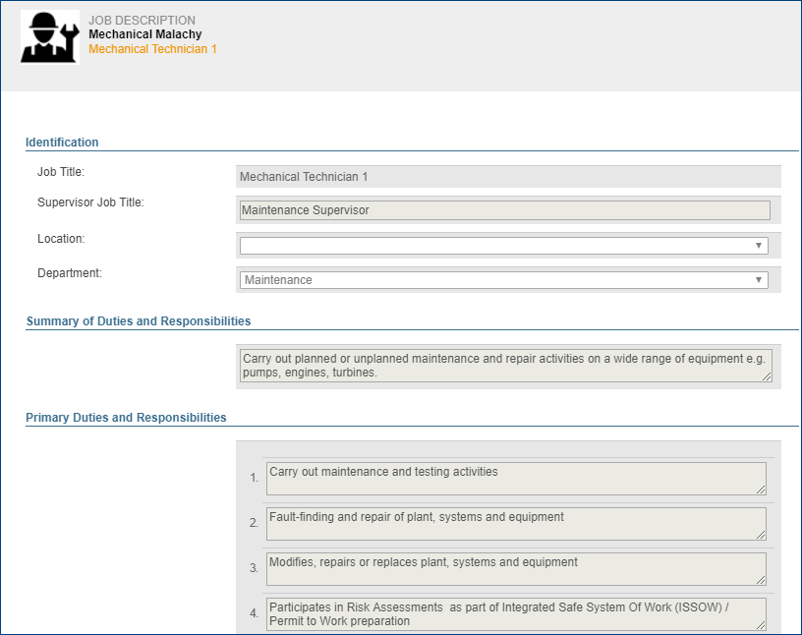
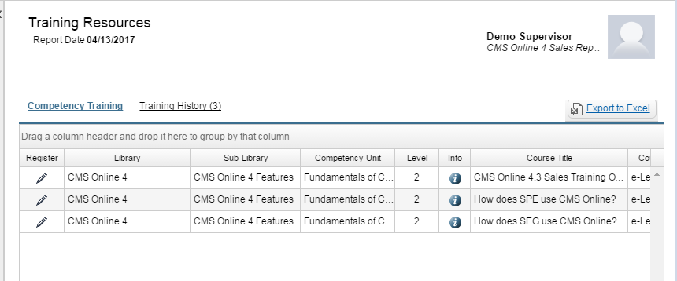
Employee Reports
Competency Model – Supports employees, SMEs and client management by listing the Competency Units and associated skill statements for a job title
Job Description – Allows an employee, SMEs and client management to view job functions and responsibilities for a job title
Training Resources – Displays all training resources available for a given competency role

Slide 27
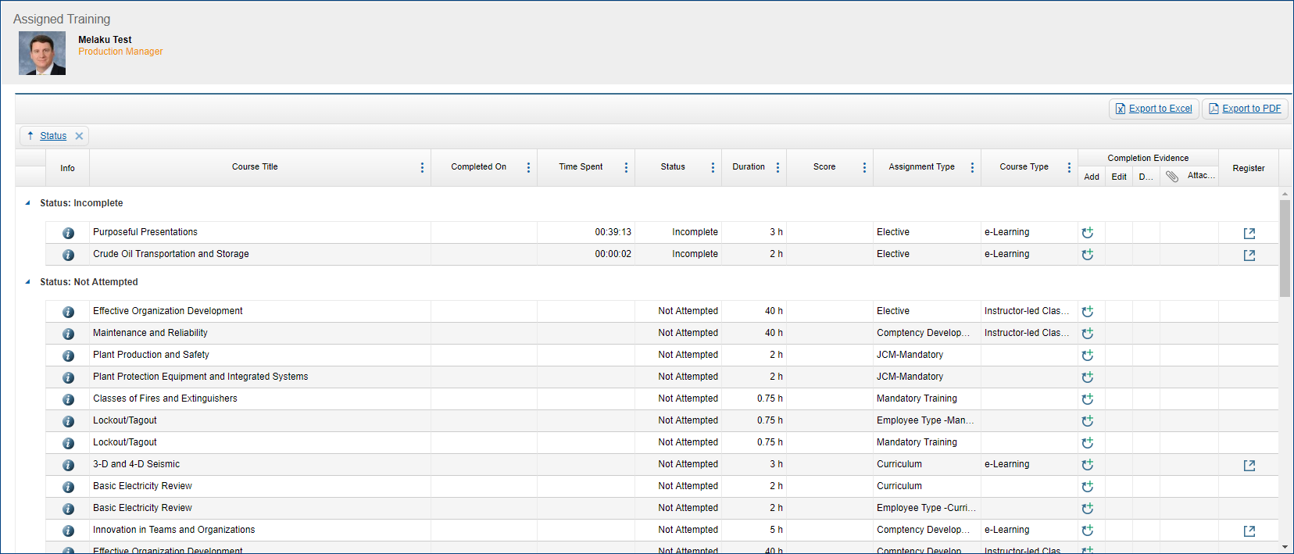
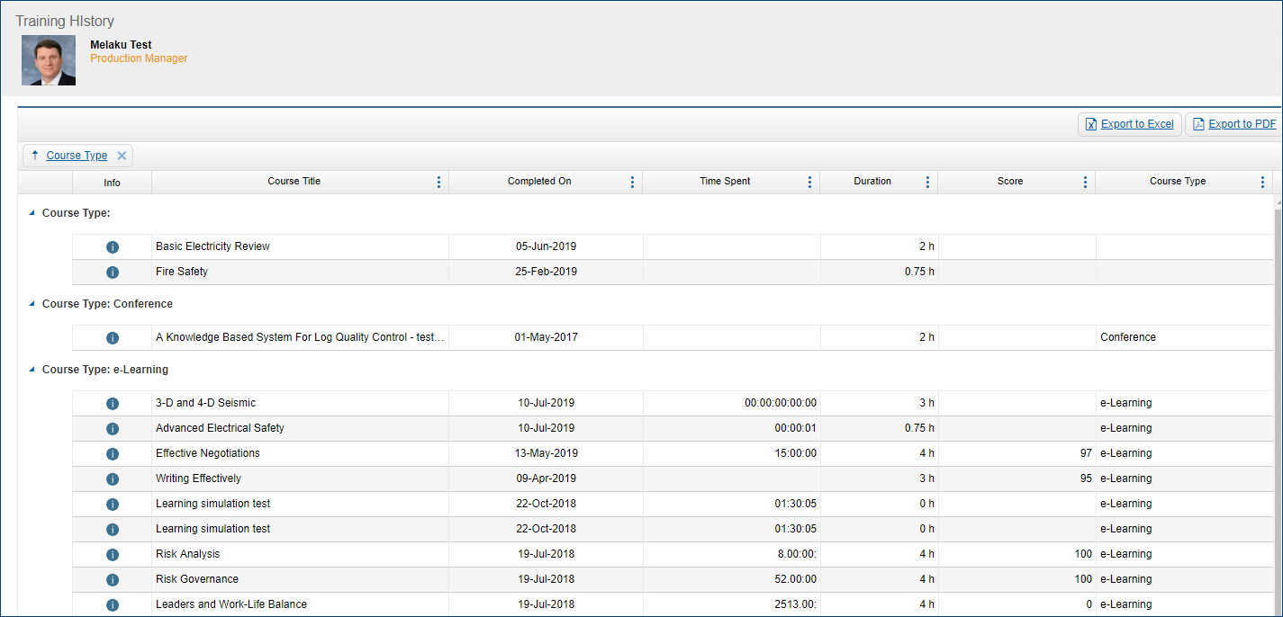
Employee Reports
Mandatory Training - Provides employees with a report to check their mandatory training status and launch training
Assigned Training – Displays all assigned training, with status and completion details for each course
Training History – Displays all completed training, including training not assigned in CMS Online

Slide 28
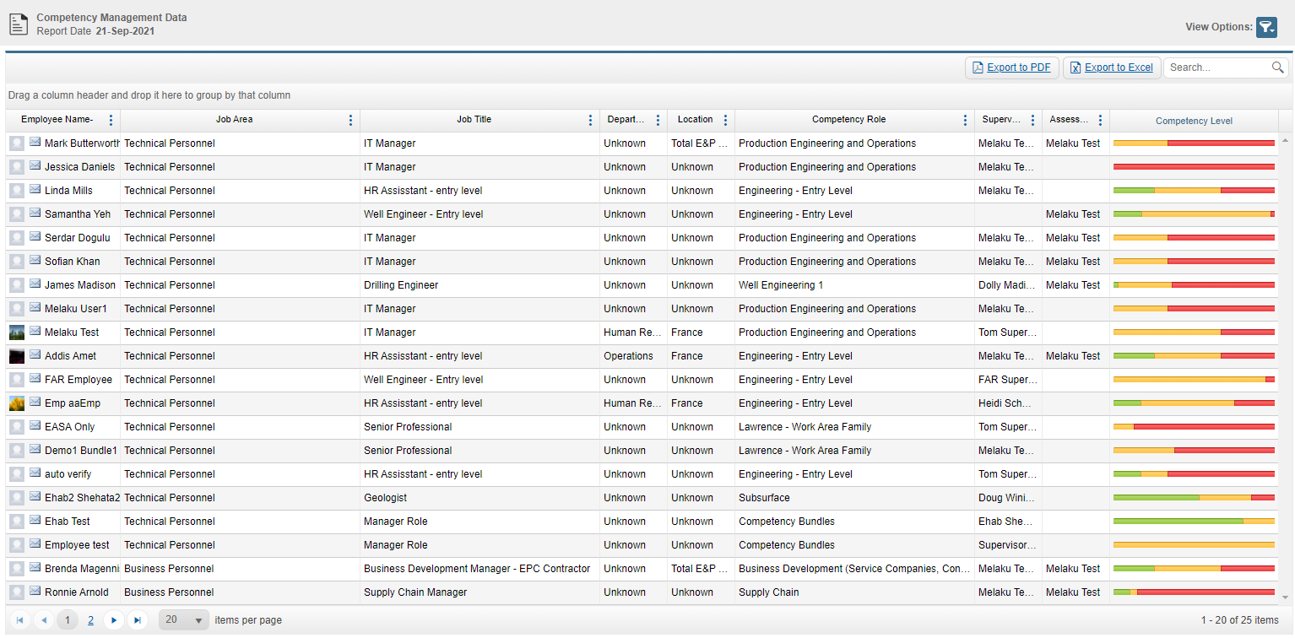
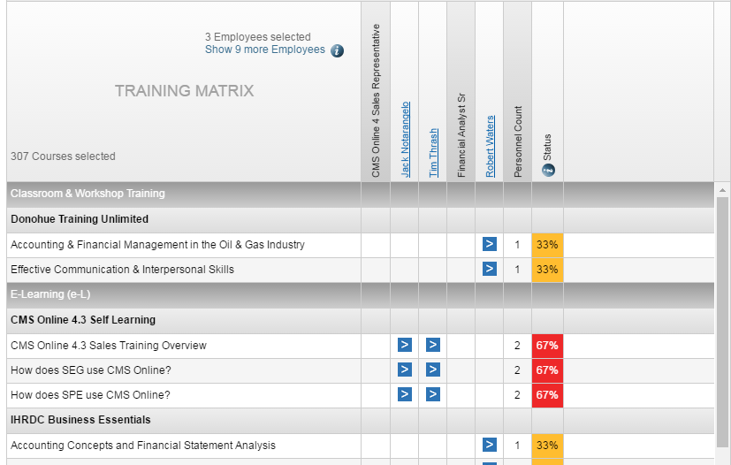
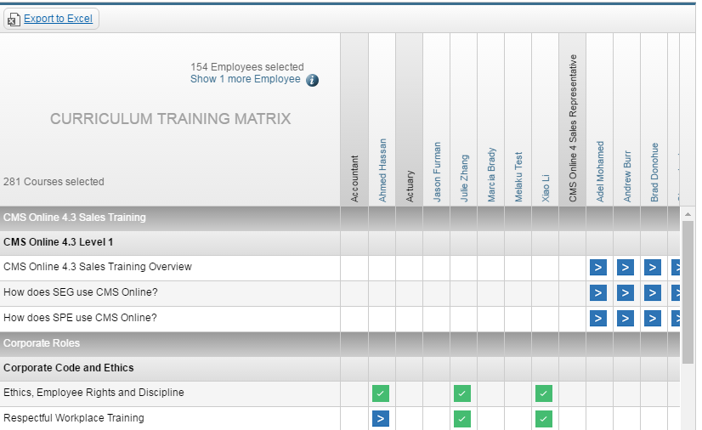
Management Reports
Competency Management Data - Shows the results of the competency assessment across a job title to highlight the strengths and the weaknesses of employees with that job title
Gap Training Matrix - Shows the recommended training across job areas, to assist with planning of training needs for a job area
Curriculum Training Matrix - Shows the training "progress" for each course across compliance roles, in order to assist with determining training status for a group of employees

Slide 29
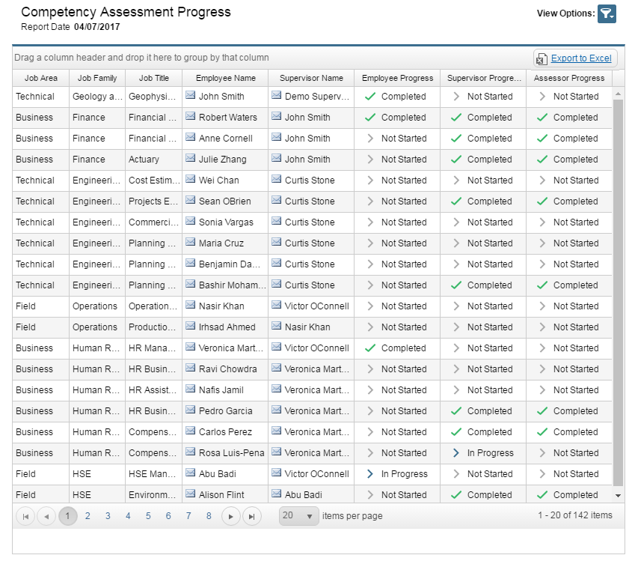
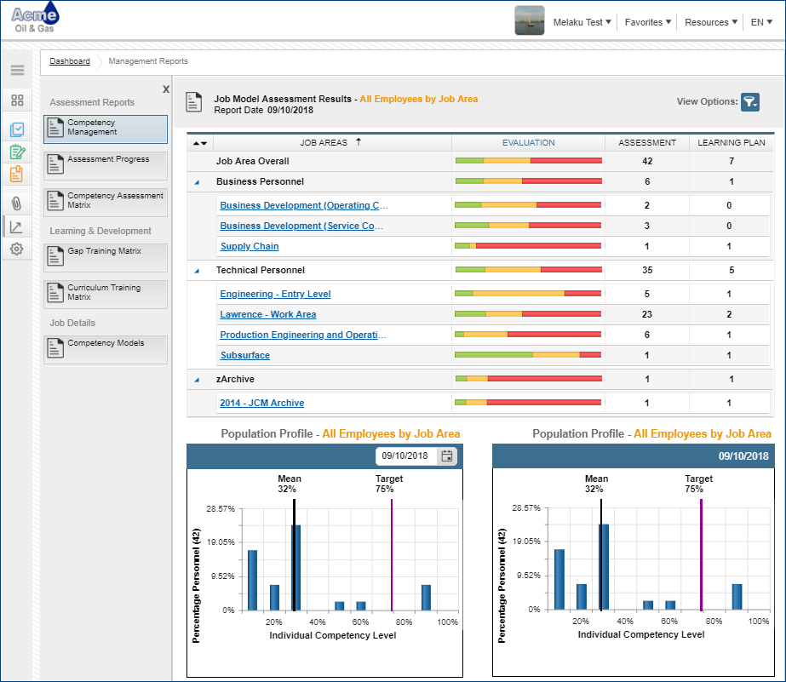
Management Reports
Assessment Progress: Displays in one view, the assessment progress of all three roles (Employee, Supervisor, and Assessor)
Competency Management: View, by job area or other grouping, the overall competency profile of the organization

Slide 30


Management Reports
Assigned Training – Company-Wide: View all assigned training for multiple users
Learning Needs: Rolled-up view of unique learning events assigned to users

Slide 31



Management Reports
Mandatory Training: View Mandatory Training status and drill down to see detail on individual users’ required learning
Competency Models: View and export job descriptions and the competency units and job level required for all competency roles
User Progress Data: Overview of the user adoption and system activities for use statistics and reporting

Slide 32

Employee Snapshot
Key Features include:
Each report displays on a separate tab
View assessment and development reports for a single employee:
  Competency Profile
  Competency Development
  Assessment History
  Career Path
  Evidence
  Assigned Training
  Training History
  Mandatory Training
Supervisors, Viewers and Administrators may see multiple reports about a single employee – all in one place
Notes:
If an LMS records a date, the record becomes available to upload evidence against the date.

Slide 33


Advanced Reporting – Power BI Integration
Integrated Power BI reporting provides flexibility and the ability to deliver client-focused reports for our clients that supplement the main application
Assessor Progress View– Provides clear status on Assessor Assessment completion, to support decision-making and resource-allocation during the assessment process
Mandatory Training Status by Role – Provides an overview of compliance status for the entire organization

Slide 34


Multi-Language Interface –Dashboard
CMS Online has multi-language interface built into the application and we have translated it into 16 different languages
  Key Features Include:
  User selects preferred language from dropdown
  Main labels and help text display in preferred language

Slide 35


Email Notifications
CMS Online provides three types of email notifications: trigger-based alerts based on system events, batch-processed emails, and customized emails that Administrators can create and send
Key Functions Include:
Emails are automatically sent to specific users when triggering events occur
Emails may be inactivated when necessary
Mandatory Training-related emails are batch-processed to send notifications on daily, weekly or monthly basis
Administrators can add, remove or edit notification emails from the default list

Slide 36

Version 4.40
CMS Online
March 2026
© Copyright 2026 International Human Resources Development Corporation

