Slide 1
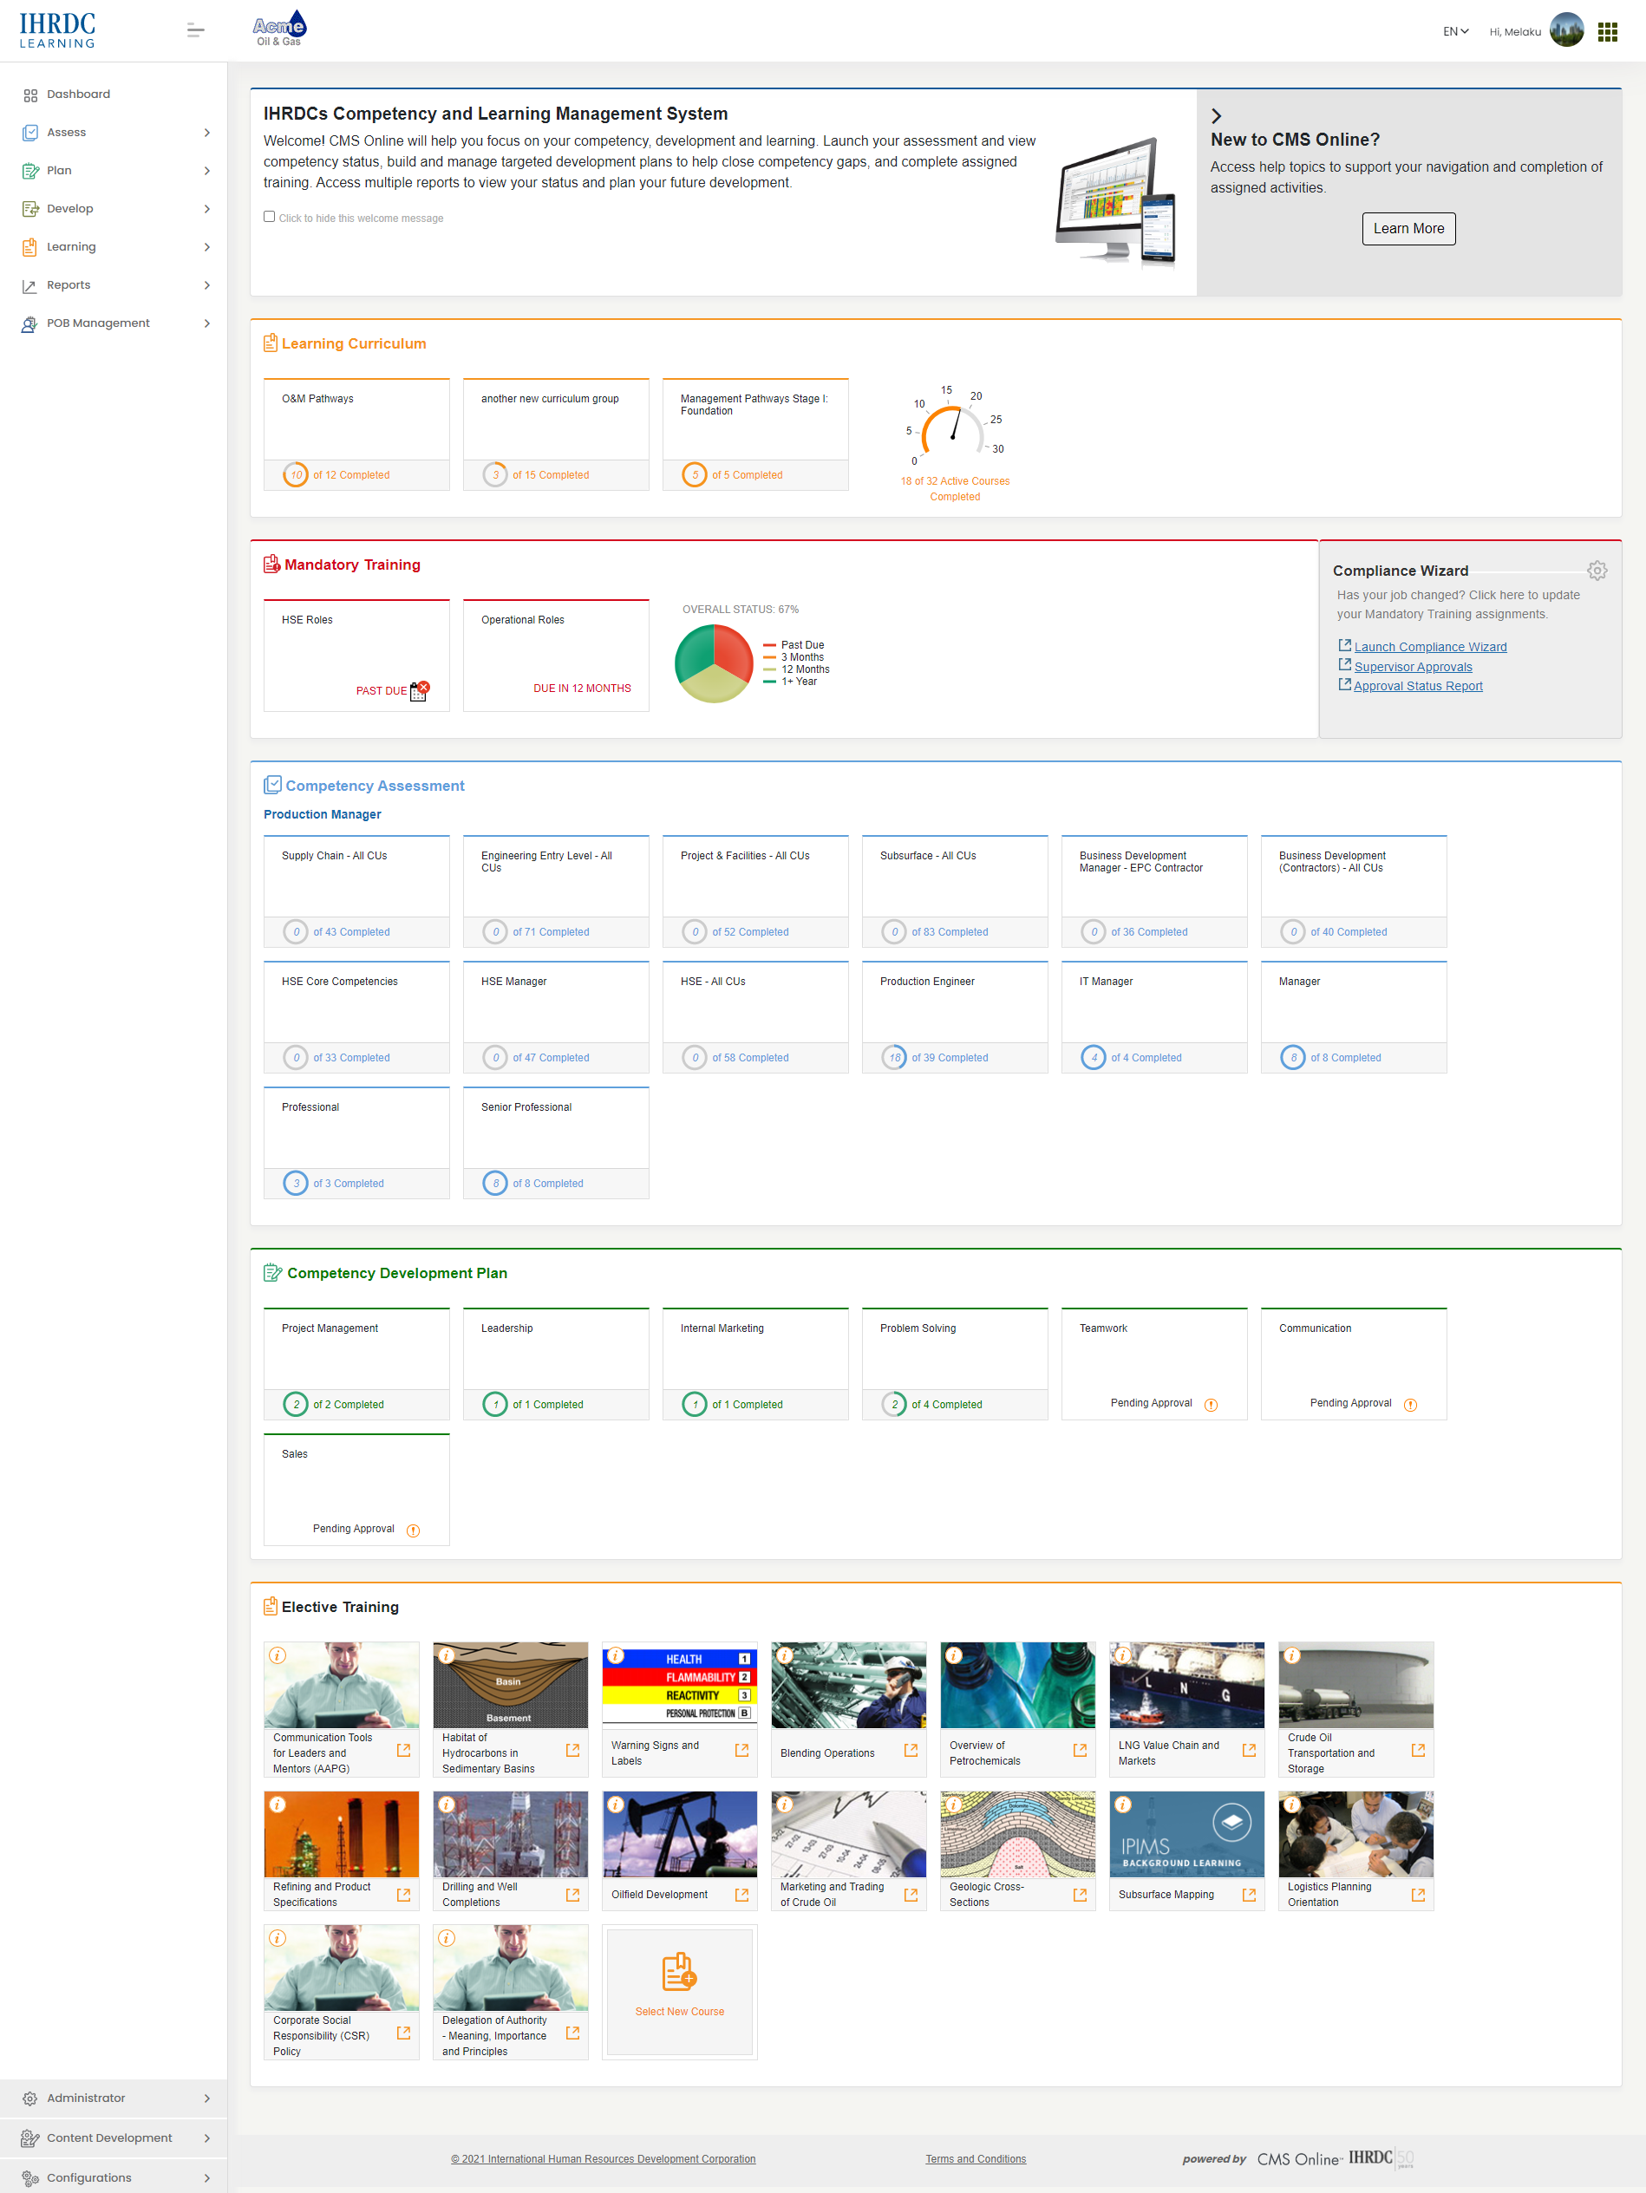
Version 4.24
CMS Online
Quarterly Release Notes
March 2022
© Copyright 2022 International Human Resources Development Corporation

Slide 2
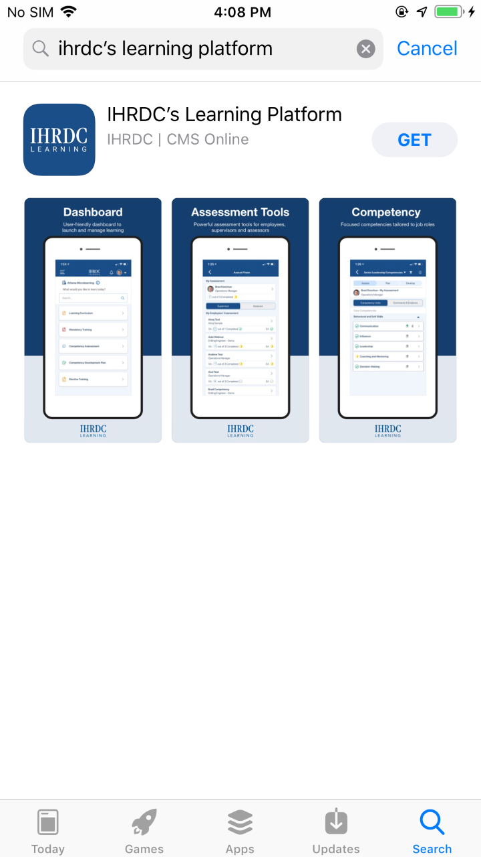
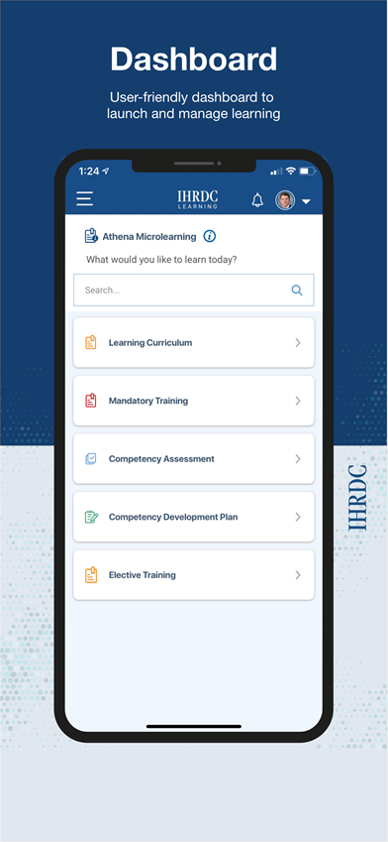
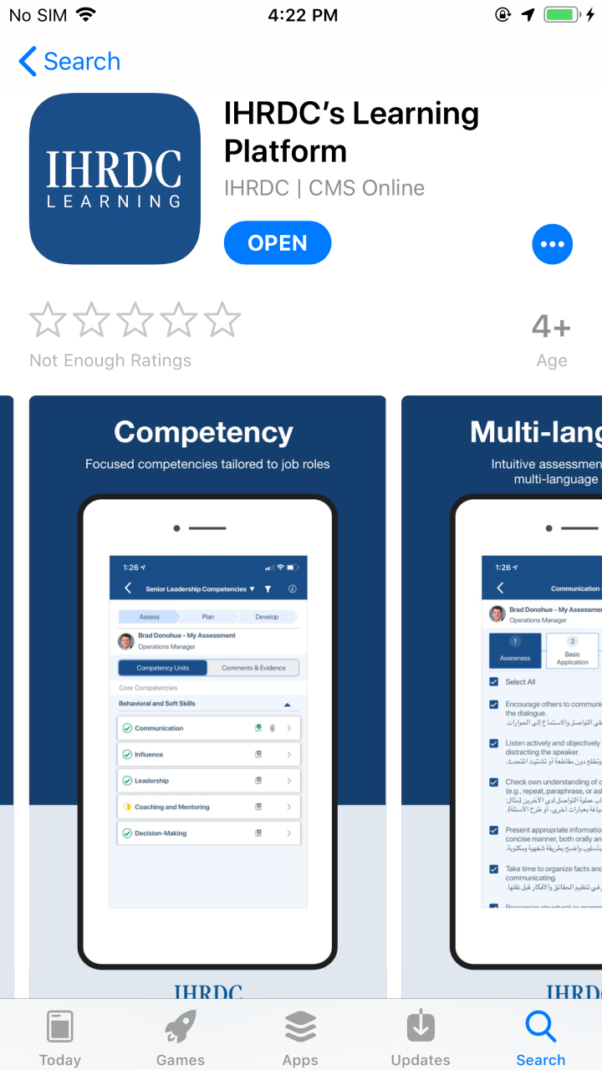
First, our big news:
Introducing IHRDC’s Learning Platform on iOS

Slide 3
4.24 Feature Updates – Quarterly Updates
CMS Online version 4.24 was released on March 21, 2022. New features include:
Feature | Description
Login Security and Performance | Implemented speed improvements as well as reCAPTCHA: an additional layer of security for all clients/instances not using SSO.
Report Performance Improvements | In response to client and internal input, we are focusing on improving the speed and performance of two management reports: Assigned Training and Training History.
Allow employee to attach file to Course Completion Acknowledgement request | When using course completion acknowledgement, this will enable an employee to attach evidence that can be viewed by the approving 3rd party
Separate evidence upload from course completion date | Allows an employee to upload a file related to a course, without using it to record a completion date
e-Learning Completion Certificate Access | Added a link to e-Learning course completion certificate in My Reports>Training History
Advanced Reports | We are retiring our Advanced Reports built using Izenda business analytics, and rebuilding them with the powerful capabilities in Power BI
Competency Role Builder Family Page | We added a grid page to the competency role builder – role family page, to improve searchability and simplify the view of competency roles.
Modify Nightly Query and Create change log | We are adding a change log to capture Supervisor updates made in client data feeds. This will enable us to report on any changes made.

Slide 4
Login updates

Slide 5
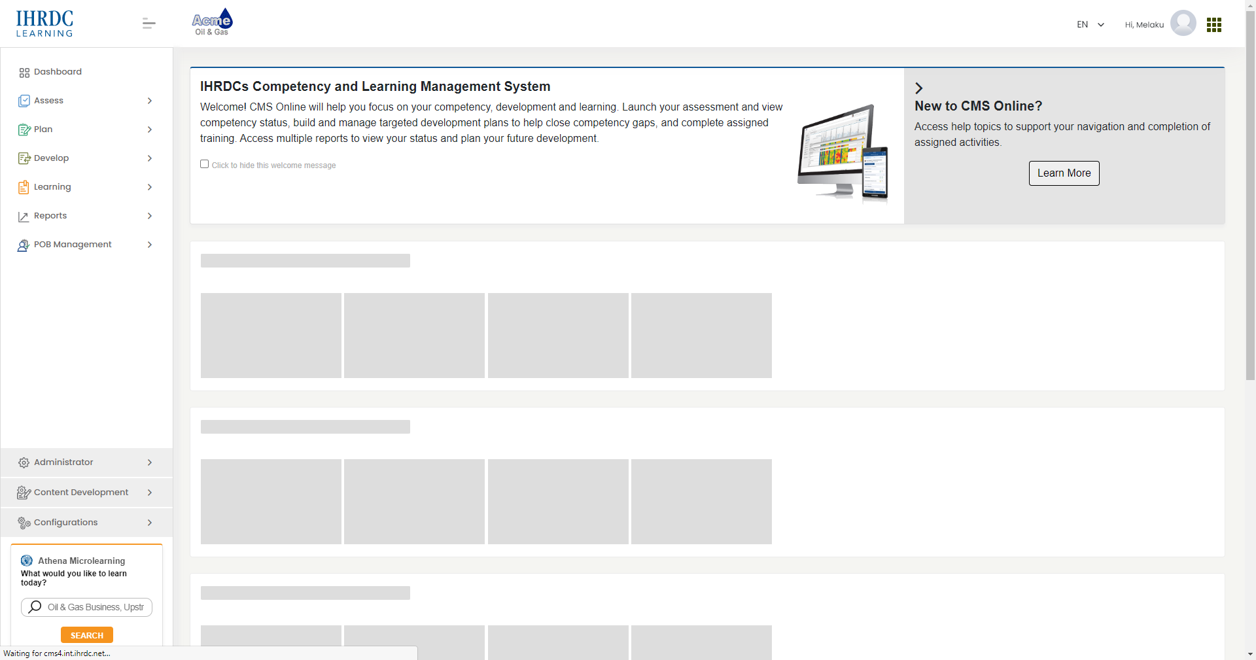
Login Updates
We implemented speed improvements in the login process and added a strong layer of security with reCAPTCHA
Key Features include:
Login speed
reCAPTCHA security added
ReCaptcha V3 is the newest type of captcha
Invisible to most users: does not require the user to complete any tasks
Configuration setting to turn reCAPTCHA on/off
“skeleton” loading on dashboard

Slide 6
Management reports performance improvements

Slide 7
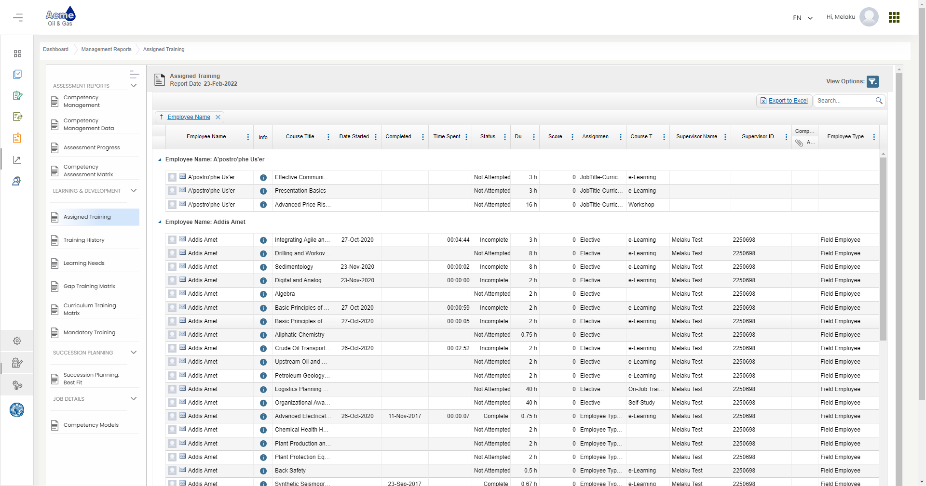
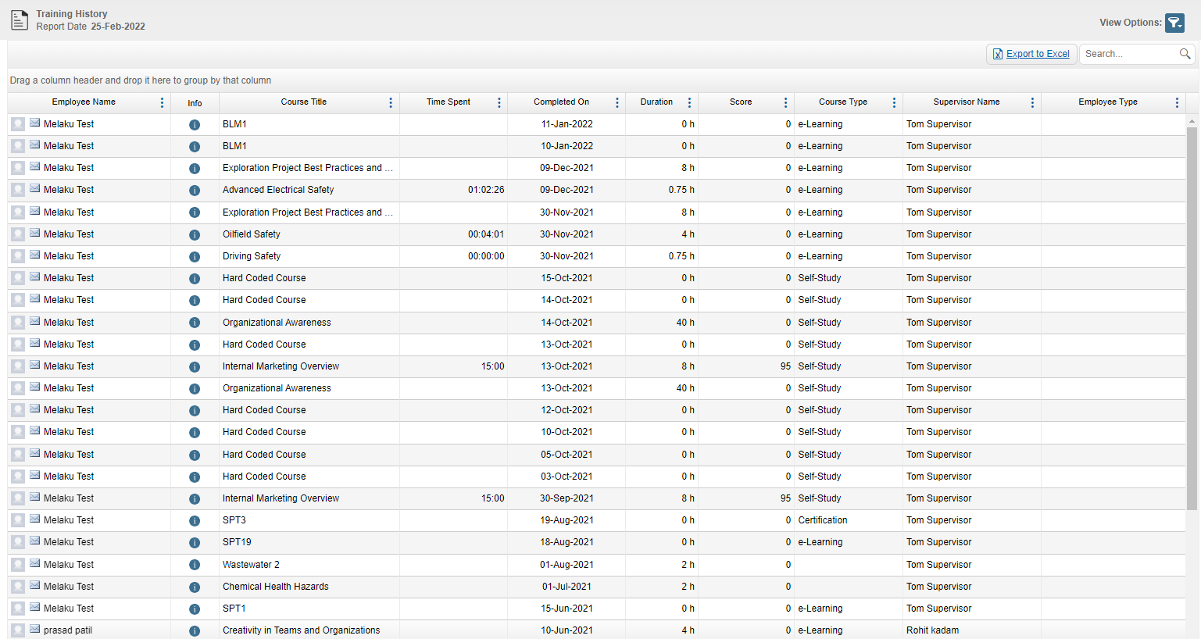
Improved Report Performance
We implemented performance improvement measures to two of our management reports: Assigned Training and Training History
Key Features include:
Assigned Training improved loading speed by 24 seconds (previous avg 28 seconds, currently 4 seconds)
Training History loads in 2 seconds
Implemented “skeleton” during loading
Additional Training History updates:
ungrouped Name field
Sorted report by most recent record first
Added column for completion evidence attachments

Slide 8
Separate evidence upload from course completion date

Slide 9
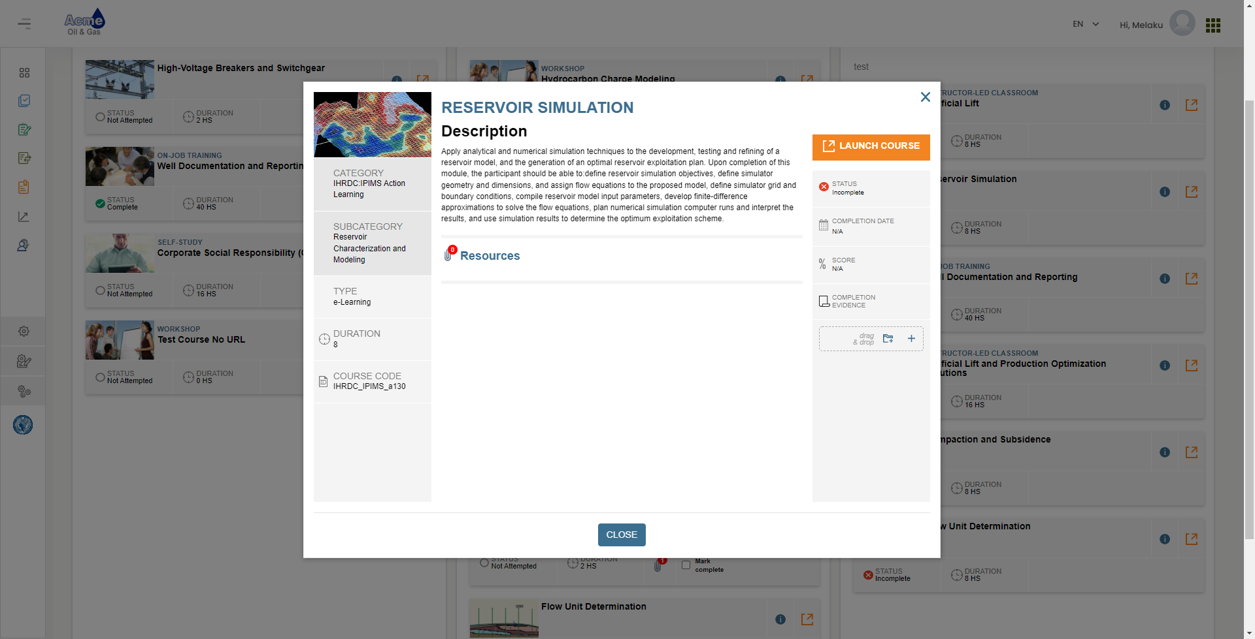
Separate Evidence Upload from Course Completion Date
We have separated completion evidence upload from employee-submitted completion date. Learners can submit completion evidence without changing completion status.
Key Features include:
In Normal status, employees can submit completion evidence, but not a date
In Checkbox Completion status (Learning Curriculum only), employee can submit completion evidence and update completion status*
In 3rd Party Acknowledgement status, employee can attach a file to acknowledgement request to 3rd party
*Note: Only for a course in Learning Curriculum. Checkbox Completion is not available via My Reports, Mandatory Training page, or Elective Training

Slide 10
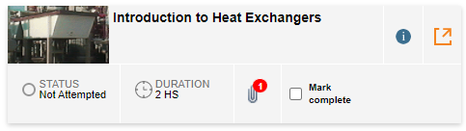
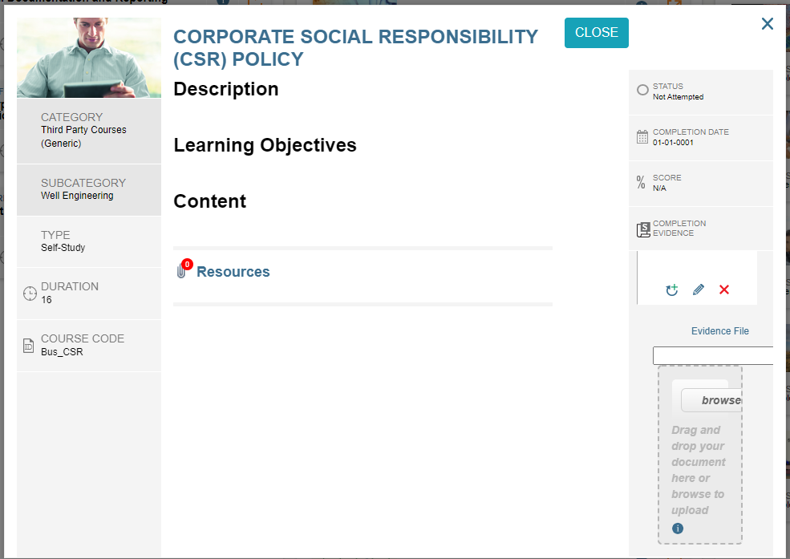
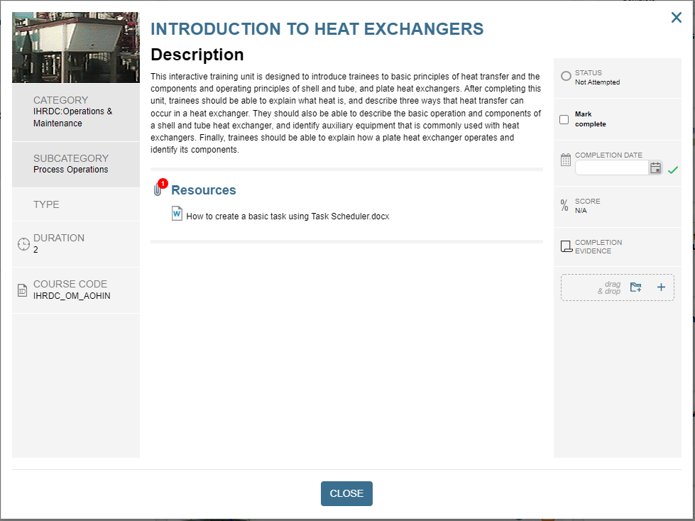
Learning Curriculum View
Views will differ when a course completion is set to “Normal” and “Checkbox Completion”
Course completion = Normal
Click info icon to open course info and upload evidence file
Completion date is read-only
Course completion = Checkbox Completion
User can check Mark complete box from curriculum page
Click info icon to open course info and upload evidence file or edit the completion date

Slide 11
Attach file to course completion acknowledgement

Slide 12
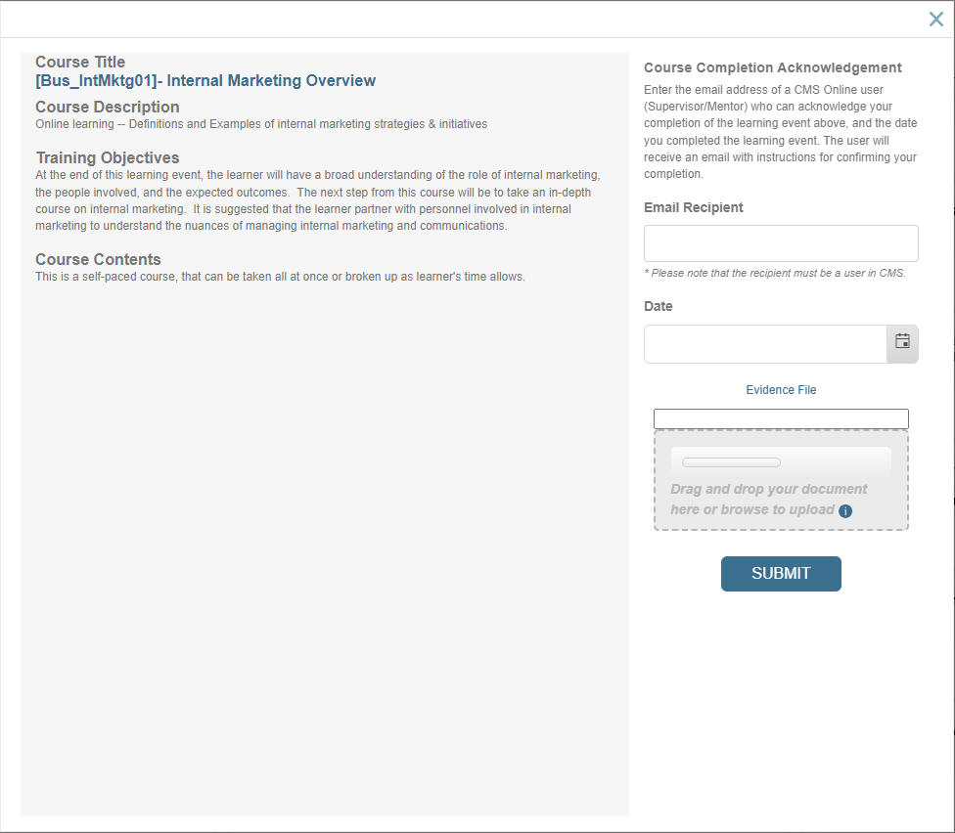
Employee Attach File to Course Completion Acknowledgement Request
Employee can upload a single file attachment that can be viewed by the person acknowledging course completion
Key Features include:
Optional action
Employee can select a single file to upload as attachment
Email recipient/acknowledger can view file attachment
File will be saved in Training History and Evidence reports

Slide 13
Course completion certificate

Slide 14
Course Completion Certificate
Learners can access completion certificates for IHRDC e-Learning courses in CMS
Key Features include:
Link to IHRDC completion certificate displays in My Reports>Training History when a course meets the following criteria:
IHRDC e-Learning
Status = complete
Score >/= 80

Slide 15
Power bi analytics

Slide 16
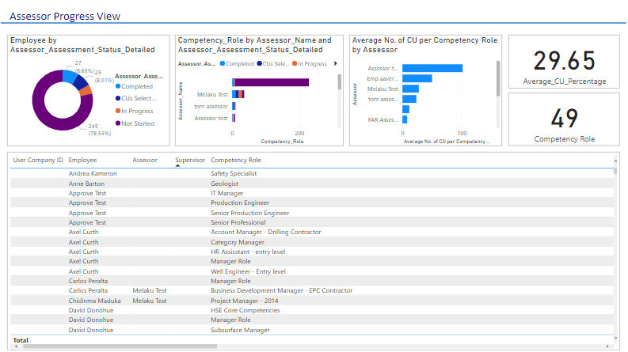
Power BI Analytics
We are retiring the Advanced Reports built using Izenda, and introducing new reports built using Power BI
Key Features include:
Powerful analytical tool
We have created reports to replace all current Advanced Reports
We will be working toward providing improved report views and utilizing the full capability of Power BI

Slide 17
Competency role builder – family page

Slide 18
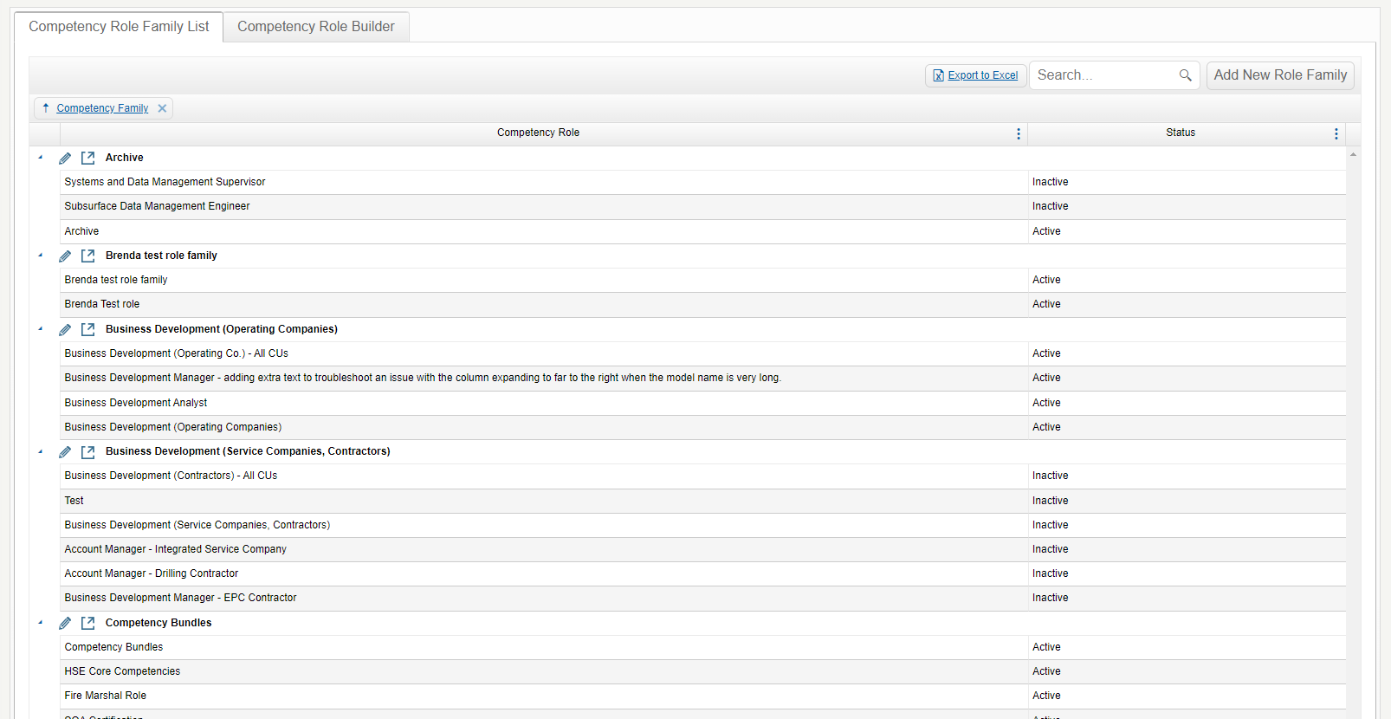
Competency Role Builder – Family page
We added a searchable competency role family page that displays all competency roles, within their role families
Key Features include:
Complements existing competency role family page
Search field returns results from family and role names
Hidden fields: date of most recent edit, name of most recent editor
Add new or edit existing role family
Launch JLR matrix for any role family

Slide 19
Enhancements and Bug Fixes
Important enhancements and bug fixes in this release include:
Reports:
Select Job Title button text too small on Success Planning Best Fit report
Succession Planning Best Fit report: Extra characters in Supervisor Name field
Learning:
Unable to open evidence attached on Mandatory Training page
Competency and Development:
Comments & Evidence popup: remove extra characters after header, change “cancel” to OK, make active, so popup closes after user clicks it
Assessor Assessment Planning: enable date format to follow format selected in configurations (had to remove time to enable this)
Assessor Assessment Select Cus grid: export to Excel not functioning
Admin Module:
User Links>Select Learning Curriculum Roles: remove double scroll bars
Unlock Assessment: no data in Supervisor Name column

Slide 20
Coming soon

Slide 21
Next Release – 4.25 Feature Updates
CMS Online version 4.25 will be released in June 2022. New features will include:
Feature | Description
Competency Role Builder: JLR Matrix | We are updating the JLR Matrix page to provide simpler navigation and improve user experience. The Excel export to provide a format that requires less manipulation prior to client review.
Refactor 2 Reports: Competency Management Data, Learning Needs | We are continuing to make performance improvements to key reports and pages within the application.
Reassign Assessment | Administrator can reassign an assessment for full reassessment.
Delete Assessment From User Account Detail | Administrator can delete an assessment directly from user accounts, under certain conditions.
Learning Resources: Prerequisite Course | This feature was available in 3x version. Allows content developer to specify a prerequisite course.
Learning Resources: Equivalent Course | This feature was available in 3x version. Course can be substituted for another course
Admin Change User Password | Administrator has option to change a user's password.
Users Confirm User Account Detail | Notification displays for a user, asking them to confirm detail in their My Profile.
Open User Account Detail in Separate Tab | Opening user detail from User Accounts page will open in another tab, preserving all sorting/grouping/etc. on the user account list.
Dashboard Updates - Mandatory Training | Design update on the dashboard, including updated icons, more information, new pie chart.
Assessor Assessment Enhancements | Clear link between Assessor Assessment PDF and fields available in plan and assessment.

Slide 22
Version 4.24
CMS Online
Quarterly Release Notes
March 2022
© Copyright 2022 International Human Resources Development Corporation

