Slide 1
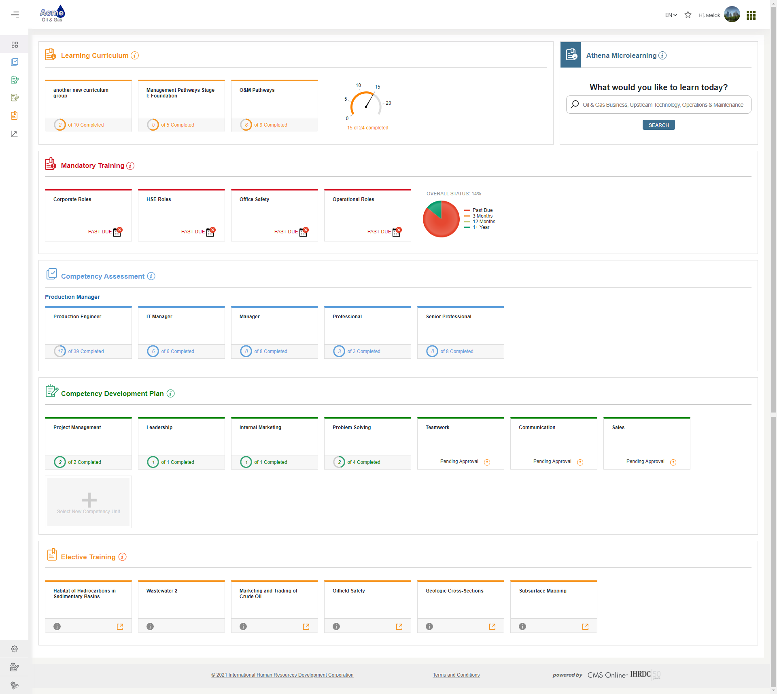
Version 4.21
CMS Online
Quarterly Release Notes
June 2021
© Copyright 2021 International Human Resources Development Corporation

Slide 2
4.21 Feature Updates – Quarterly Update
Version 4.21 was released June 18, 2021. We developed the following new features:
Feature | Description
Competency Unit Criticality Rating - enhancements | Clients can associate a passing percentage for competency units levels 1 & 2 with criticality rating; view criticality rating in Competency Development plan and Assessor Assessment.
Add Evidence Report to Employee Snapshot reports | We are adding to the suite of available reports in the Employee Snapshot. The Evidence Report will allow Viewer, Supervisor and Administrator users to see current and historical evidence uploaded throughout the assessment and learning processes.
Learning Curriculum Updates | Updated the look and feel of the Learning Curriculum and changed how total number of courses are counted when a curriculum role is locked.
System Speed Improvements | We are focusing efforts on analyzing and improving the login speed into the web application, as well as performance of matrix reports
Administrator Updates | We refactored the user accounts grid, updated the bulk user import, added some time-saving search options, and gave Administrators the ability to activate an inactive assessment and upload to the Document Repository
Additional Enhancements | We added language translation to the minimum competency level popup, added course equivalency option, added responsive design to additional pages, made the support URL inside a client instance configurable, updated report calculations

Slide 3
Criticality rating

Slide 4
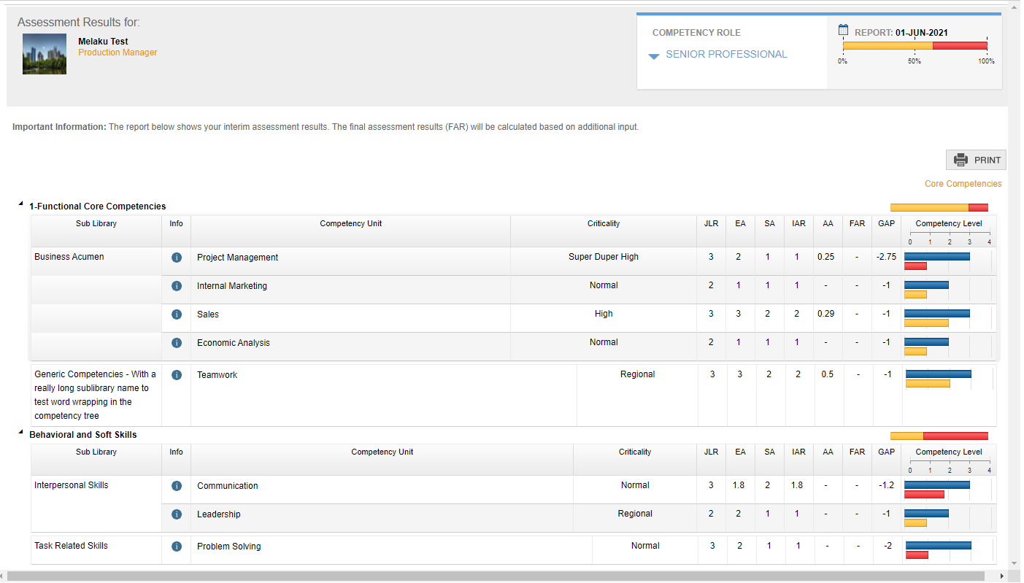
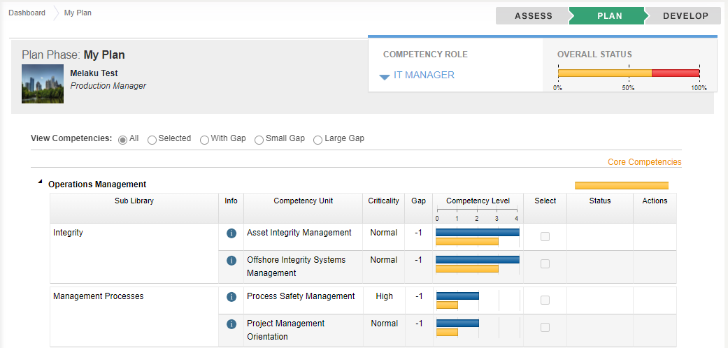
Criticality Rating Enhancements
We added the option to associate a competency unit level 1 & 2 passing percentage with criticality rating. Specific criticality competencies can have passing percentage that differs from the default selected by the organization.
Key Features include:
Choose any passing % to associate with a criticality
Criticality can be used with or without associated passing %
Criticality Rating field added to:
My Plan/My Mentees’ Plan/My Employees’ Plan
Assessor Assessment
My Reports> Assessment Results

Slide 5
Add evidence report to employee snapshot

Slide 6
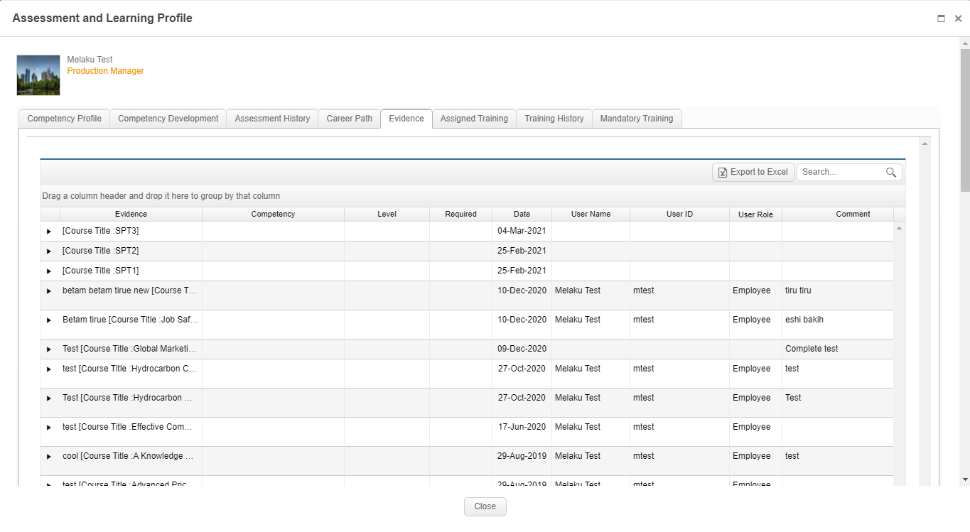
Add Evidence Report to Employee Snapshot
We enhanced the suite of reports available in the Employee Snapshot, by adding Evidence report.
Key Features include:
Enables Supervisor, Viewer and Administrator access to the report
Displays full history of evidence submitted
Displays who submitted the evidence

Slide 7
Learning curriculum updates

Slide 8
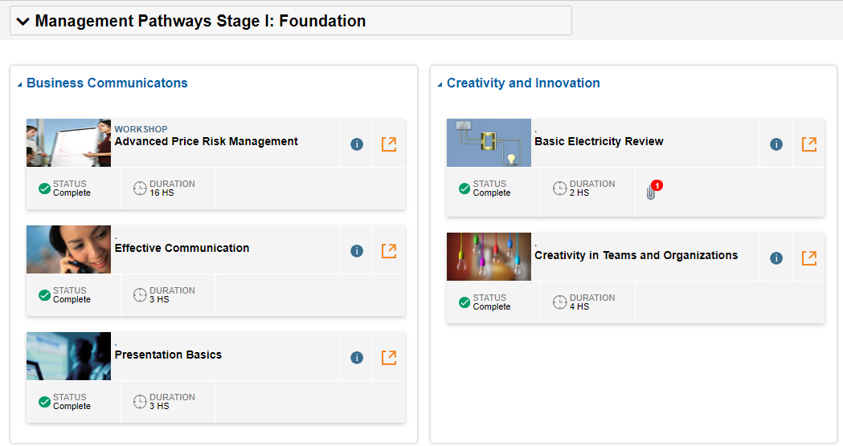
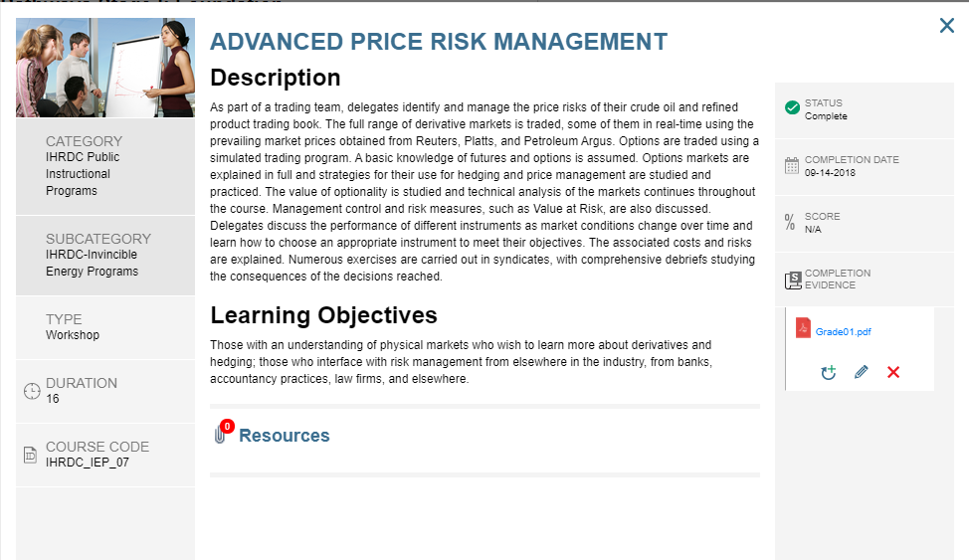
Learning Curriculum Updates
We improved the look and feel of the learning curriculum feature and updated how we calculate number of courses completed.
Key Features include:
Locked curriculum roles excluded from total on dashboard
Streamlined course information displayed on curriculum page
Enabled client-selected thumbnails to display for select courses
Updated the course information popup
Added new email trigger: Curriculum Role has been Unlocked

Slide 9
Administrator updates

Slide 10
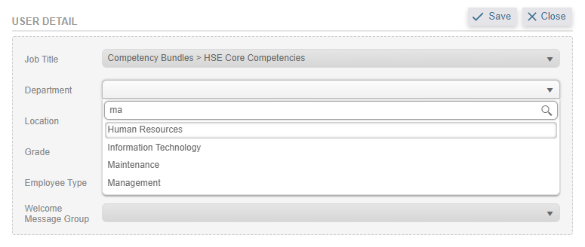
User Accounts Updates: Users List
Refactored grid to improve speed, separated inactive users from active, improved the search functionality in user account detail drop-downs
Key Features include:
Separated Inactive Users from Active Users
Refactored grid to improve speed
Added Login ID to User Accounts grid Active Users list
Added easier search to dropdown lists in User Detail
Fixed fonts, color and alignment on user accounts

Slide 11
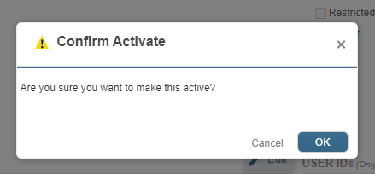
User Accounts Updates: Activate an Inactive Assessment
Gives Administrators the option to reactivate an assessment that was intentionally or accidentally inactivated.
Key Features include:
Saves time from raising a support ticket
Toggle from inactive to active

Slide 12
User Accounts Updates: User Bulk Import Improvements
We added fields to the bulk user import template, to better align with available fields
Fields Added:
Salutation
Middle Name
Work Phone
HR Job Title
User Account Expiration Date
Nationality
User Company ID
Supervisor Email
Mentor Email
Job Title
Department
Location
Grade
Employee Type
Welcome Message Group
Client-Defined ID
Learner ID

Slide 13
Company Settings Updates: Lists and Links
We added an improved search feature in Create User Links and a System List Bulk Upload option for single-tier lists
Key Features include:
Scroll or start typing in dropdown search
Saves time when working with long lists
Bulk Import single-tier lists:
Department
Grade
Shift
Team
Location
Fixed where unable to delete user link to competency role in manage user links

Slide 14
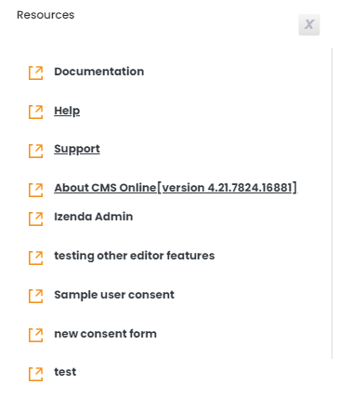
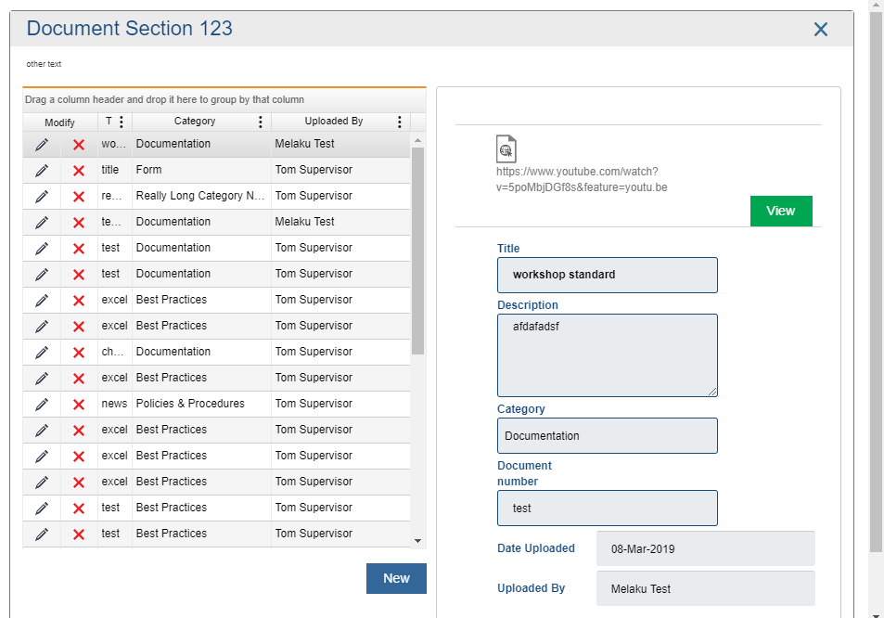
Administrator Access to Upload to Document Repository
We added the ability for Administrators to upload, edit and delete documents from the Document Repository
Key Features include:
Content Developer permissions no longer required to upload
Manage the repository content viewable by all users

Slide 15
Additional Enhancements and bug fixes

Slide 16
Enhancements and Bug Fixes
Important enhancements and bug fixes in this release include:
Learning:
Course equivalency: users can get credit for course completion when completing an equivalent course (managed in database for now)
Fixed Elective Training display issue
Competency and Development:
Added ability to translate minimum level required popup message
Fixed alignment in Comments & Evidence section when evidence is specified
Fixed calculation on My Mentees’ Plan so % of plans does not exceed 100%
Administration/Content Development:
Competency Role Builder: added column definition to distinguish between competency roles
Made the Support URL inside a production instance configurable
Reports:
Added responsive design to multiple reports to improve mobile view of the web application
Competency Management Report: Recalculated histogram mean percentage
Training History Report: added column “Acknowledged By”

Slide 17
Coming soon

Slide 18
Next Release – 4.22 Feature Updates
CMS Online version 4.22 will be released in September 2021. New features will include:
Feature | Description
Secondary Supervisor | A limited-authority supervisor can complete a Supervisor Assessment for a specified portion of an assessment.
New Report: Competency Management | We are adding a new report to Management Reports that will display full assessment data in a grid that can be filtered and manipulated by clients
Notification Field | We are adding a field that allows Administrators to customize mobile in-app notifications. This is our first step toward in-app notifications in the web application.
Career Development | Employees can add to and maintain a history of developmental goals.
Mandatory Training Assignments | We are adding the option to link Mandatory Training roles to competency roles.
System Lists | We are updating how we create list items, to make it easier and more efficient to set them up.
Training Matchup Design | We are focusing on the analysis and design of our Training Resources Matchup feature, with the goal to simplify and create efficiency in how we match learning events to competency units

Slide 19
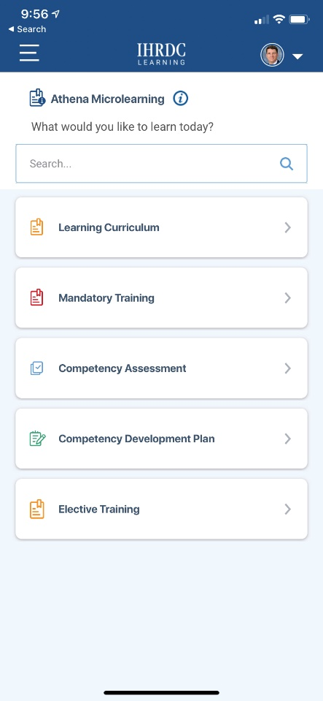
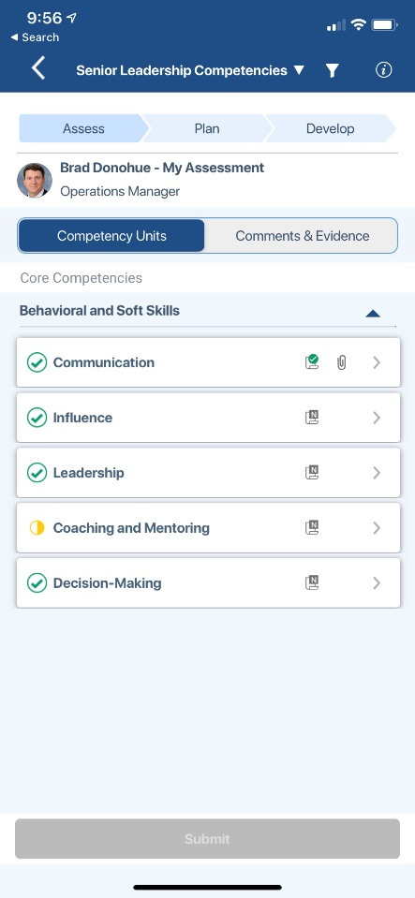
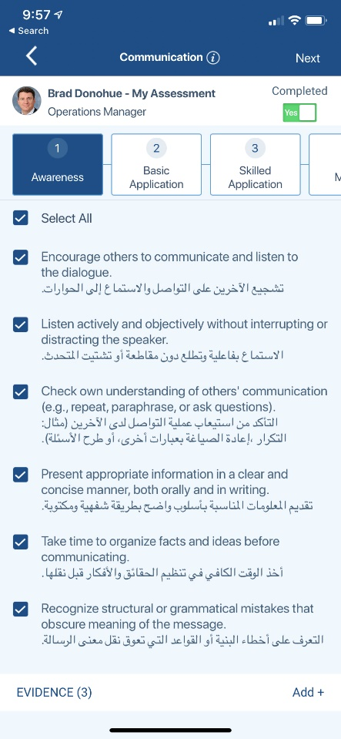
CMS Online Mobile App
We have been developing native mobile apps for CMS Online. The iOS app will be released soon. The Android app will be a few months behind.

Slide 20
Version 4.21
CMS Online
Quarterly Release Notes
June 2021
© Copyright 2021 International Human Resources Development Corporation

