Slide 1
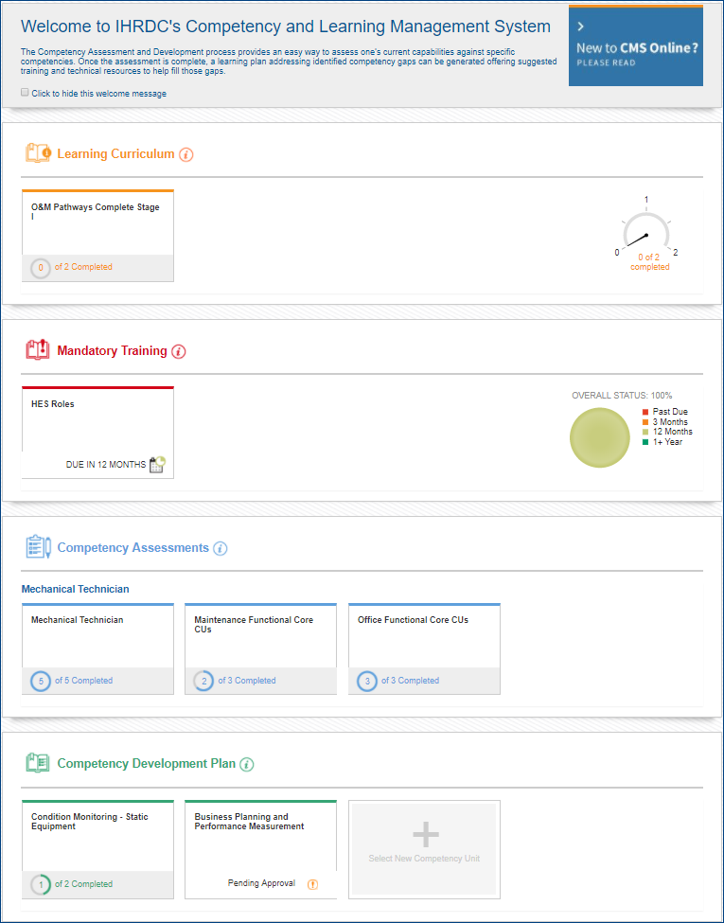
Version 4.7
CMS Online
Quarterly Release Notes
January 2018
© Copyright 2018 International Human Resources Development Corporation

Slide 2
4.7 Feature Updates – Quarterly Update
Version 4.7 was released on January 19, 2018 and includes the following new feature updates to CMS Online.
Competency Roles The introduction of competency roles enables greater flexibility in creating and assigning competency models. As an alternative to direct assignment of one competency model per job title, smaller numbers of competency units may be grouped into roles and assigned to a job title. Thus, each job title can contain multiple competency roles
Job Description
We updated and streamlined our job description template to better reflect our clients’ needs
Assessment Completion Certificate
Employees may access, view and print a certificate of completion after each competency assessment is finalized
Access to Self-Help Portal from Resources menu
We added a link in the CMS Online resources menu for users to access our new self-help portal. The portal enables our users to access descriptions and screenshots of commonly used CMS Online functions.

Slide 3
Competency roles

Slide 4
Competency Roles
CMS Online 4.7 provides the increased flexibility our clients have sought when creating and assigning competency standards. The concept of Competency Roles introduces the ability for an employee user to be assigned more than one competency model at a time.
It enables a more manageable process for a project team by allowing small groups of competency units to be created and reused across multiple employees. The process becomes more manageable for employees, who can assess themselves against one or more small group of competencies at a time.
New Key Features include:
Build small competency roles that can be reused across an organization
Assign multiple roles to a single job title
Toggle among competency roles during assessment and within competency development plan
Display assessment results for each role independently

Slide 5
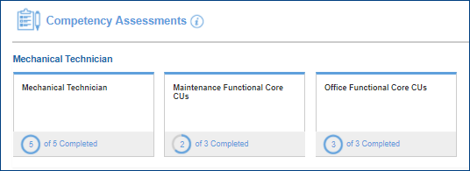
Employee Dashboard
Each employee user’s job title may be linked to one or multiple competency roles, according to organizational and individual developmental priorities.
Key Features
View and launch all active assessments
Displays separate status for assessments for each role
Complete assessments one role at a time, or all in one sitting

Slide 6
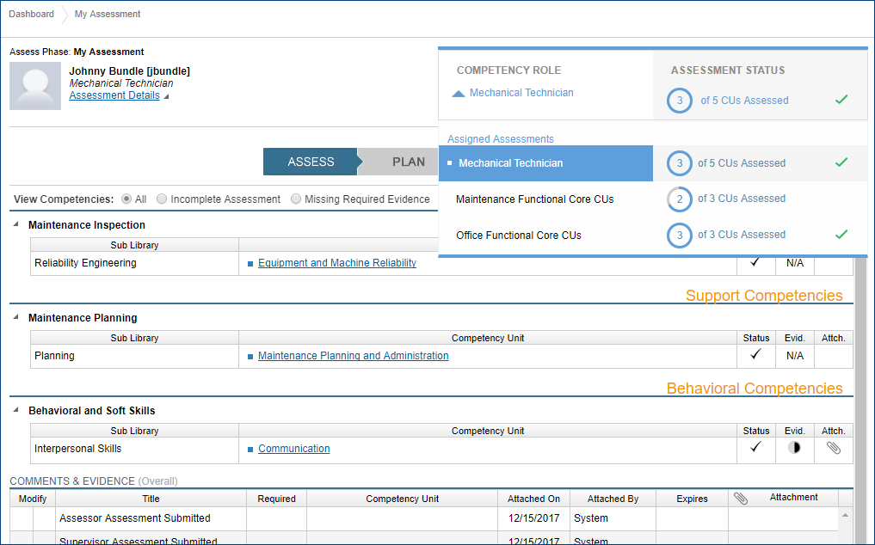
My Assessment
The My Assessment page allows employees to view status of all assigned competency roles, toggle between them, and assess against one or more competency role.
Key Features
View all assigned assessments with status
Toggle between assessments
Launch assessments

Slide 7
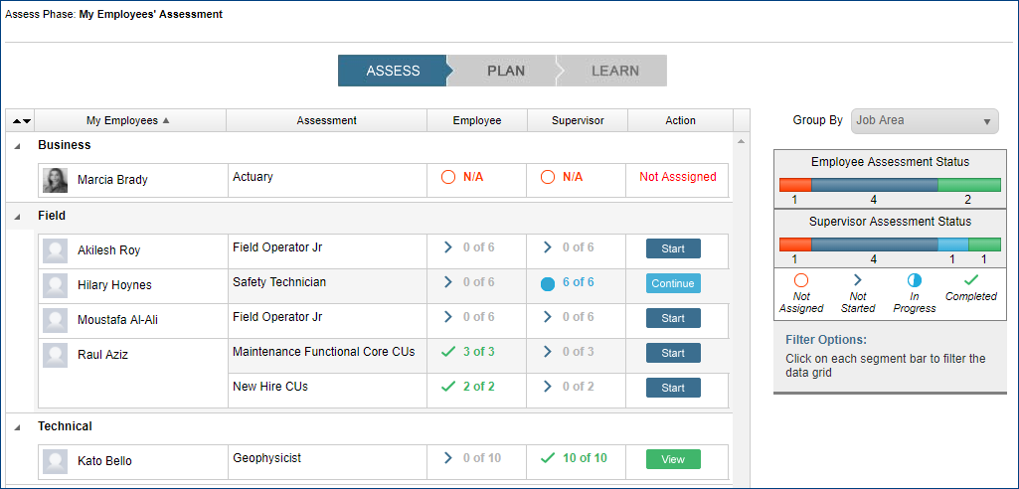
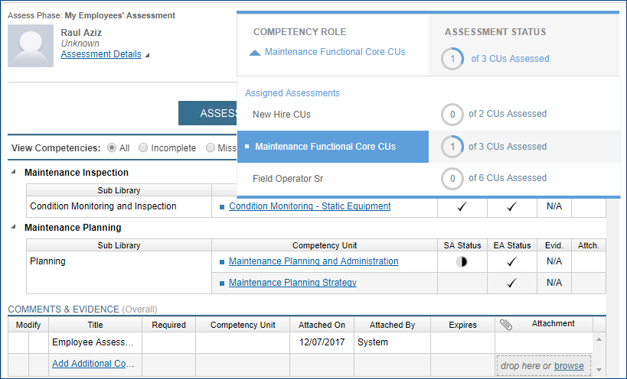
My Employees’ Assessment
The My Employees’ Assessment page allows supervisors to view status of all assigned competency roles and launch assessments against one or more competency role.
View group and individual status, and launch a supervisor assessment
Toggle between competency roles during assessment

Slide 8
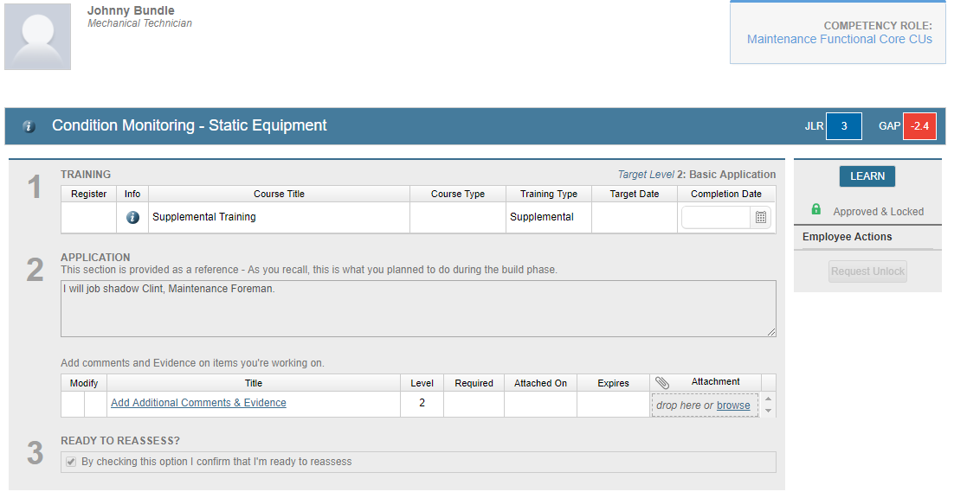
Competency Development Plan
Employees build competency development plans for CU’s within each competency role with a completed assessment
Toggle between completed assessments and select CUs
Build a competency development plan for prioritized CUs

Slide 9
Job description

Slide 10
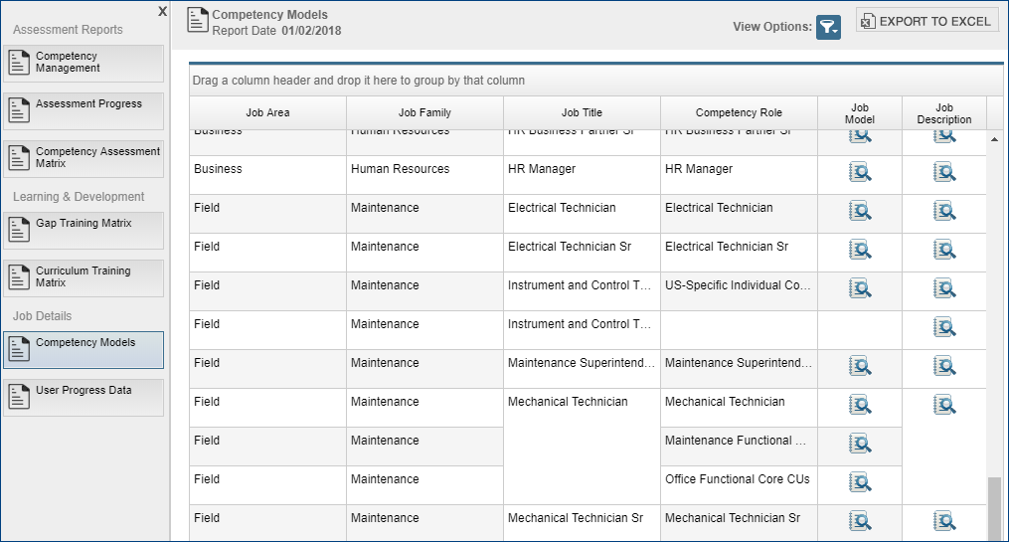
Job Description Editor
Job Description has been updated and streamlined. CM Developer – Write access is required to edit.
Key Features
View or edit job descriptions from Management Reports>Competency Models (dependent upon access level)

Slide 11
Job Description – Employee view
Key Features:
Employee users view from Reports>Job Description
Job description for an employee’s assigned job title displays

Slide 12
Assessment completion certificate

Slide 13
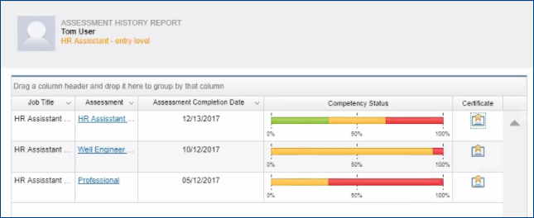
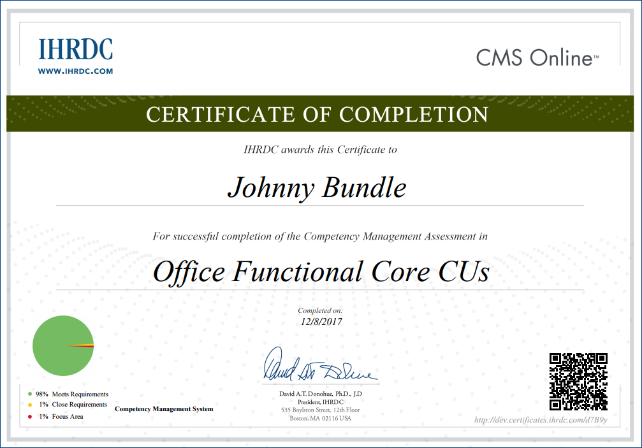
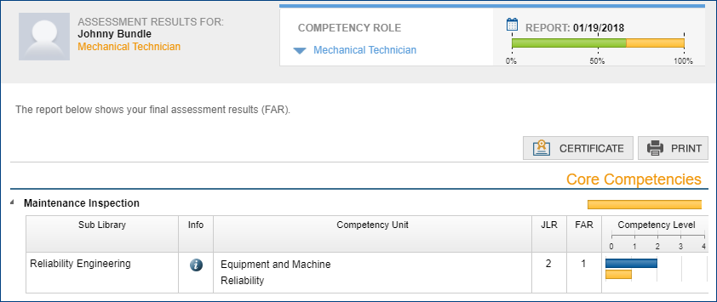
Assessment Completion Certificate
Employee users may view and print a certificate of completion after an assessment is finalized
Key Features
Link displays in Assessment Results and Assessment History after assessment is complete (has FAR)
QR code may be scanned to access certificate online

Slide 14
Self-help portal

Slide 15
Self-Help Portal
Introducing the new CMS Online Self-Help Portal! Access from the Help link in the Resources menu in CMS Online or directly at cm-support.ihrdc.com
Key Features
Click-by-click instructions for major functions
Topics arranged by function and user level
Administrators login to view content

Slide 16
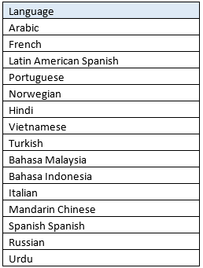
Next Release – 4.8 Feature Updates
Version 4.8 will be released March 2018 and will include the following new feature updates to CMS Online.
Multi-Language Interface As an international company, we recognize the need to deliver applications in multiple languages and are making a huge step in that direction. We converted the main dashboard page to a number of languages and will let users set their preferred language.
Email Notifications
We will add a small set of standard email triggers to CMS4 to enable emails to be sent when assessments and development plans have been completed by various users in the system.

Slide 17
Version 4.7
CMS Online
Quarterly Release Notes
January 2018
© Copyright 2017 International Human Resources Development Corporation

