Slide 1
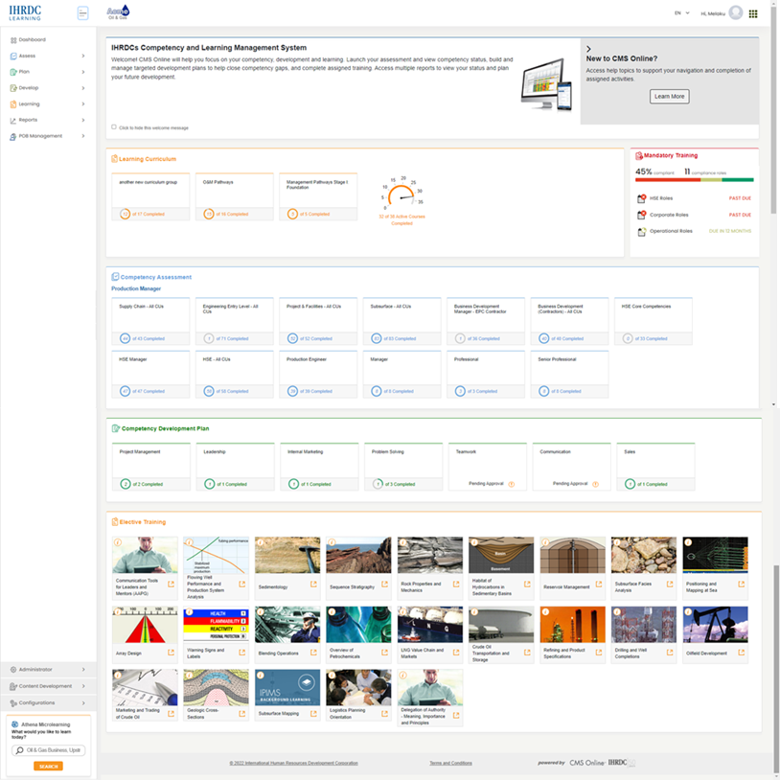
Version 4.28
CMS Online
Quarterly Release Notes
March 2023
© Copyright 2023 International Human Resources Development Corporation

Slide 2
4.28 Feature Updates – Quarterly Updates
CMS Online version 4.28 was released on March 15, 2023. New features include:
Feature | Description
Reassessment: Carry through Supervisor ticks | When an assessment is reassigned, all Supervisor Assessment ticks from previous assessment(s) are carried through.
Reassessment: Carry through evidence from previous assessment | When an assessment is reassigned, any evidence submitted during the previous assessment(s) is carried through.
Assessment Campaign - Send Email | Launch an email on-demand from within an assessment campaign
Auto-Assess from Assessor Assessment page | We added the option for Assessor to use Auto-Assess option after viewing interim assessment results.
Supervisor Bulk Update | We added Supervisor to the options available in Create User Links to allow Administrators to update multiple supervisor assignments at one time.
Restricted Viewer and Restricted Admin: add Company field to assignment options | We added Company to the options available for linking Restricted Viewer and Restricted Administrator to access specific user populations.
Training Matchup - next steps | Display Unmatched CU’s in separate table Display training matchups and evidence requirements in CU detail Complete matchups in CU detail
Learning Resources Categories Enhancement | Expand All/Collapse All added to Learning Resources categories page
Refactor Management Reports: Assessment Progress Report | Refactored report to improve loading speed
Refactor Assessment Campaign Selection Grid | Refactored page to improve loading speed

Slide 3
Reassessment: carry through information

Slide 4
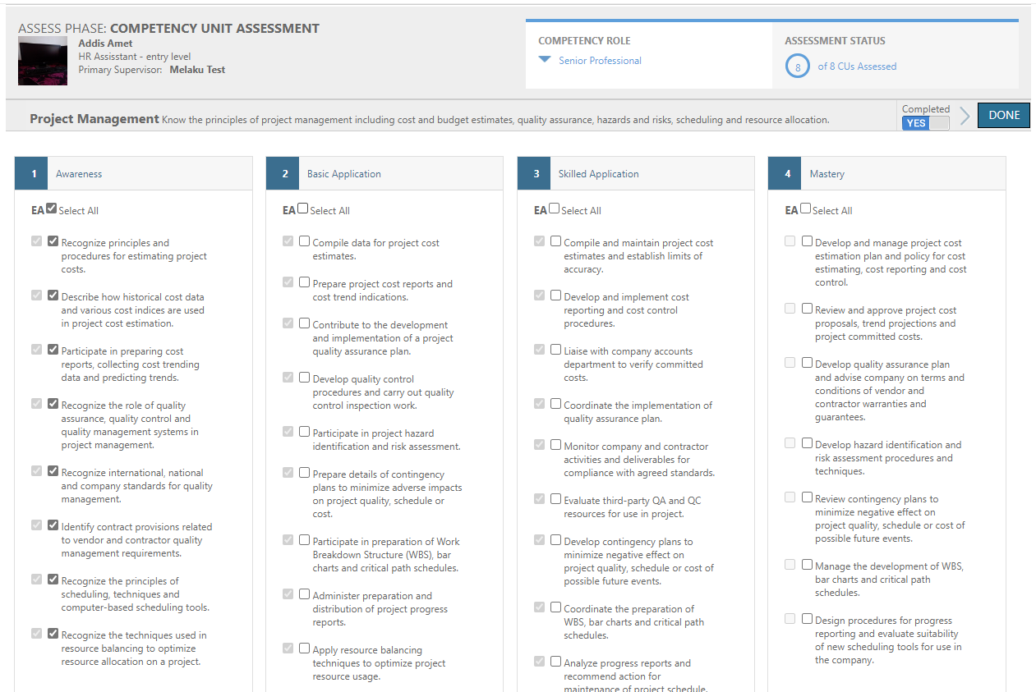
Carry Through Supervisor Ticks from Assessment
When an assessment is reassigned, all Supervisor Assessment ticks from previous assessment(s) are carried through.
Key Features include:
Supervisor ticks from previous assessment display in new assessment
Supervisor will see all ticks from earlier assessments

Slide 5
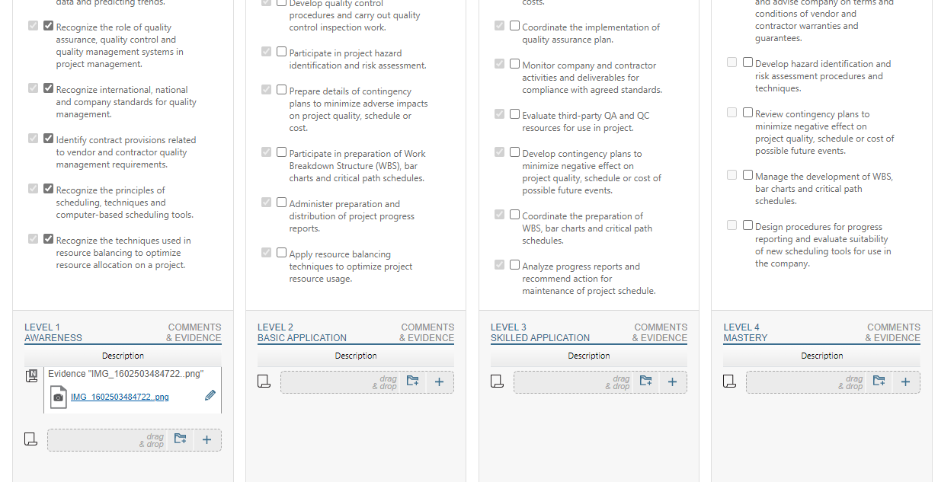
Carry Through Evidence from Assessment
When an assessment is reassigned, any evidence submitted during the previous assessment(s) is carried through.
Key Features include:
Evidence from previous assessments displays in new assessment

Slide 6
Auto-assess from assessor assessment

Slide 7
Auto-Assess from Assessor Assessment
Assessor can choose to Auto-Assess an assessment after reviewing an employee’s interim assessment results.
Key Features include:
Option available to Unrestricted and Restricted Assessors
Auto-Assess an individual employee’s competency role
Note: organizational guidelines should always be followed when selecting Auto-Assess
NOTE:
Auto-assess will apply to the entire competency role, ignoring any CUs selected by the Assessor.

Slide 8
administrator updates

Slide 9
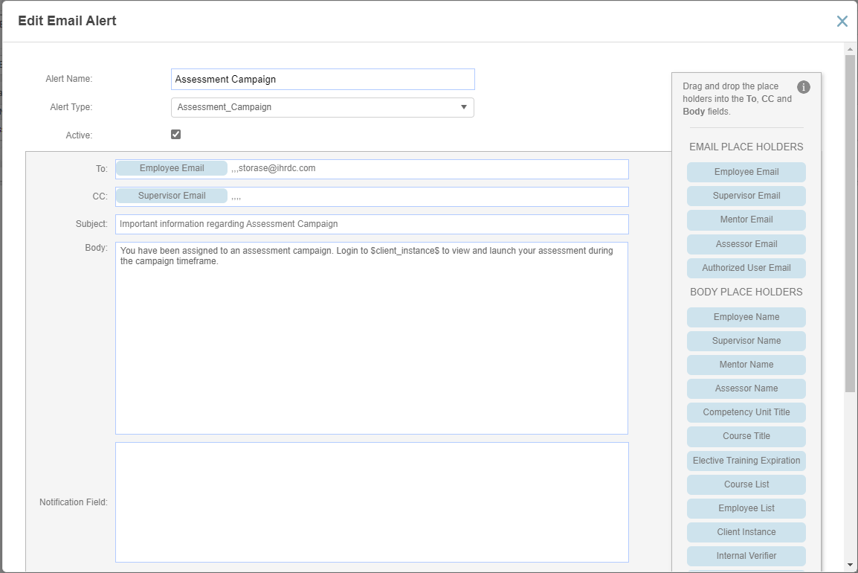
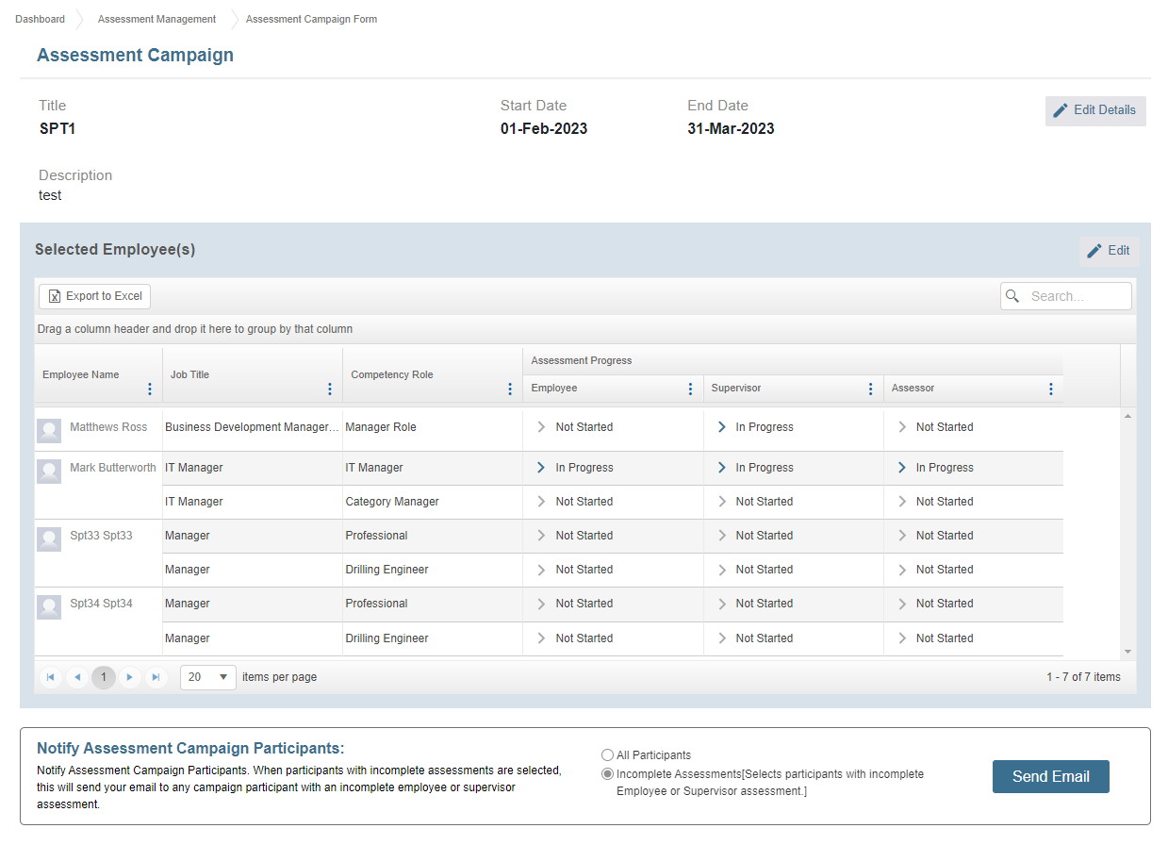
Assessment Campaign Email On-Demand
Launch an email on-demand from within an assessment campaign
Key Features include:
Admin can edit email content within Email Alerts
Email can be launched on-demand
Send to all campaign participants or those with incomplete assessments

Slide 10
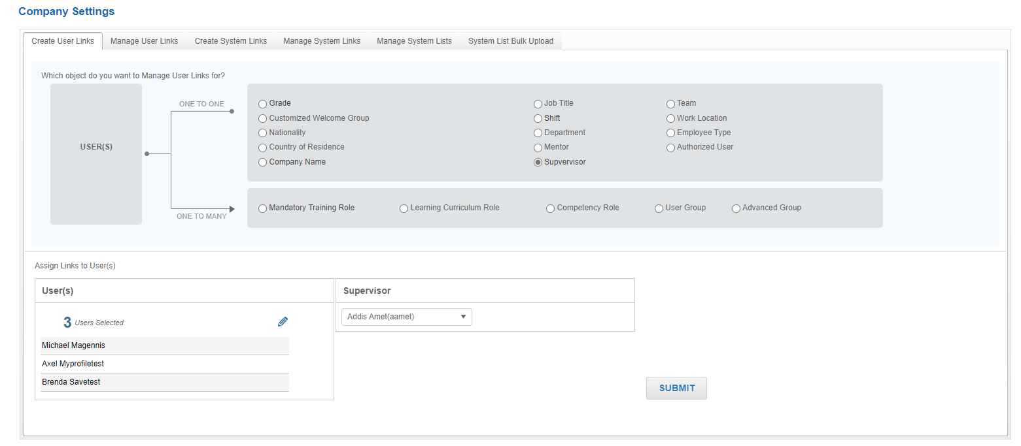
Supervisor Bulk Update
We added Supervisor to the options available in Create User Links to allow for multiple supervisor updates at one time.
Key Features include:
Assign Multiple Users to Supervisor

Slide 11
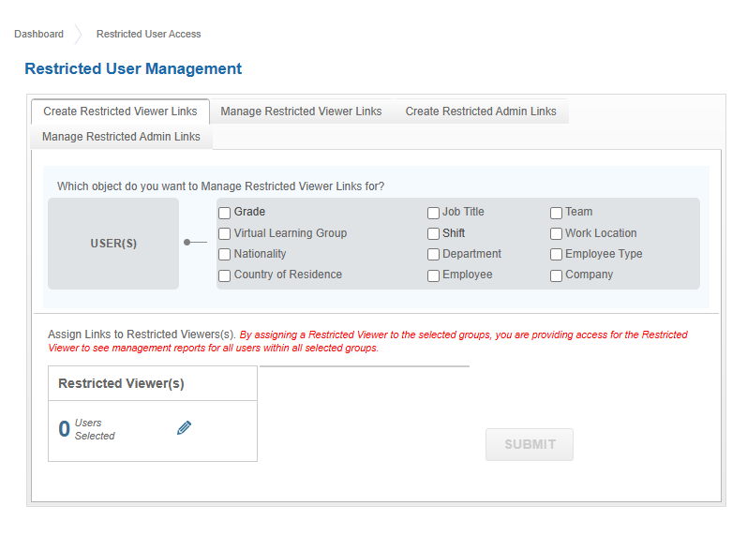
Use Company Field to Assign Restricted Users
We added Company to the options available for linking Restricted Viewer and Restricted Administrator to access specific user populations.
Key Features include:
Company field
Grid displays all Users

Slide 12
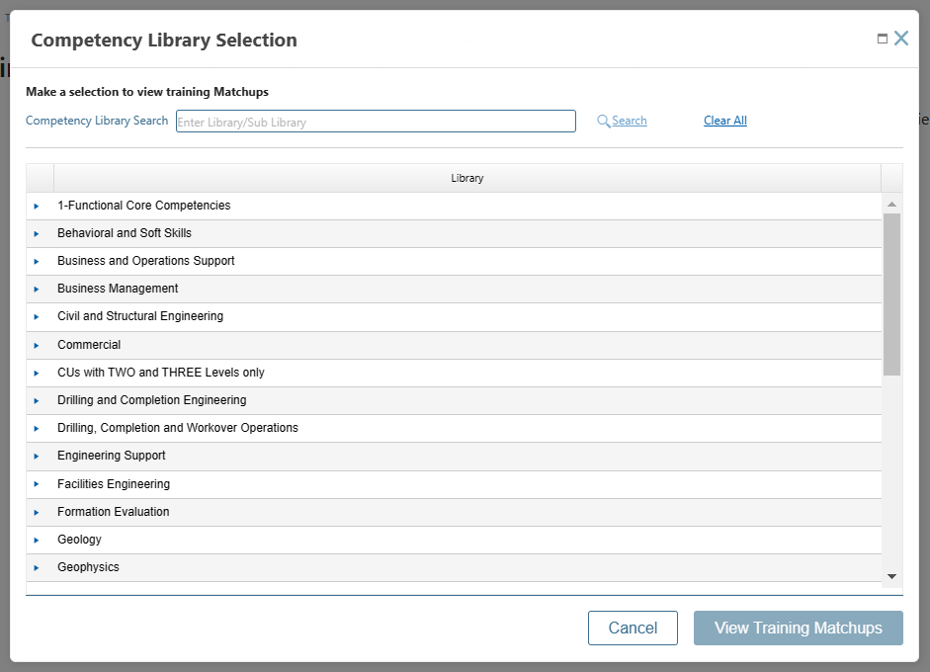
View of all training matchups
We are making the first step toward bringing Training Matchup functionality from 3x into 4x. We added a new page with view of all training matchups for all competency units (CUs)
Key Features include:
Select one or more sublibrary to view
Grid displays all courses matched to competency units
Displays match level for each course
CU detail and course detail available at info icons

Slide 13
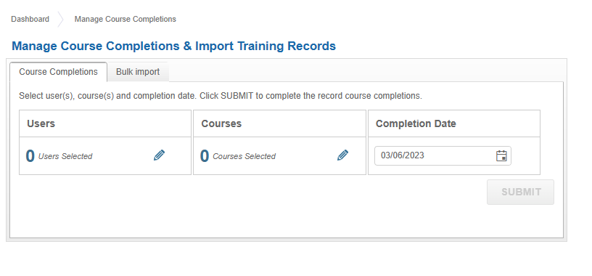
Manage Course Completions
We added a new option for Administrators to record course completions for one or more user at a time.
Key Features include:
Select User, Course and Completion Date
View completions in Training History report

Slide 14
Training Matchup

Slide 15
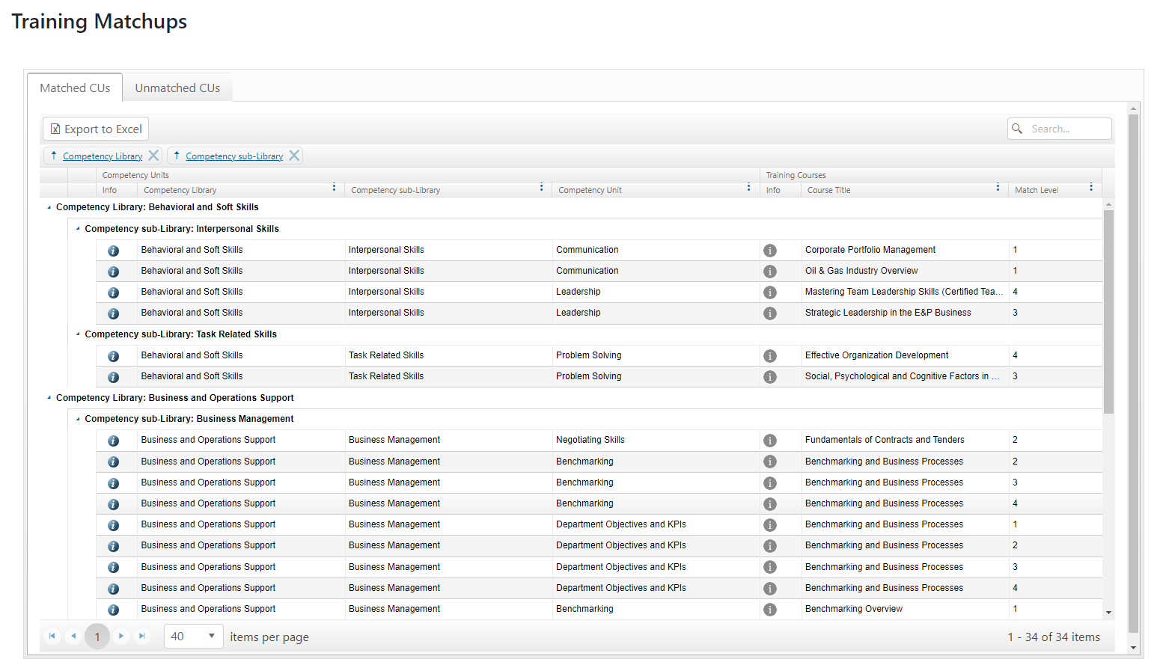
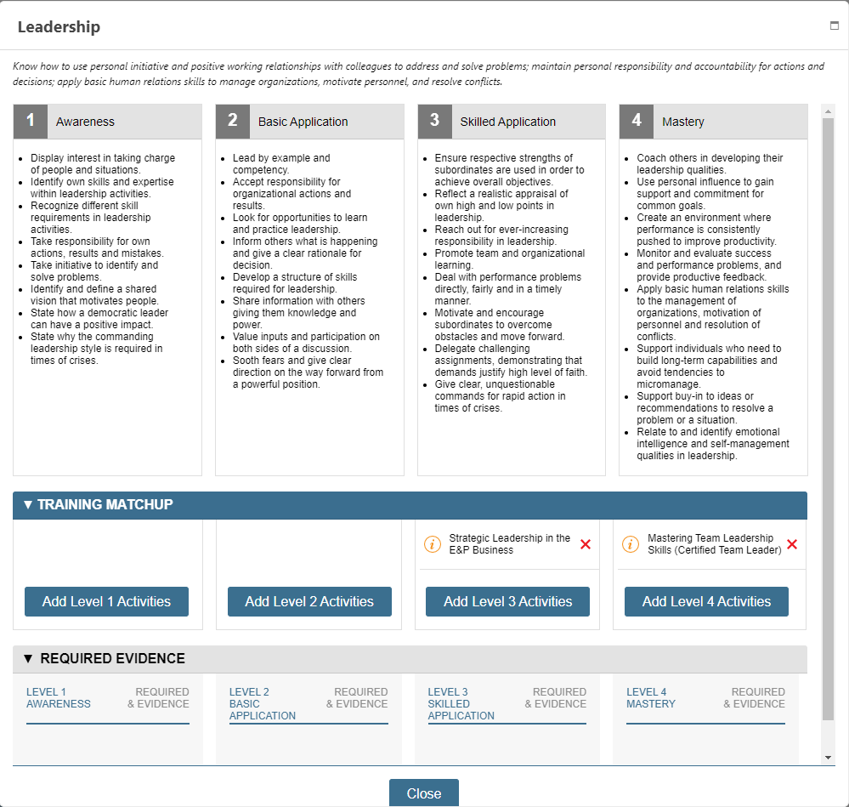
Training Matchup Enhancements
We are enhancing the view of Training Matchups and added capability to add new and edit existing matchups
Key Features include:
Separate tab for unmatched competency units (CUs)
CU view includes matchups and required evidence
Add a new matchup from CU detail

Slide 16
Learning resources categories update

Slide 17
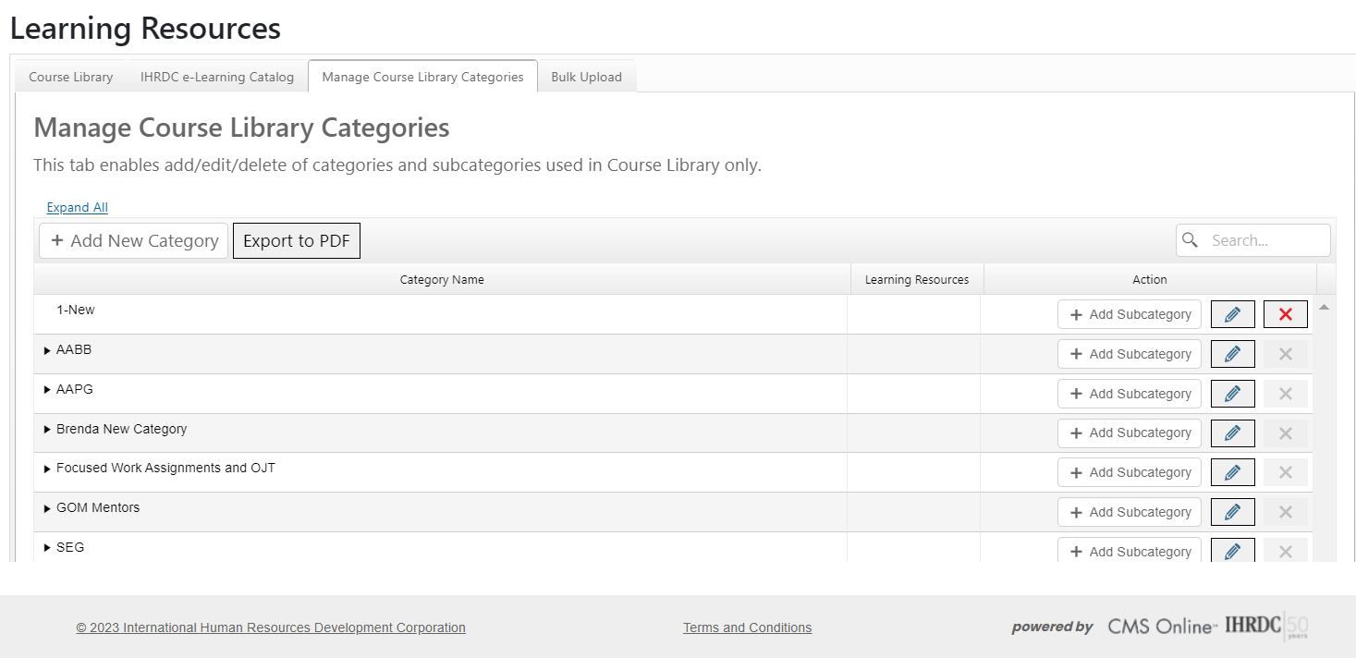
Added Collapse/Expand to Learning Resources Categories page
When working with Learning Resources Categories and Subcategories, the Content Developer can expand all/collapse all categories.
Key Features Include:
Page opens with all categories collapsed
Added Expand All and Collapse All

Slide 18
Refactor assessment progress report

Slide 19
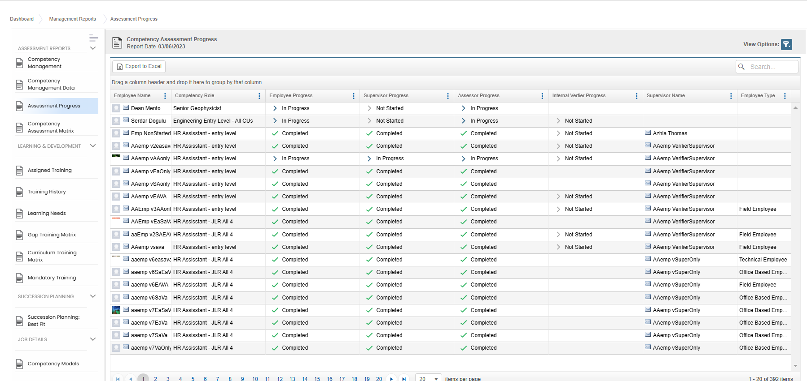
Refactor Assessment Progress Report
As part of our ongoing effort to improve the speed and performance of our Management Reports, we refactored the Assessment Progress report
Key Features include:
Improved build time from average 2 minutes, 30 seconds to 50 seconds

Slide 20
Enhancements and bug fixes

Slide 21
Enhancements and Bug Fixes
Important enhancements and bug fixes in this release include:
General:
Chrome and Safari load time optimized
Dashboard refactored for quick load
Mandatory Training not showing on dashboard
Reports:
My Reports:
display structure optimized
Evidence report white space corrected
Management Reports:
Interface alignment fixed for many Management Reports
Multiple display issues on Management Reports
Learning:
Styles for non-editable fields in course detail for IHRDC e-Learning course modified
Course Completion submission acknowledgment
Competency and Development:
Vietnamese characters not displaying properly in Primary Supervisor field
Submit button not displaying for EA and SA
Assessment Campaign:
Edit campaign takes too long to load sometimes doesn’t even load
After Editing campaign info and saving user lands on Unlock assessment tab
Reassess:
In reassess SA and AA, Next and Done functionality appears inconsistent
Incorrect ticks carry over when reassigning after a reassess
In reassess the AA previous ticks not loading
After reassess unlock - Employees assessment detail showing older ticks - Issue fixed
Assessor Plan popup on Internal Verifier page is blank
Assessor Management page - can't get to the bottom of the page

Slide 22
Enhancements and Bug Fixes cont’d
Administrator:
Inactive Competency Roles displayed in Job Title List
Create Restricted Admin Links: when you uncheck selections they don't get removed from the page
Editing Email Alert issue [Trigger]
Assessor Assignment: when use Select All and then deselect some employees, they were assigned
Move "Export to Excel button in criticality rating page to left so it's consistent with role builder page
Manage Course Completions - Laptop screen: When large number of users selected, the SUBMIT button can't be reached
Can't delete users/roles from assessment campaign
Content Development:
Grouping on Competency Role Builder and Criticality Rating Assignment tabs
In training matchup no way to unselect a selected CU, this may be an improvement more than a bug. Once a CU is selected can only add more CU to see training matchup for others.
Unable to save Learning Resources categories/subcategories
Select competency Library button display issue on training matchup screen
Criticality Rating export to Excel shows incorrect rating and is misaligned
Configurations:
Configurations>General Settings Select eLS Products/Disciplines fonts are incorrect

Slide 23
Coming soon

Slide 24
Next Release – 4.29 Feature Updates
CMS Online version 4.29 will be released in June 2023. New features will include:
Feature | Description
Competency Development Plan Expiration Date | Set a start and end date for a competency development plan.
Cascade Assessment Dates and Location in Assessment Plan | When Assessor builds a plan, the date and location selected for first CU will cascade to all others in the plan.
Keep Assessor Assignment after FAR | Option to maintain Assessor link to assessment after FAR.
User Account Detail: rearrange page elements | SAVE button is not visible when adding a new user and scroll to bottom of the page.
Internal Server Status Page | internal-facing IHRDC page to display any server status issues
Experiential Learning | New course type with a modified form to house a task list that employee can tick off. Route for approval
Add Fields to User Import Template | Adding more fields to bulk import template.
Supervisor Acknowledgement and Self-Acknowledgement for Course Completion | Content Developer selects completion option for learning event. Added 2 new options for course completion acknowledgement
Update My Plan page | Improve look and feel of My Plan
Allow Plan Development Prior to Assessment | This will allow an employee to build a competency development plan on Cus in a competency role that has not yet been assessed.

Slide 25
Version 4.28
CMS Online
Quarterly Release Notes
March 2023
© Copyright 2023 International Human Resources Development Corporation

