Slide 1
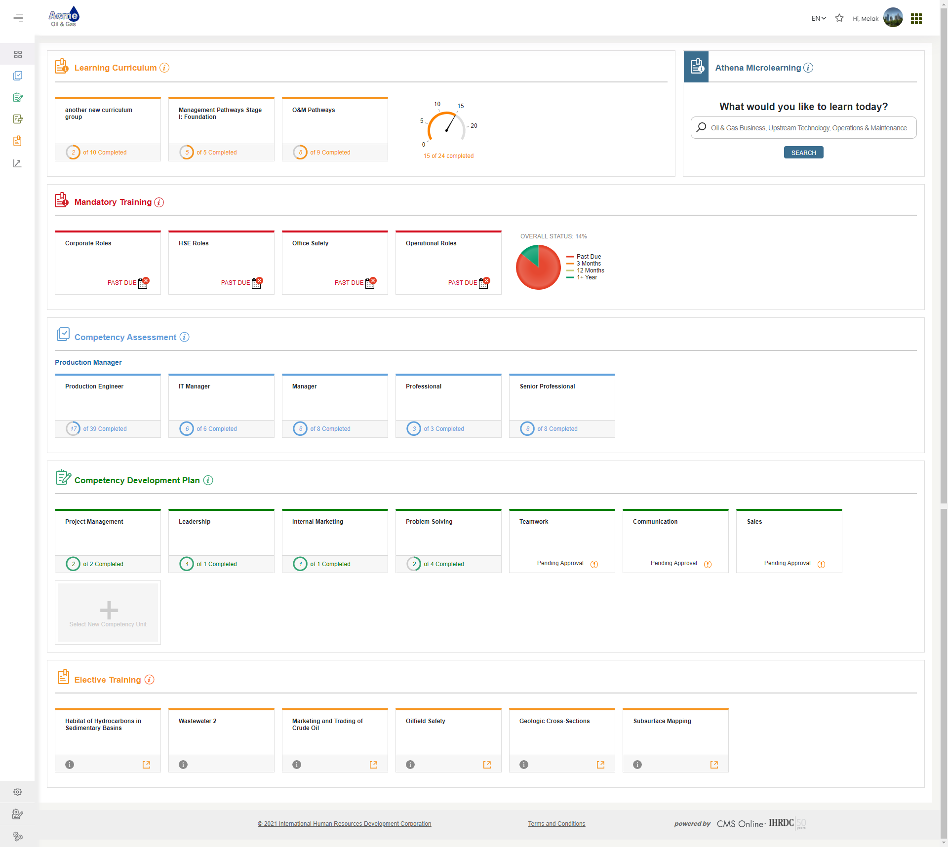
Version 4.20
CMS Online
Quarterly Release Notes
March 2021
© Copyright 2021 International Human Resources Development Corporation

Slide 2
4.20 Feature Updates – Quarterly Update
Version 4.20 was released March 12, 2021. We developed the following new features:
Feature | Description
User Interface Enhancement | UI theme update! Updated the menu functionality including left navigation and top nav bar.
Email Alert Updates | Separated batch-processed emails from trigger-based email alerts, brought the Mandatory Training batch email alerts into our 4x code, added the bcc field to Custom Email options, and added Authorized User to the place holder options in trigger-based email alerts
Course Completion Option | We added an option for a Content Developer to enable a simple checkbox for an employee to record course completion. This is available as an alternative to the employee-submitted course completion evidence
Alert Learner when Learning Event has Attachment | When a learning event has one or more file attachment, such as checklists, PowerPoints, and other supporting materials, an icon will display to alert a learner that attachments are available
Competency Unit Criticality Rating | Introduced the ability for clients to define criticality ratings for the organization and assign them to competency units built into competency roles. In our next release we will add the ability to modify the assessment calculation based on criticality.
Additional User Account Fields | The User Account detail page has been updated with more fields so that clients can track additional data.
Enhancements and Bug Fixes | We implemented multiple enhancements and bug fixes to improve the look & feel and functionality of the application

Slide 3
User interface Enhancements

Slide 4
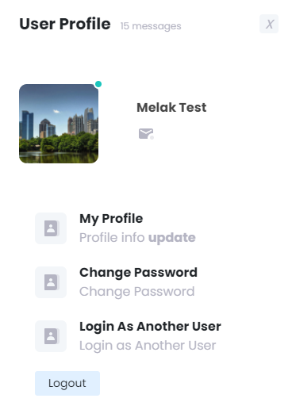
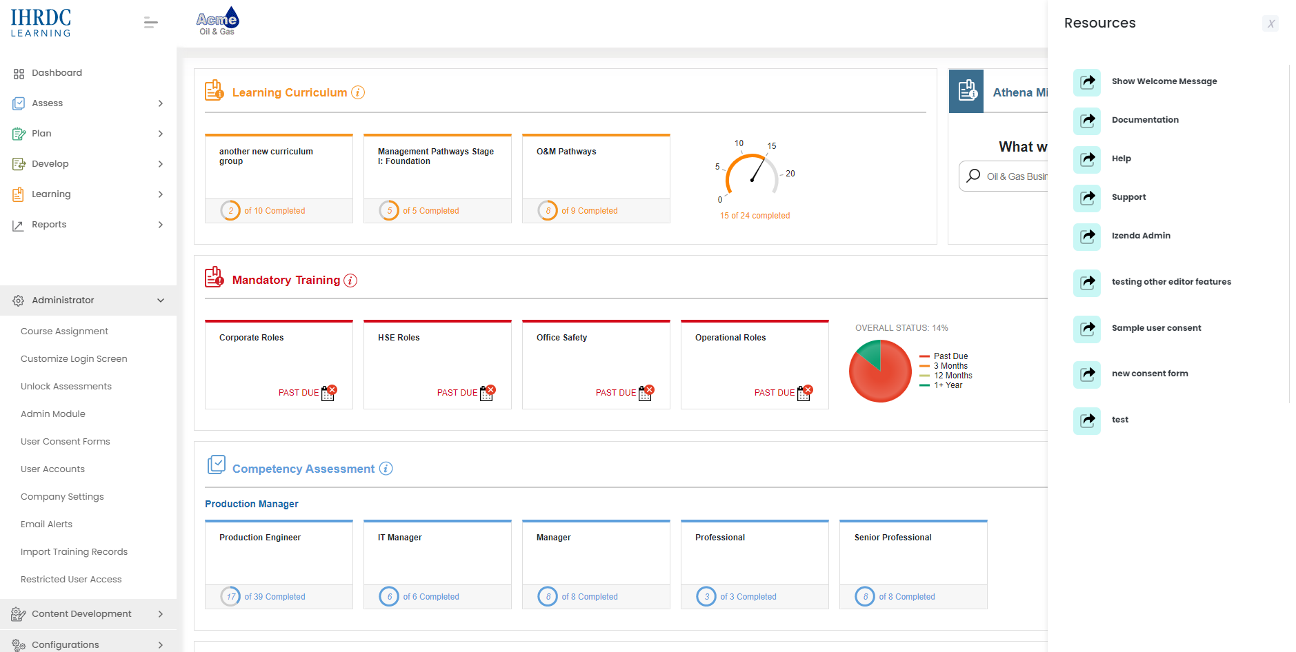
User Interface Enhancements – Header/Footer/Menus
Key Features include:
New header and footer
Modified responsive left navigation menu
Updated resources and profile menus

Slide 5
Email alert updates

Slide 6
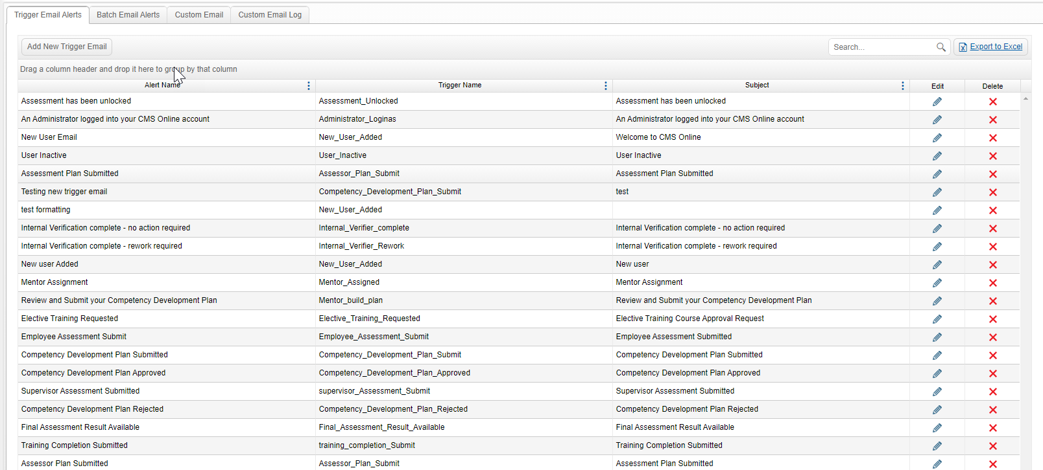
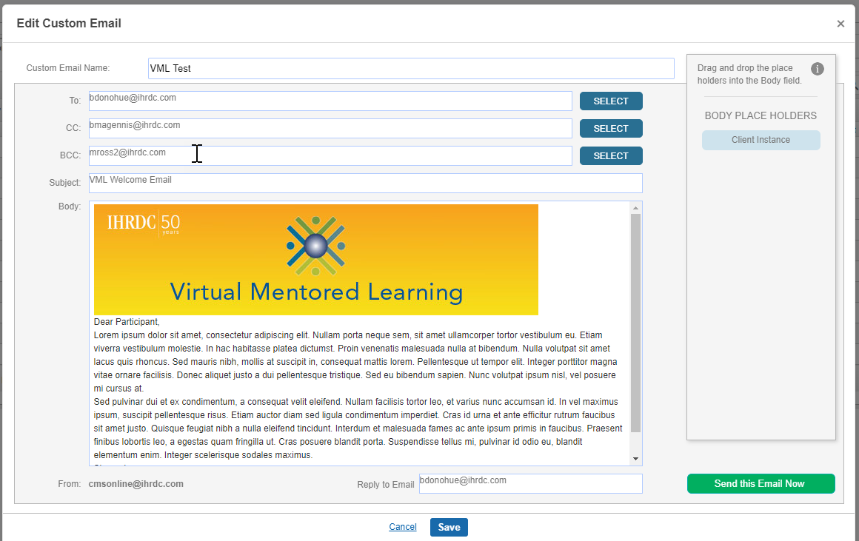
Email Alert Updates
We made some improvements to our email alerts to support useability and function for Administrators and recipients
Key Features include:
Separated trigger-based and batch-processed email alerts
Improved useability of placeholders in batch-processed emails
Added bcc field to custom email template
Added Authorized User to placeholder options in trigger-based emails

Slide 7
Course completion option

Slide 8
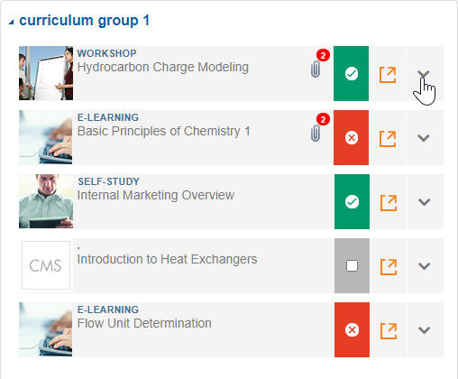
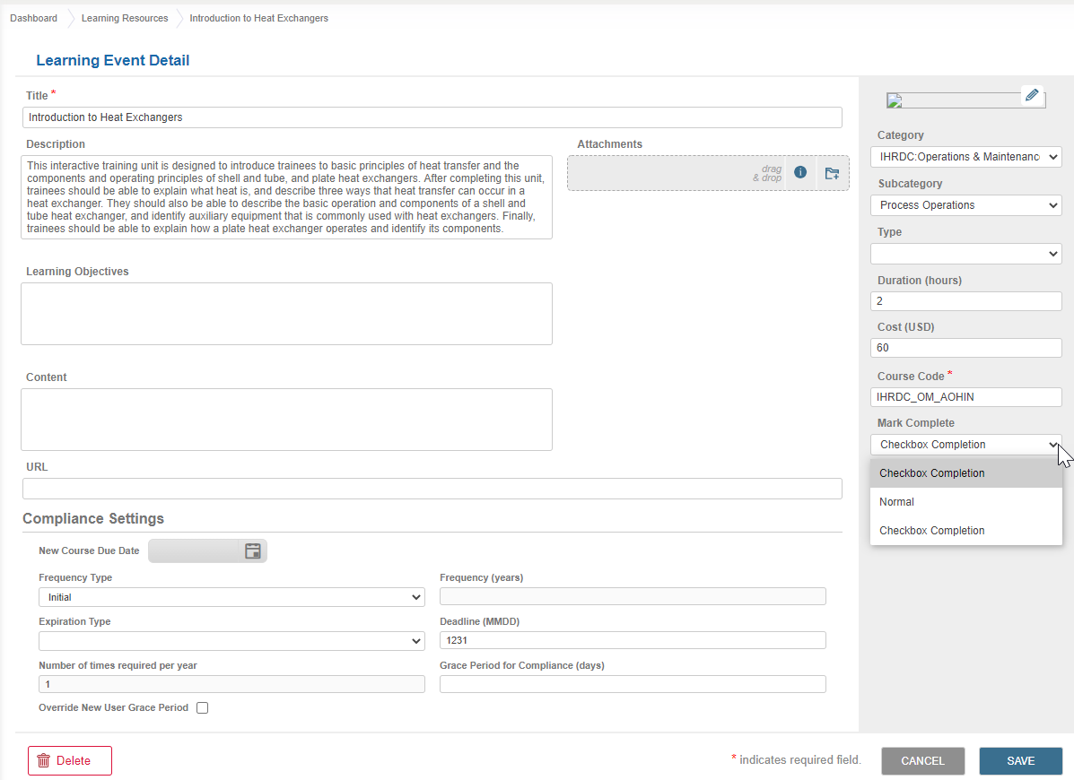
Course Completion Option – Simple Checkbox
We added the option to enable a simple checkbox that learners can use to record their completion of a learning event within a curriculum role.
Key Features include:
Content Developer selects option for individual learning event
Learner accesses via Learning Curriculum
Learner checks box, which records completion with current date
Status updates to Complete

Slide 9
Alert learner when learning event has attachment

Slide 10
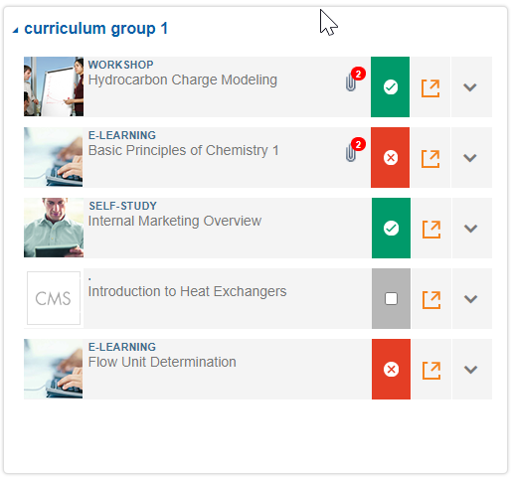
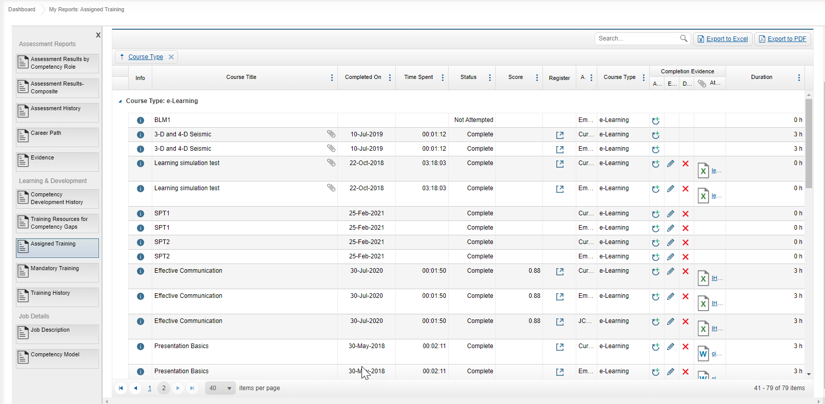
Alert Learner when Learning Resource has Attachment
In version 4.19, we added the ability to attach one or more files to a learning resource, to supplement the content. We enhanced the learning resource views to add more visibility to the user when a learning event has attachments.
Key Features include:
Icon displays everywhere the course displays
Badge specifies # of attachments
Learners can access attachments via the learning event detail

Slide 11
Competency unit criticality rating

Slide 12
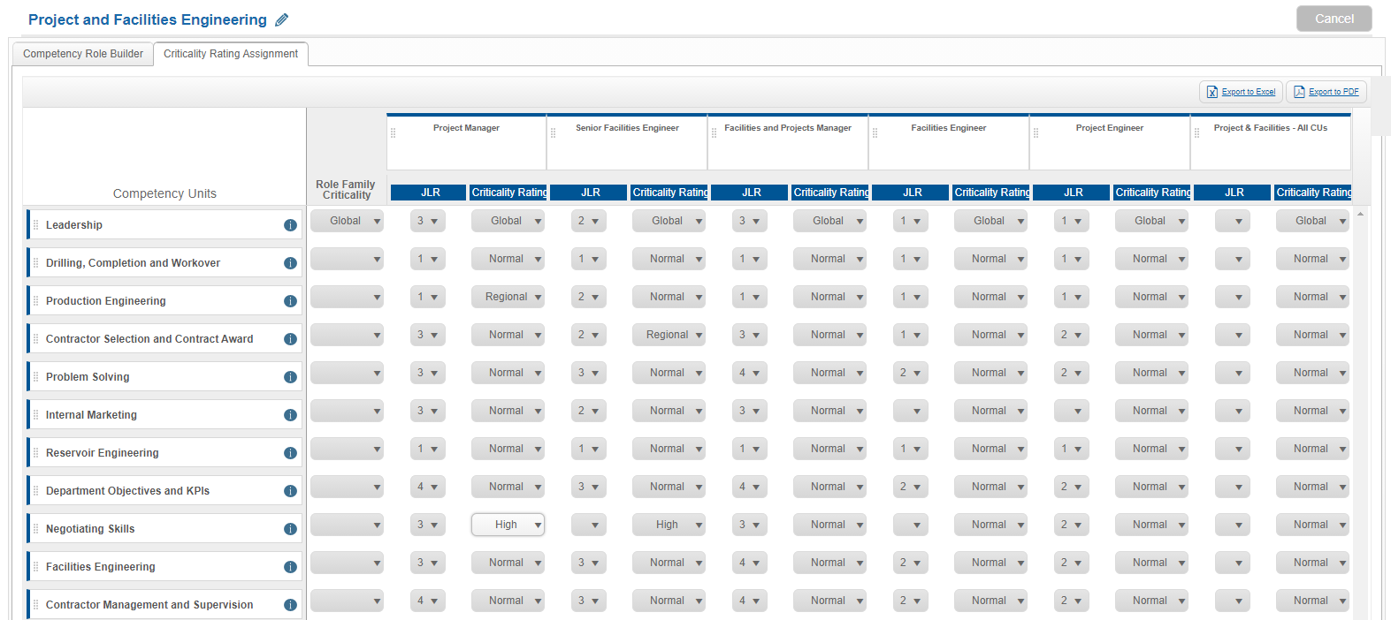
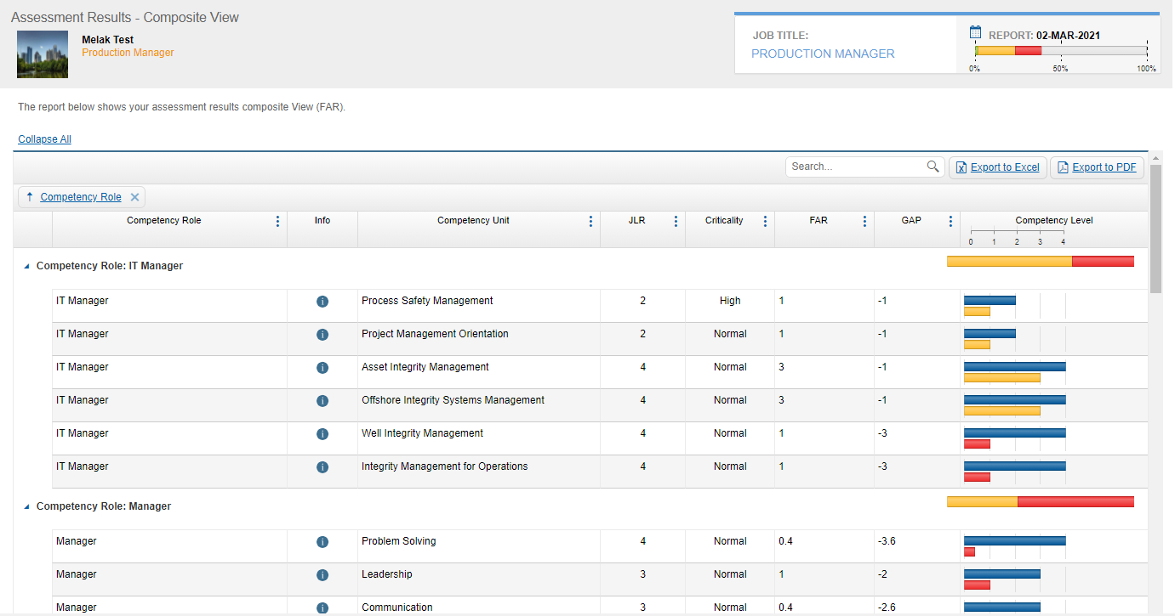
Competency Unit Criticality Rating
Clients can define criticality ratings for the organization. Criticality ratings are assigned to competency units to distinguish critical content.
Key Features include:
Feature enabled in Configurations
Administrator creates list of criticality ratings
Content Developer assigns criticality ratings to competency units
Criticality rating can be viewed in Composite view of assessment results

Slide 13
Additional user account fields

Slide 14
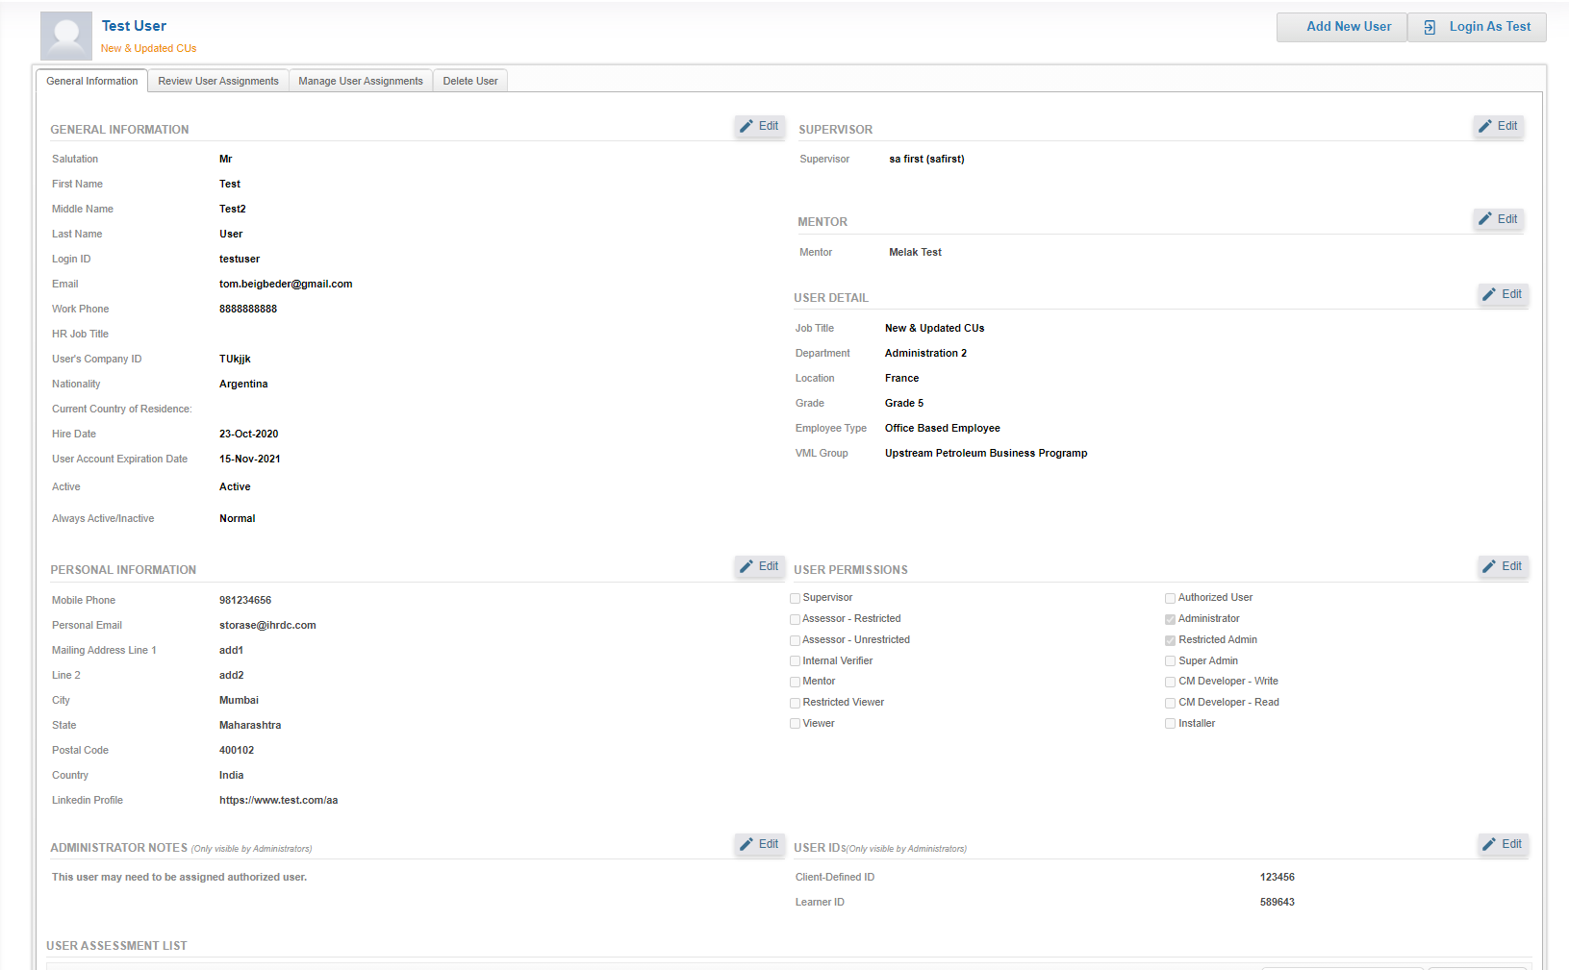
Additional User Account Fields
We expanded the fields available in User Account Detail, so that clients may track additional information about each CMS Online user.
Key Features include:
Additional fields added
Administrator notes section
Bulk import template updated to include more fields
Ability to add a new user directly from user detail

Slide 15
Enhancements and bug fixes

Slide 16
Enhancements and Bug Fixes
Important enhancements and bug fixes in this release include:
Competency Assessment and Development:
Assessor Assessment planning: restrict ability to select a date in the past
My Employees’ Plan: restrict ability to click SUBMIT when Needs Approval radio button is ticked
Added “Supervisor” field to Assessor Management and Assign Assessor
Fixed where direct assignment of competency role inactivated other assigned roles
Mandatory Training:
Added filters to Mandatory Training page to display selected status(es)
Administration/Content Development:
Updated terminology in Company Settings:
removed “JCM;” removed abbreviations from Manage System Links grid “Link Type” column
Updated Customized Welcome Message labels to remove reference to “Virtual Learning Group”
Added Search box to Manage System Lists grids
Fixed where Mentor field was adding a random user in User Accounts
Learning Resources: Added rich text editor to Learning Objectives and Content fields
Able to add mp4 as file attachment in learning event
Competency Role Builder: fixed accessibility to Export buttons when there are a large number of roles

Slide 17
Enhancements and Bug Fixes, cont’d.
Learning:
Add status filter to Mandatory Training page
Elective Training: fixed where expiration dates were changing to one day earlier
Reports:
Competency Management Reports: added 0%-10% competent category to histogram
Career Path was displaying incorrect number of comparison CUs
Training Request and Approval:
Added Employee Type
Fixed where selected employee names were getting cleared when adding another employee
Navigation:
Assessment History Report: fixed path back to main report after drilling down
Competency Management Report: navigate back to company-wide report after drilling down
Add to Favorites was opening a disabled form

Slide 18
New advanced reports Released February 2, 2021

Slide 19
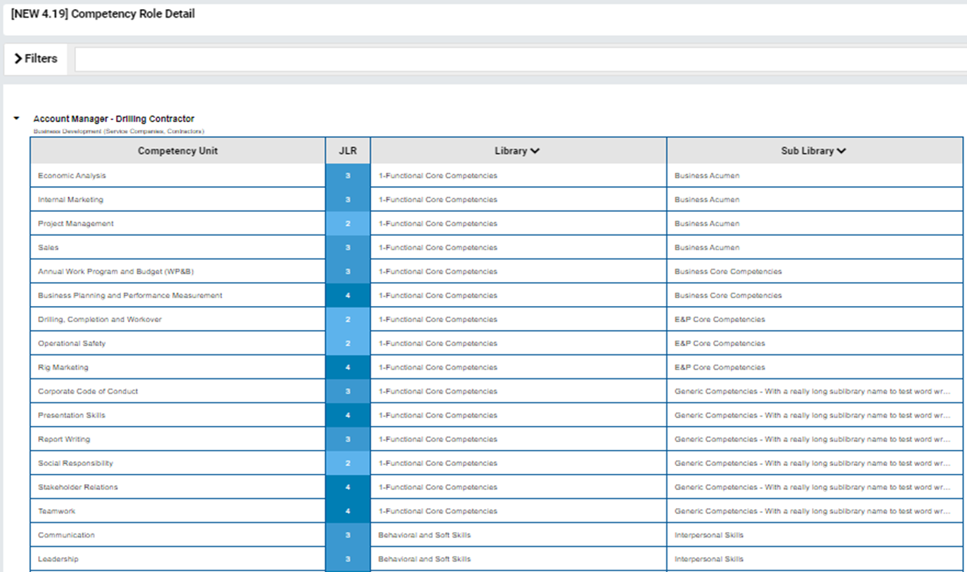
Advanced Reports Released in February
Competency Assessment Matrix – by Job Title: Shows assessment results, grouped by job title
Competency Role Detail: Shows all competency units and JLR for separate competency roles

Slide 20
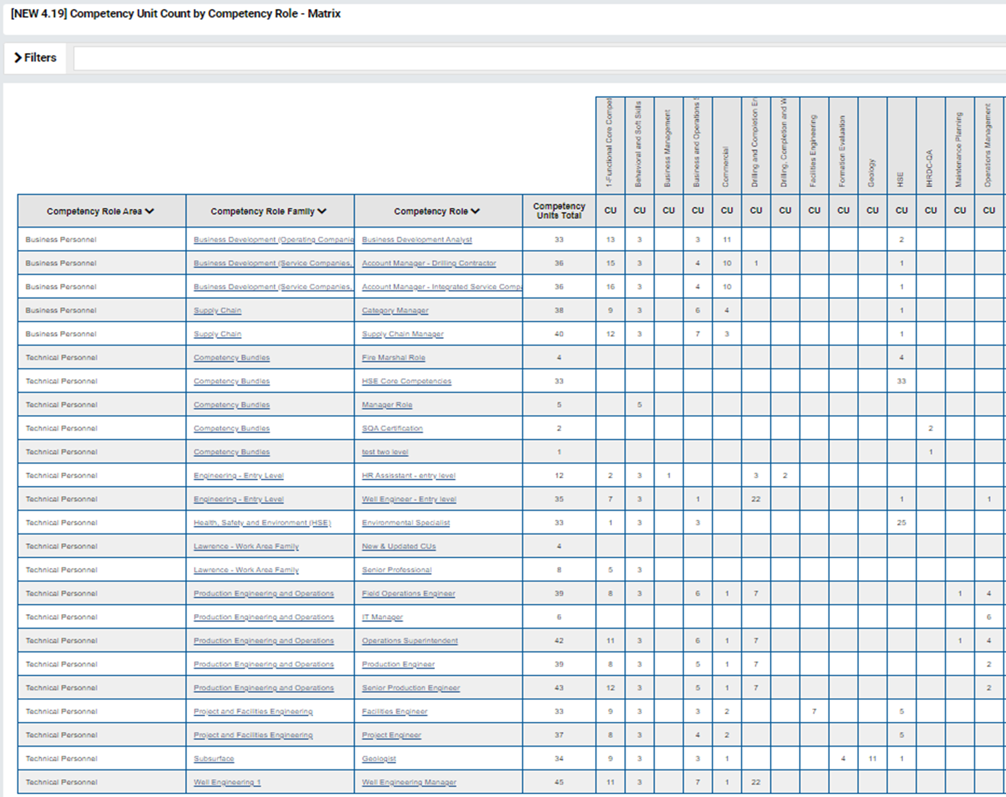
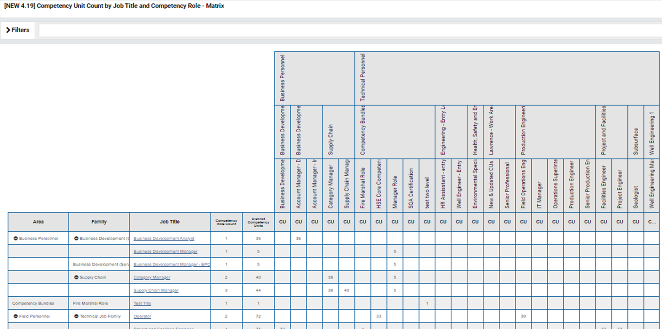
Advanced Reports, cont’d.
Competency Unit Count by Competency Role: Matrix displays number of times competency unit is used in roles
Competency Unit Count by Job Title and Competency Role: Displays all competency roles selected for Internal Verification, current status and verifier comments

Slide 21
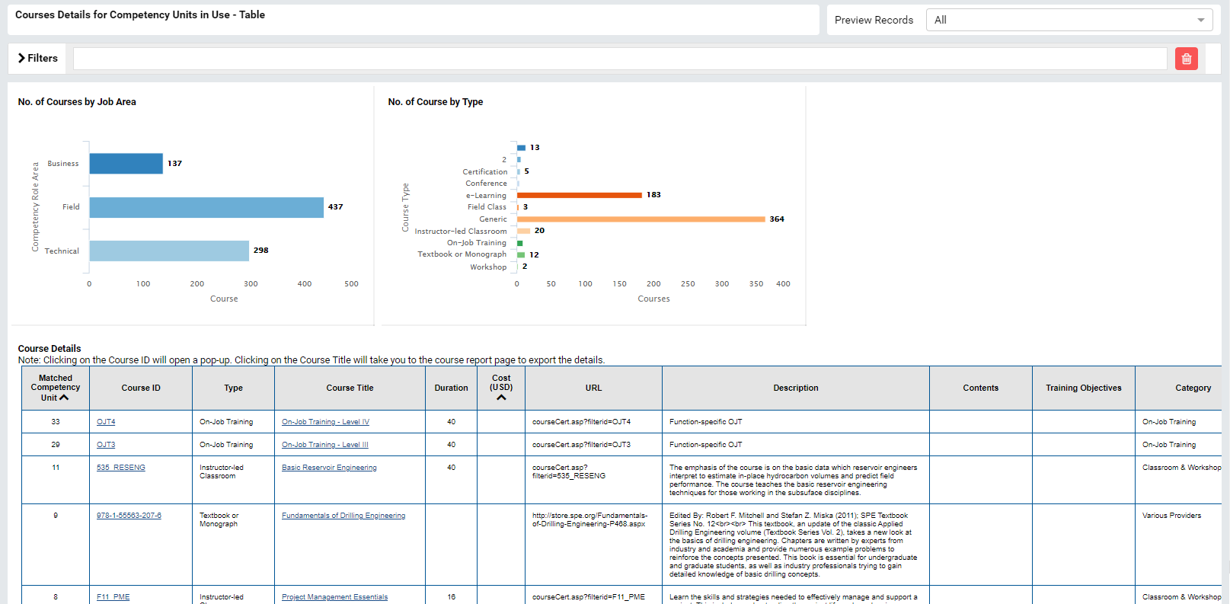
Advanced Reports, cont’d.
Course Details for Competency Units in Use - Table: Displays courses matched to all competency units that have been built into competency roles. Subreport (below) shows detail
Course Details for Competency Units in Use - Form: contains course detail, including competency unit matchups, for individual learning events

Slide 22
Coming soon

Slide 23
Next Release – 4.21 Feature Updates
CMS Online version 4.21 will be released in June 2021. New features will include:
Feature | Description
Competency Unit Criticality Rating - enhancements | Clients can associate a passing percentage for competency units levels 1 & 2 with criticality rating; view criticality rating in Competency Development plan and Assessor Assessment.
Add Evidence Report to Employee Snapshot reports | We are adding to the suite of available reports in the Employee Snapshot. The Evidence Report will allow Viewer, Supervisor and Administrator users to see current and historical evidence uploaded throughout the assessment and learning processes.
Learning Curriculum Updates | Updating the look and feel of the Learning Curriculum and changing how total number of courses are counted when a curriculum role is locked.
Crew Movement Module | Developing an integrated module to track personnel on board (POB) to help clients with vessel and shift staffing details. This will be an add-on option for clients who want to use this functionality.
Login Speed Improvements | We are focusing efforts on analyzing and improving the login speed into the web application.

Slide 24
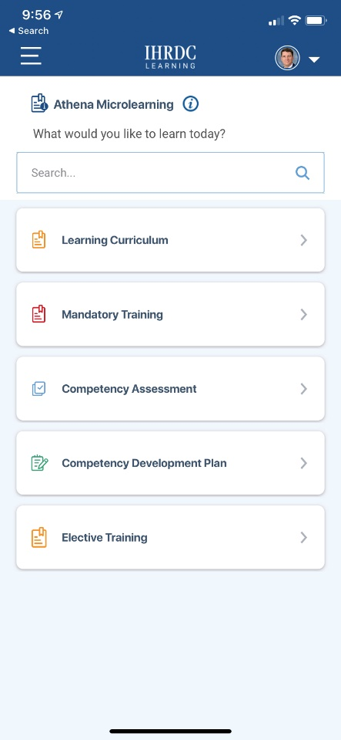
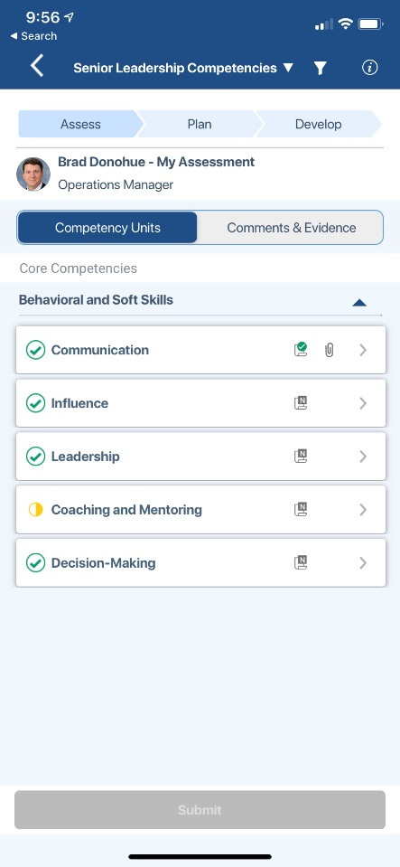
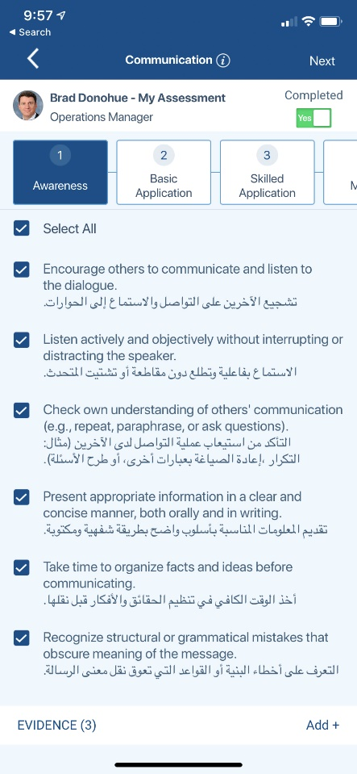
CMS Online Mobile App
We have been developing native mobile apps for CMS Online. The iOS app will be released by the end of March. The Android app will be a few months behind.

Slide 25
Version 4.20
CMS Online
Quarterly Release Notes
March 2021
© Copyright 2021 International Human Resources Development Corporation

